Slide 1
INTRODUCTION TO ANIMAL KINGDOM
Ecology
Dr.Sawant P.L.
Department of Zoology
Shri Chhatrapati Shivaji College, Omerga
Tal-Omerga,Dist-Osmanabad.

Slide 2
Table of Contents
What Is Ecology
Biotic And Abiotic Factors
Types Of Ecology
Importance Of Ecology
Examples Of Ecology

Slide 3
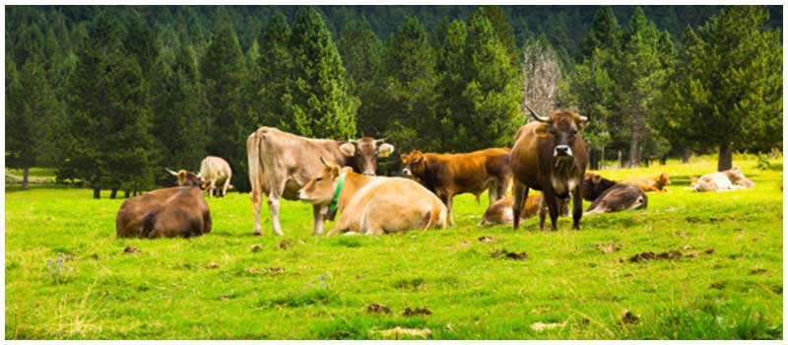
What is Ecology?

Slide 4
Types of Ecology

Slide 5
Importance of Ecology
Conservation of Environment
Resource Allocation
Energy Conservation
Eco-Friendliness

Slide 6
Examples of Ecology
Human Ecology
Niche Construction

Slide 7
Frequently Asked Questions
What are the different levels of ecology?
What is ecology?
What are the different types of ecology?
How are ecology and evolution related?
Who devised the word ecology?
What is habitat ecology?
What is a niche?

Slide 8
BIOTIC ENVIRONMENTAL FACTORS

Slide 9
PARASITISM
Parasitism
Types
Examples
Humans
Plants
Insects

Slide 10
What is Parasitism?
Types of Parasitism
Obligate Parasitism
Facultative Parasitism
Ectoparasitism
Endoparasitism
Mesoparasitism

Slide 11
Examples of Parasitism
Parasitism in Humans
Parasitism in Plants
Parasitism in Insects

Slide 12
Mutualism
Mutualism
Types
Obligate Mutualism
Facultative Mutualism
Trophic Mutualism
Defensive Mutualism
Dispersive Mutualism
Examples Of Mutualism
Humans and Plants
Oxpeckers and Rhinos

Slide 13
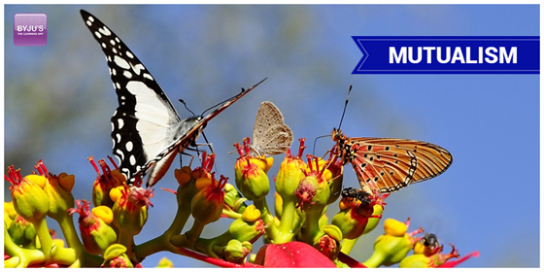
What is Mutualism?

Slide 14
Types of Mutualism
Obligate Mutualism
Facultative Mutualism
Trophic Mutualism
Defensive Mutualism
Dispersive Mutualism

Slide 15
Examples Of Mutualism
Humans and Plants
Oxpeckers and Rhinos

Slide 16
ABIOTIC ENVIRONMENTAL FACTORS
Water

Slide 17
Sunlight

Slide 18
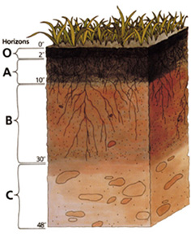
Soil

Slide 19
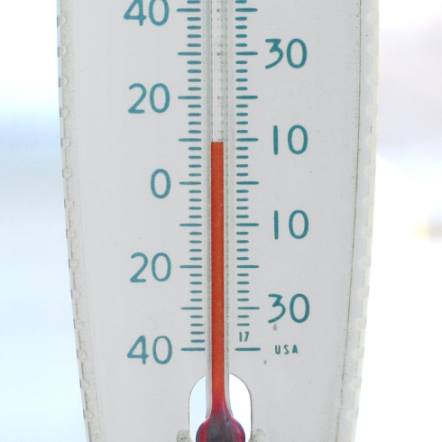
Temperature

