Slide 1
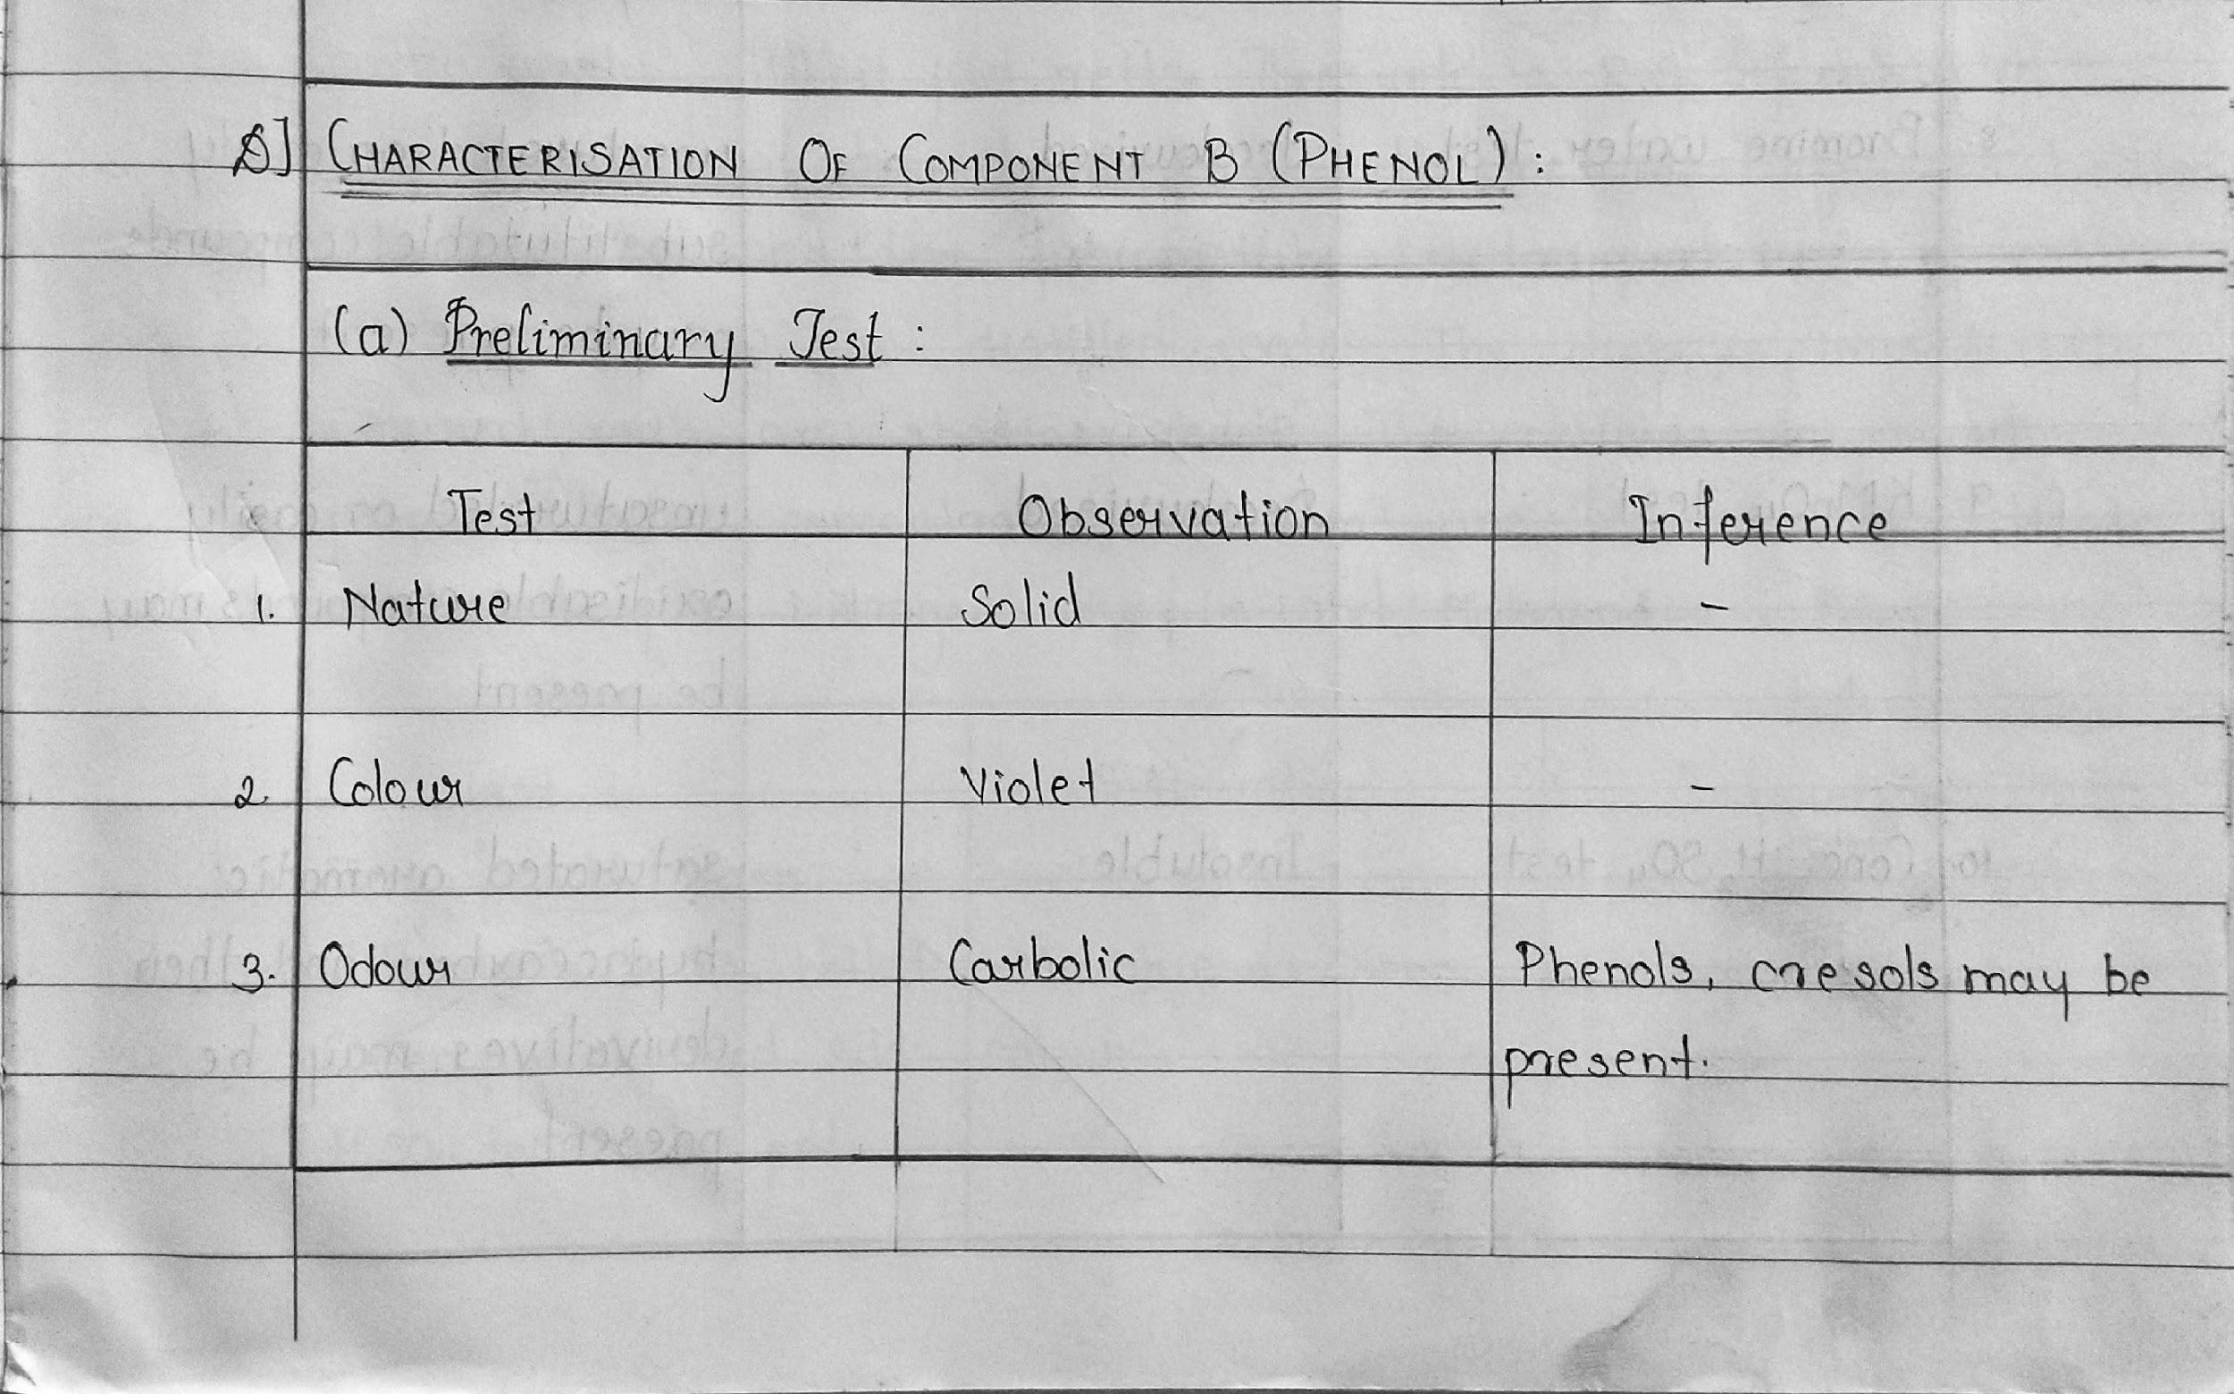
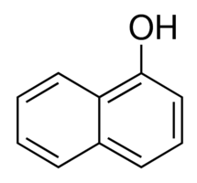
D] CHARACTERISATION OF COMPONENT B (Phenol)

Slide 2
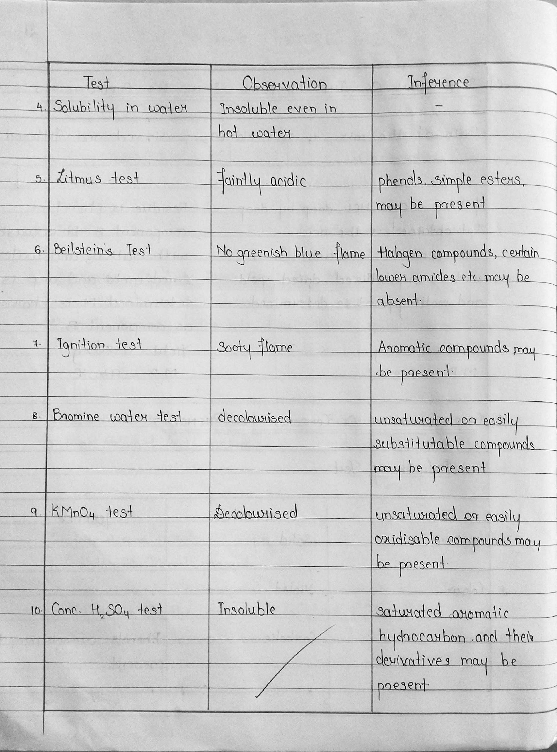

Slide 3
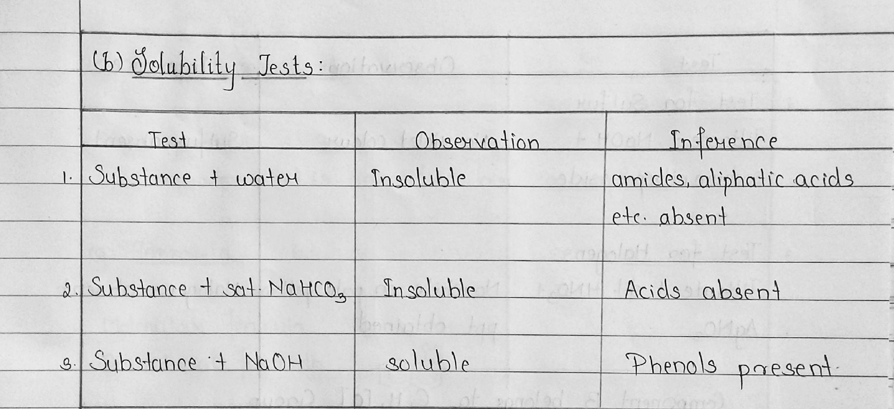

Slide 4
(c) Elemental Analysis
Freshly cut sodium metal is taken in a dry fusion tube and heated gently, till it just melts. Then add a R.G. of dry solid. The substance is allowed to react with sodium. It is heated till red hot and the fusion tube is dropped in the porcelain dish containing 5 ml of distilled water. The dish is immediately covered with asbestos sheet. The contents are mixed properly, boiled, concentrated to 2 ml and filtered.
The filtrate is tested for nitrogen, sulphur and halogens.

Slide 5
Therefore, component B belongs to C,H,[O] group.
Notes:
https://www.youtube.com/watch?v=7vKQuWWgULw - Detection of Nitrogen -- -this was shown
https://www.youtube.com/watch?v=lGcr_cUmzbY - Detection of Halogens

Slide 6
(d) Determination of the class of the compound under C,H,[O] group.

Slide 7
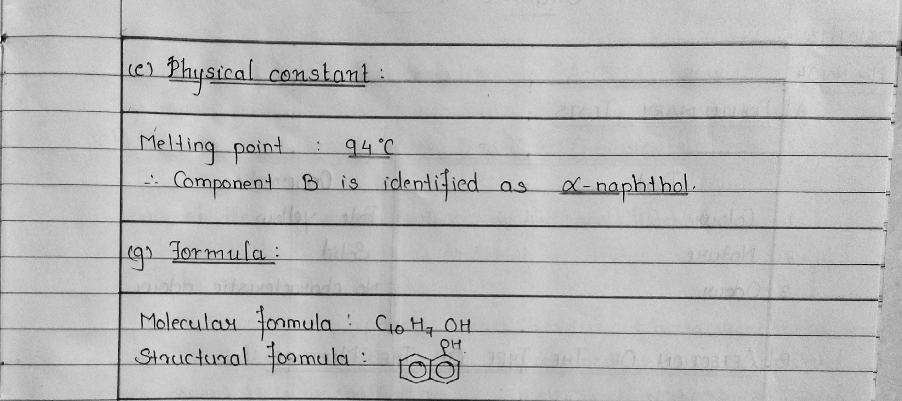

Slide 8
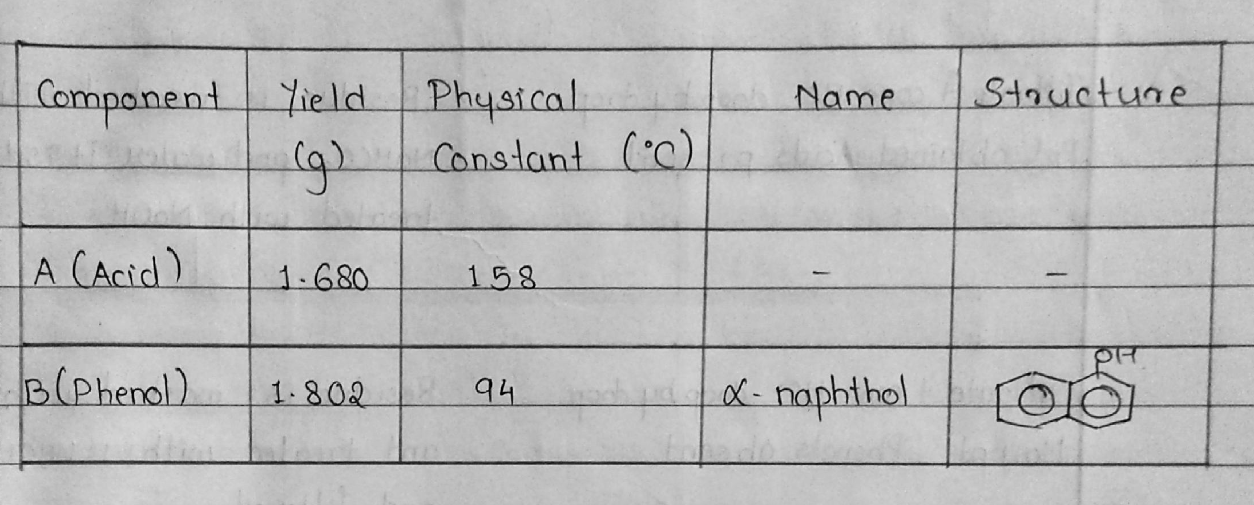
E] CONCLUSION
Notes:
MM did till here 28-09-2020 @session 2
2 hr to 4 hr prac done by MN on 5-10-2020 and 12-10-2020 for OM-1 with proper writing format discussed. 12-10-2020 , Session 2 was cancelled due to Mumbai Power Cut.
19-10-2020: MN to continue with format discussion of OM-1

Slide 9
Elucidate the steps to determine the mixture, given that the type is: Mix no. 4
ACID + BASE

Slide 10
A] PRELIMINARY TESTS
TEST | OBSERVATION
Colour | Pale Yellow
Nature | Solid
Odour | No characteristic odour

Slide 11
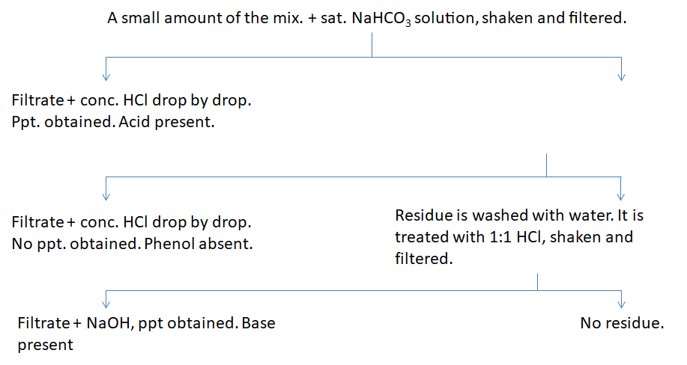
B] DETECTION OF THE TYPE OF THE MIXTURE
Therefore, the type of the mixture is Acid + Base.

Slide 12
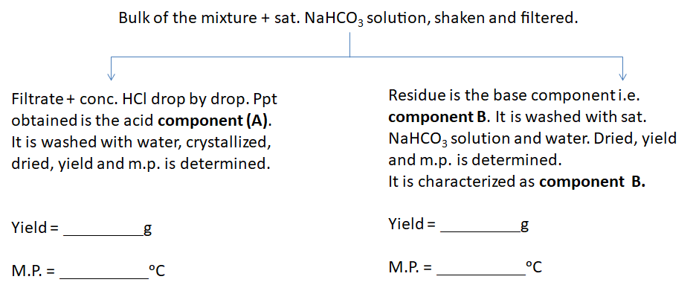
C] SEPARATION OF THE MIXTURE INTO ITS COMPONENTS

Slide 13
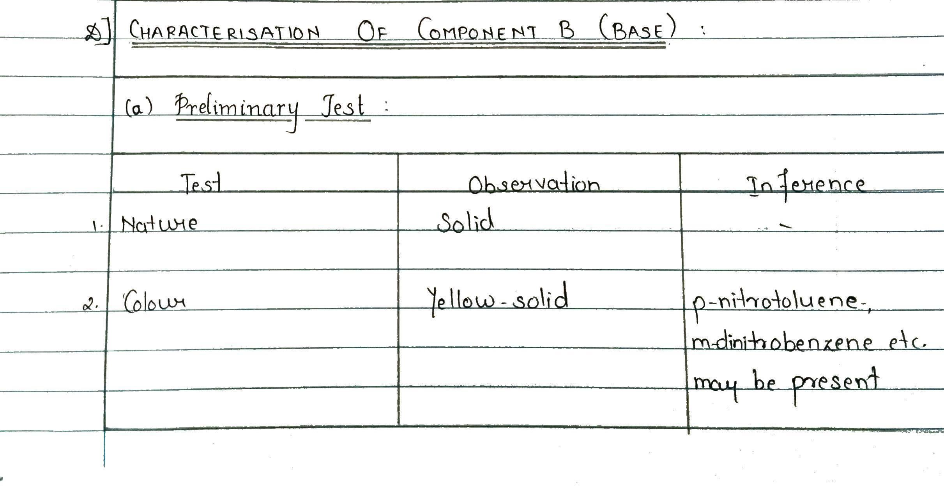
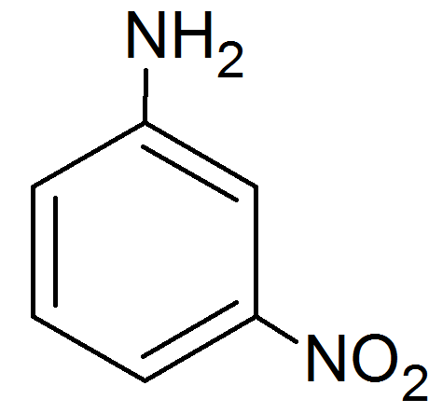
D] CHARACTERISATION OF COMPONENT B (Base)

Slide 14
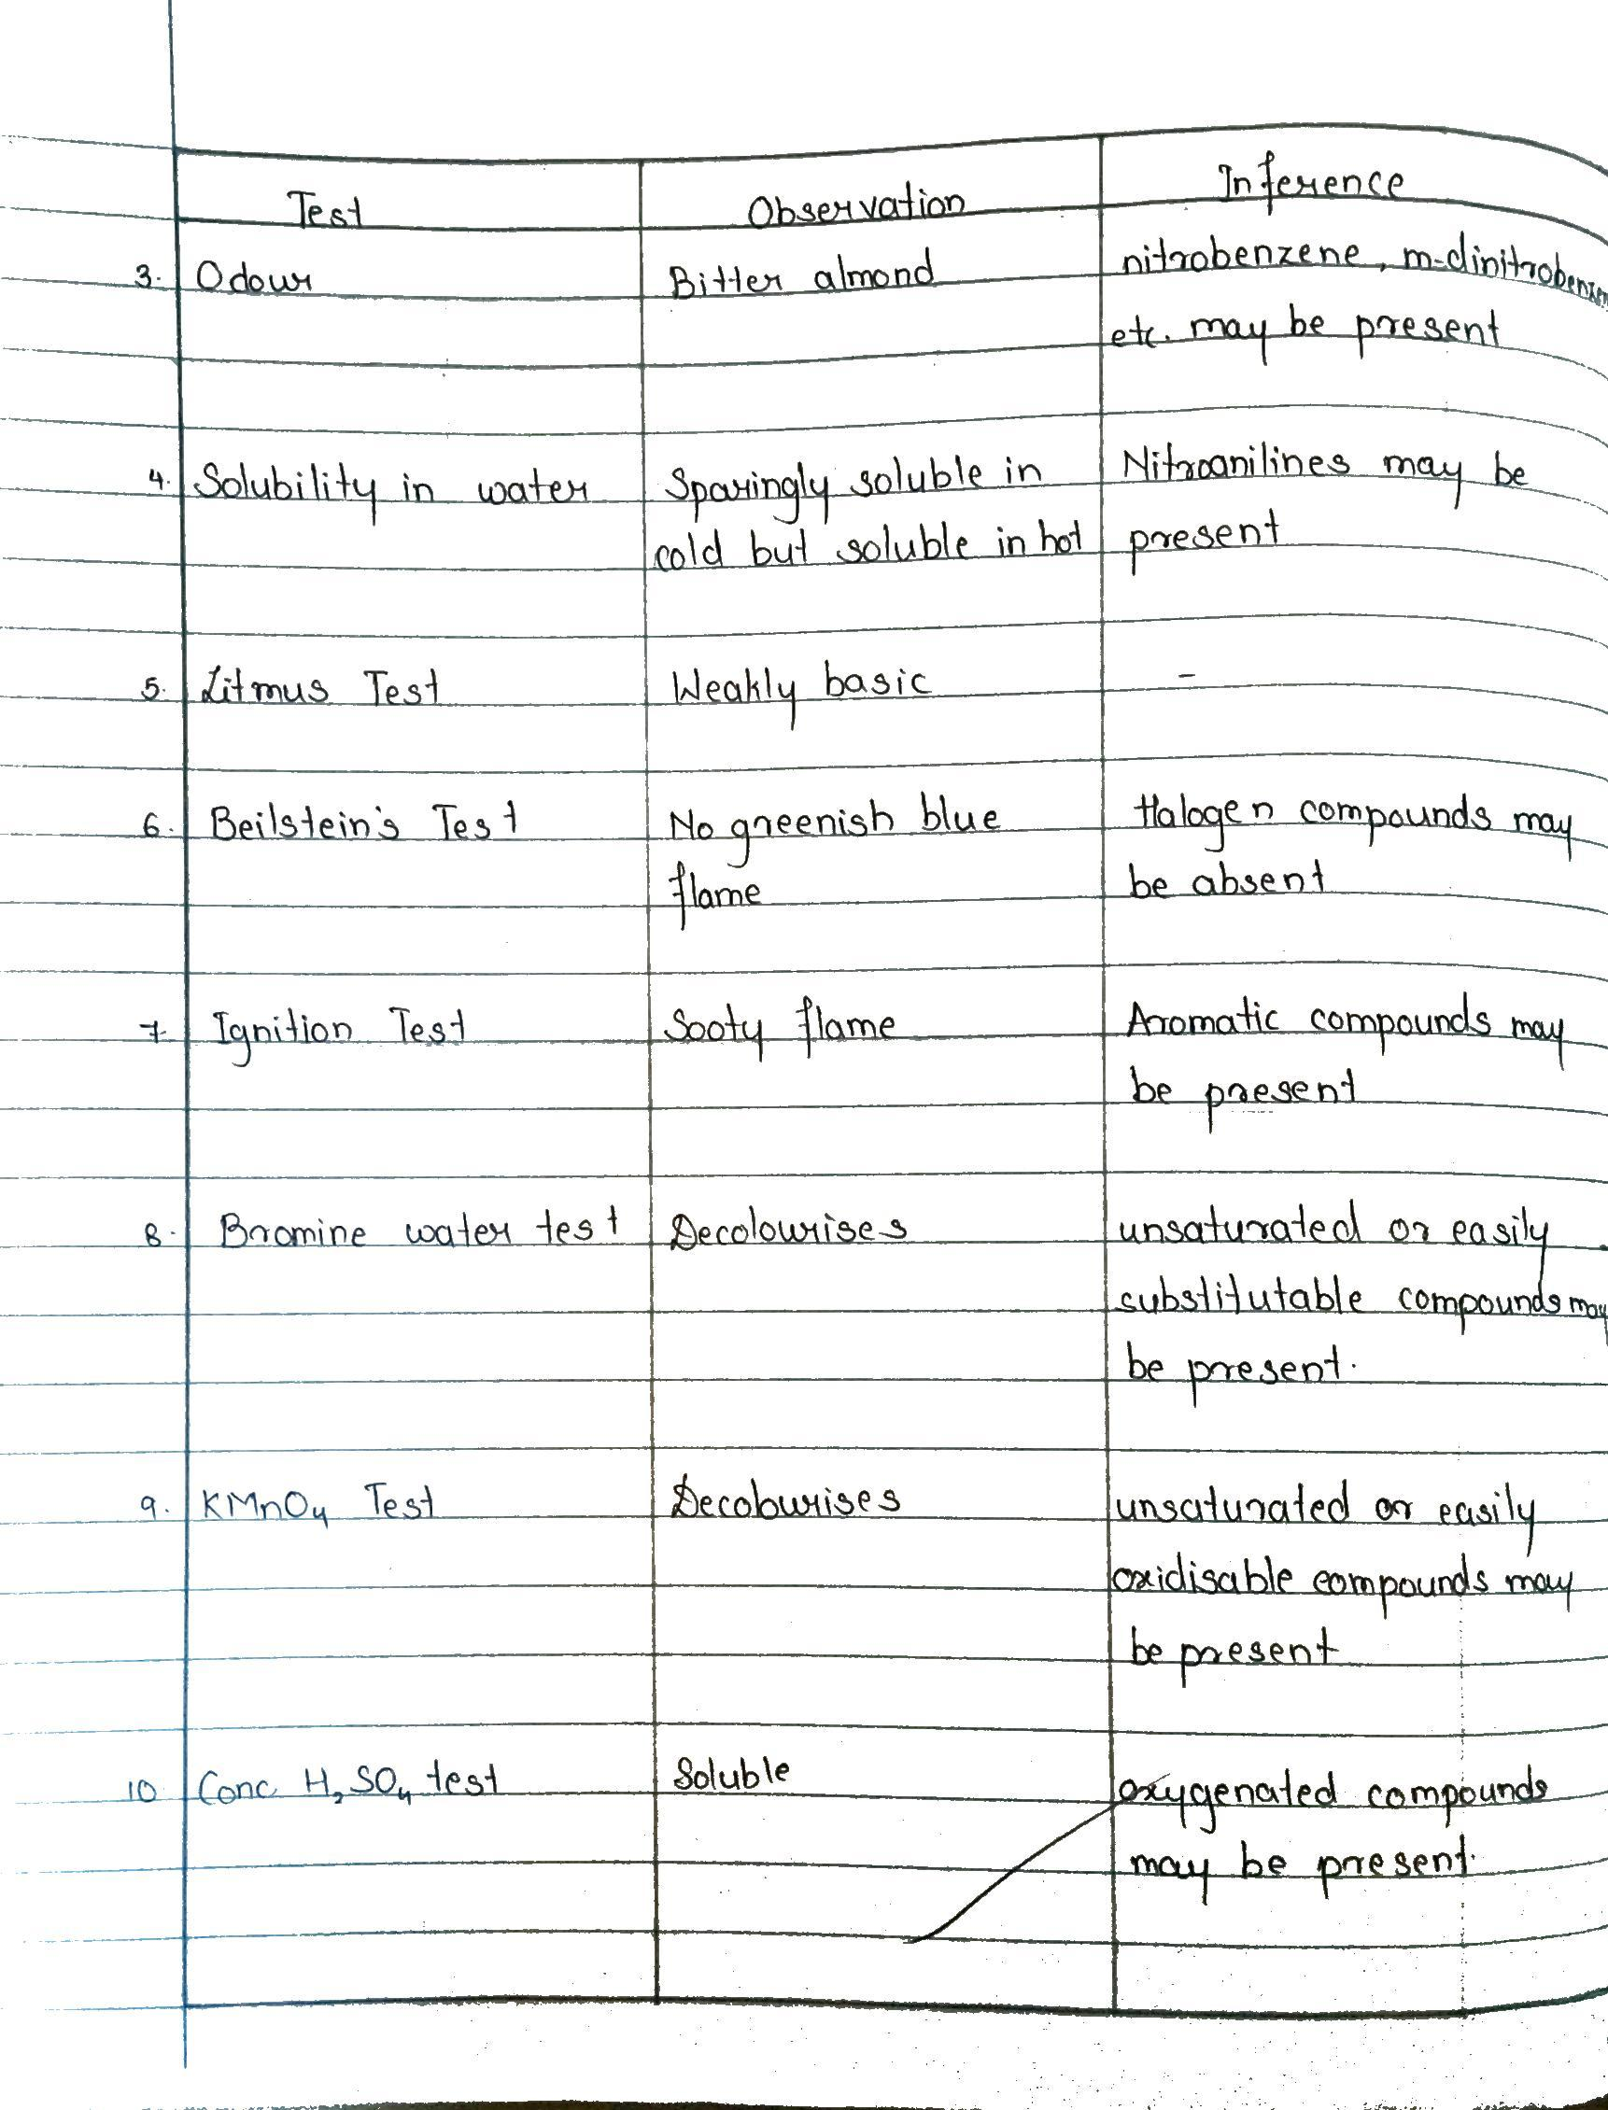
Notes:
KB did till here @session 1 , 26-10-2020

Slide 15
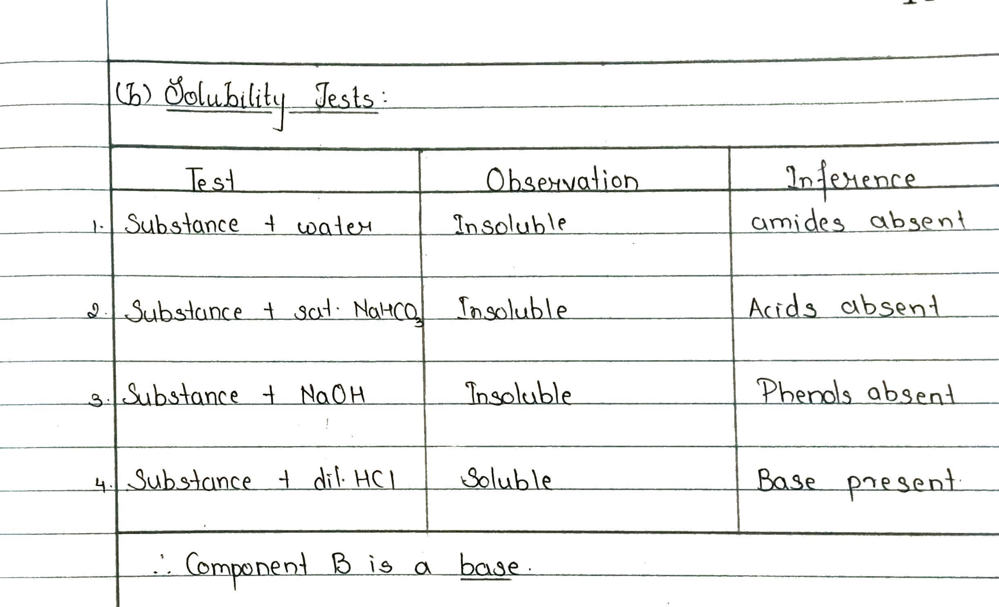

Slide 16
(c) Elemental Analysis
Freshly cut sodium metal is taken in a dry fusion tube and heated gently, till it just melts. Then add a R.G. of dry solid. The substance is allowed to react with sodium. It is heated till red hot and the fusion tube is dropped in the porcelain dish containing 5 ml of distilled water. The dish is immediately covered with asbestos sheet. The contents are mixed properly, boiled, concentrated to 2 ml and filtered.
The filtrate is tested for nitrogen, sulphur and halogens.

Slide 17
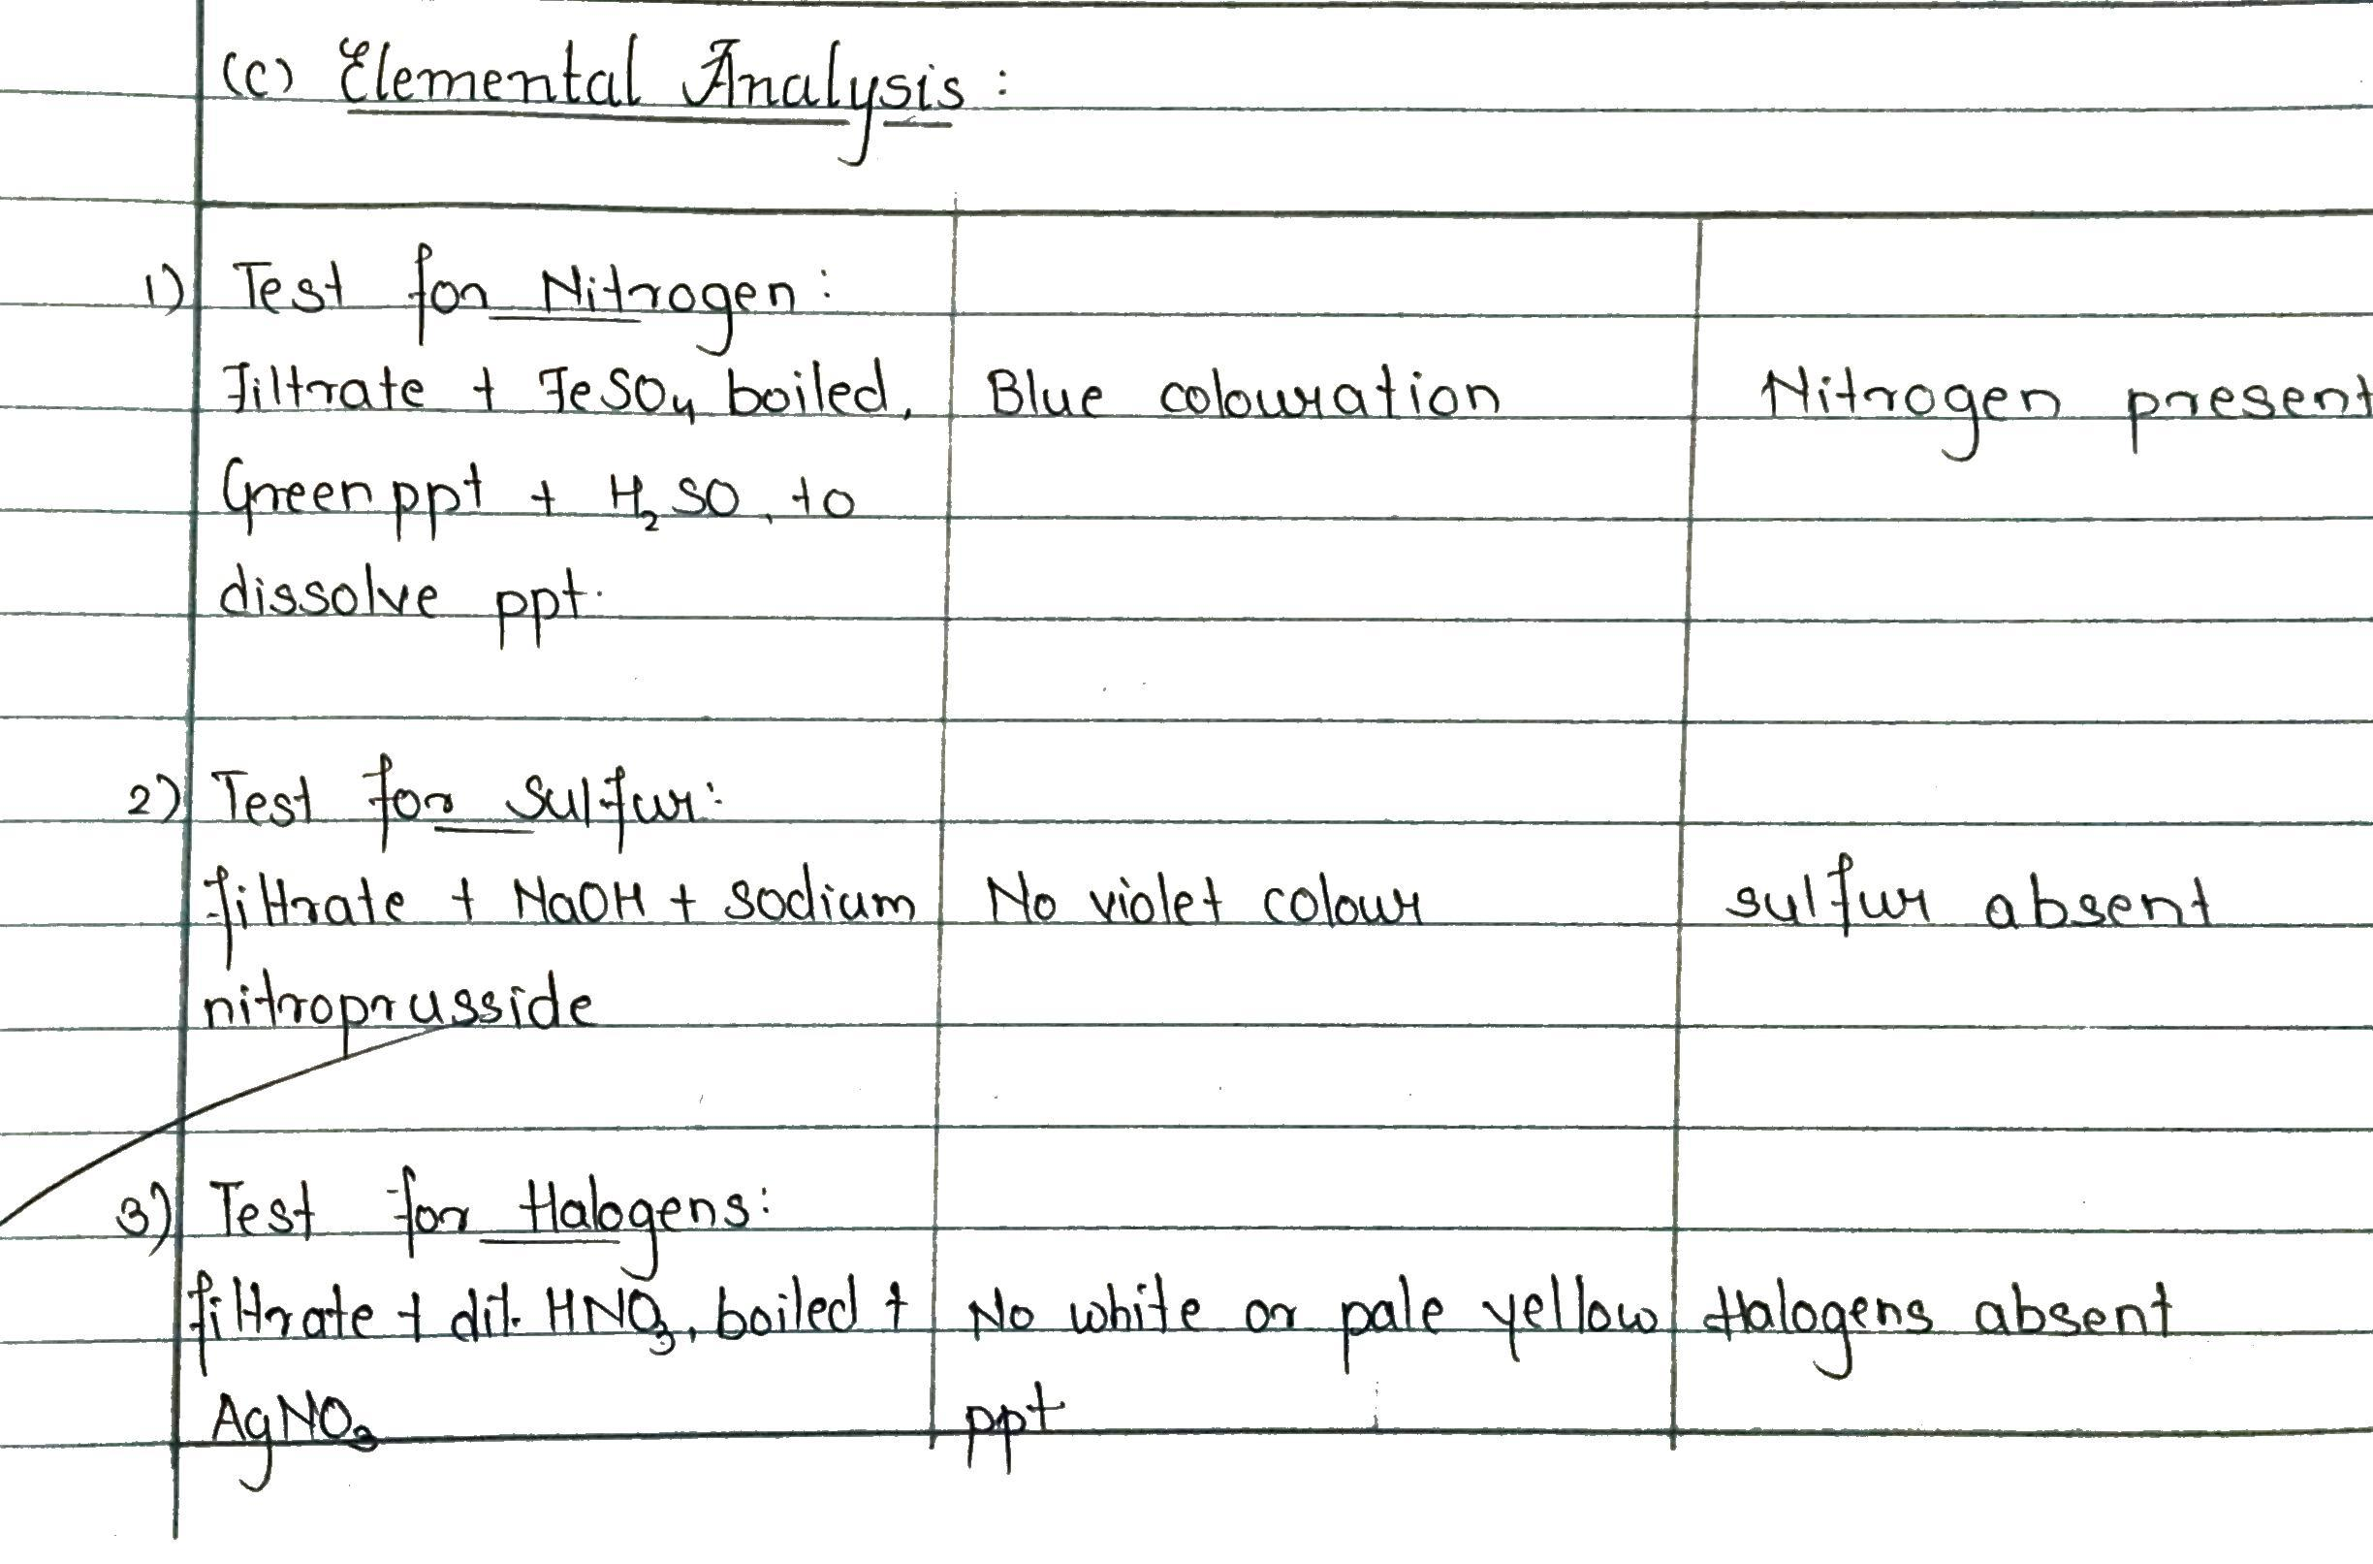
Therefore, component B belongs to C,H,[O],N group.

Slide 18
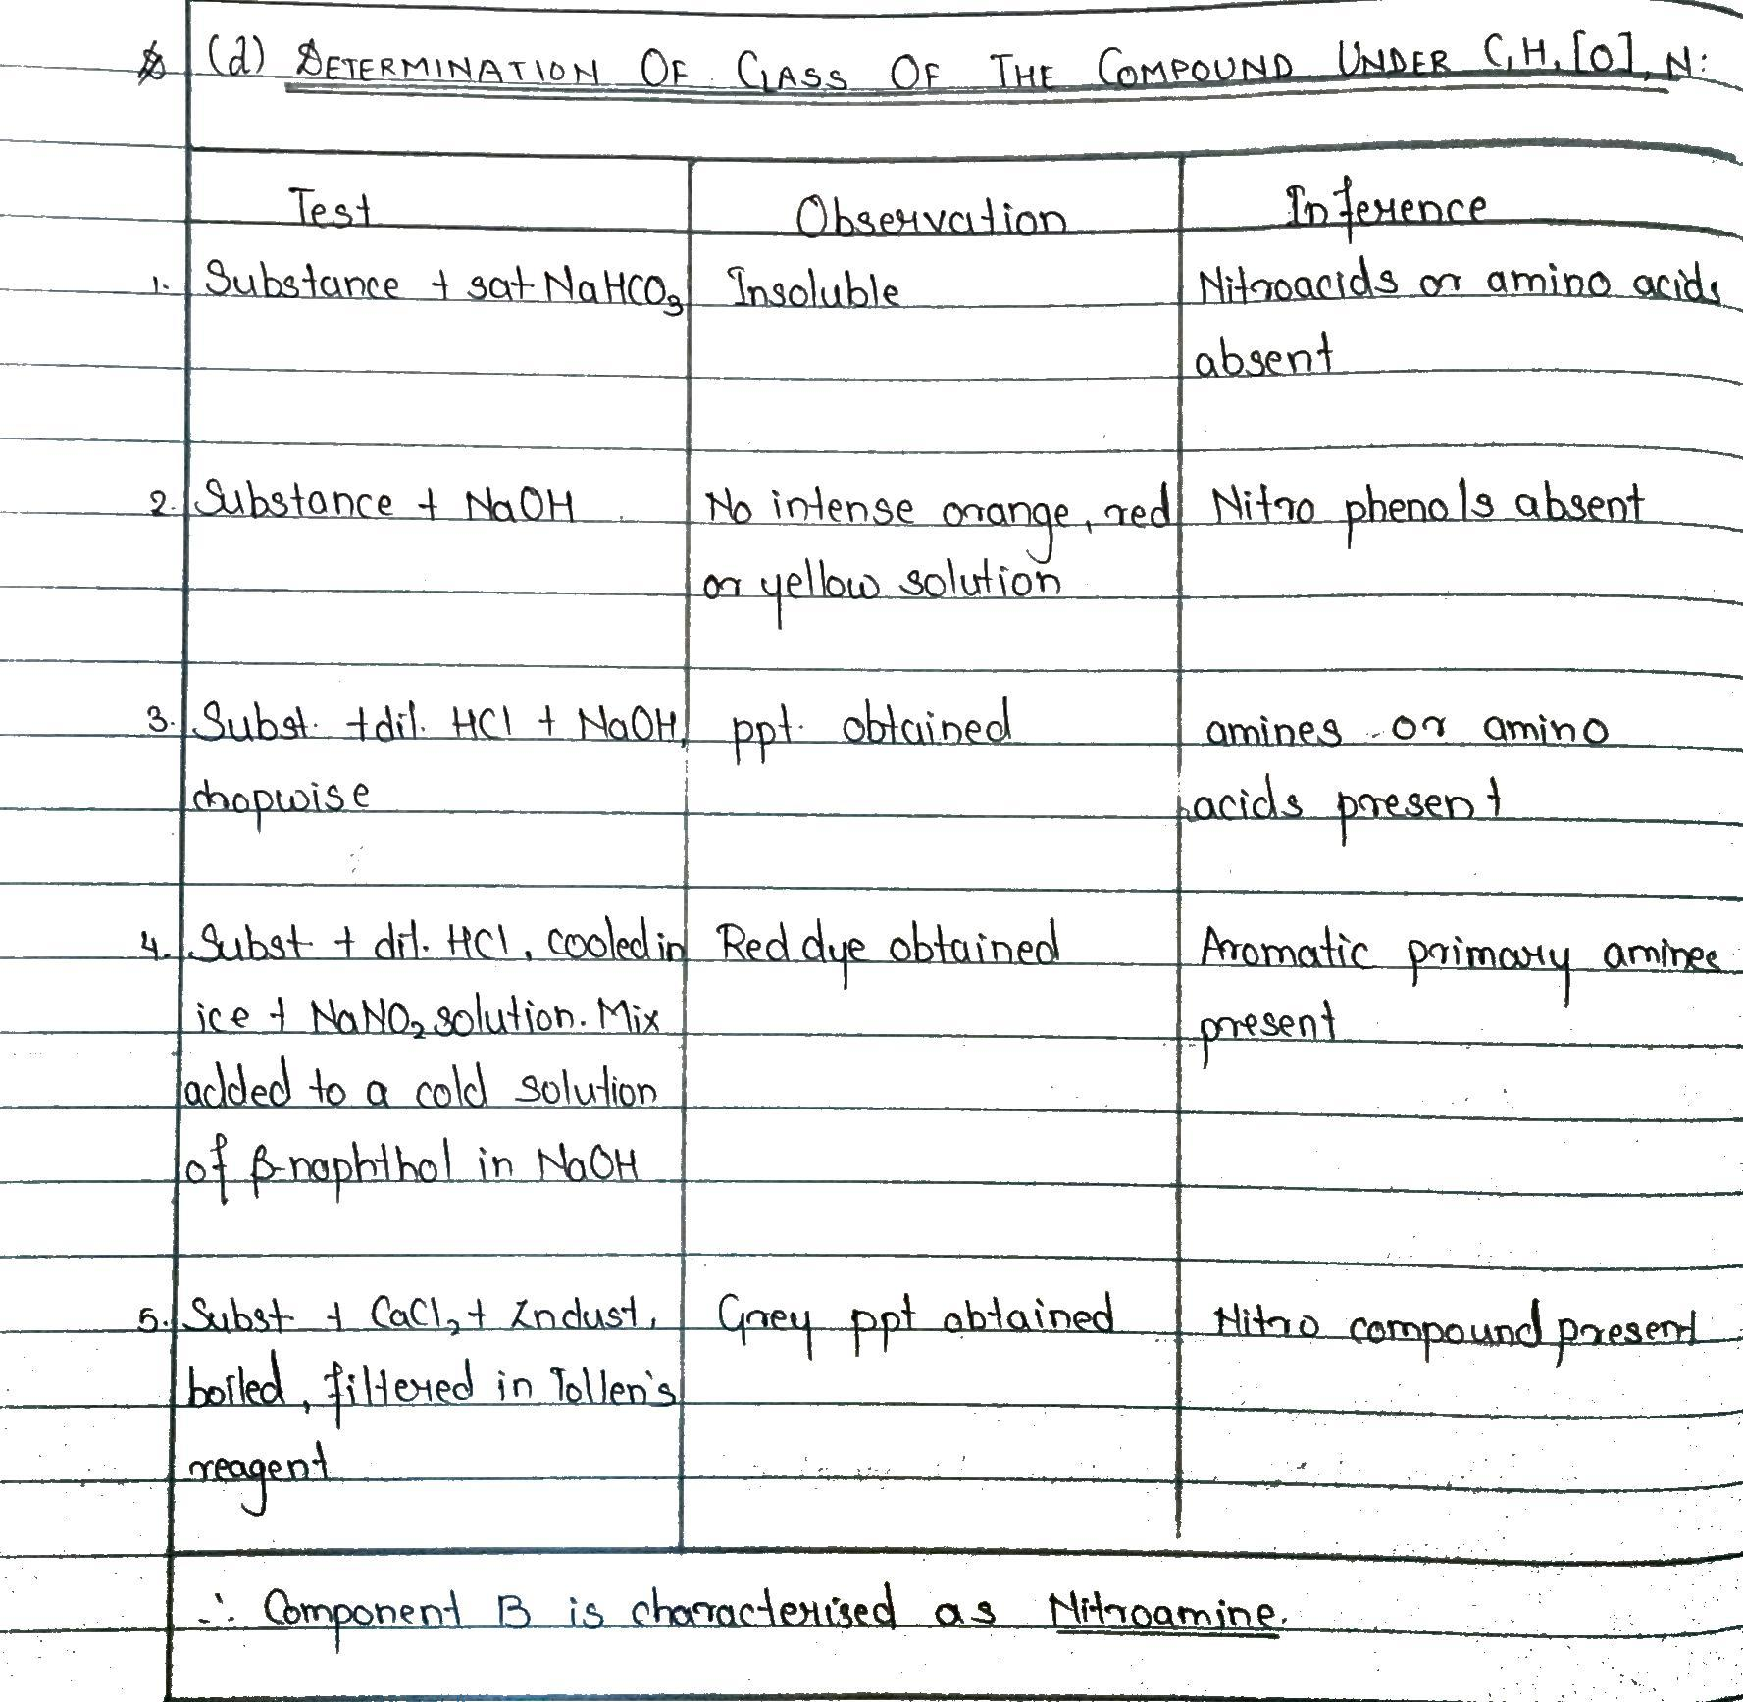
∴ Component B is an Nitro substituted Aromatic Primary Amine
Notes:
Nitro substituted Aromatic Primary Amine

Slide 19
Notes:
Confirmatory test is red dye test itself

Slide 21
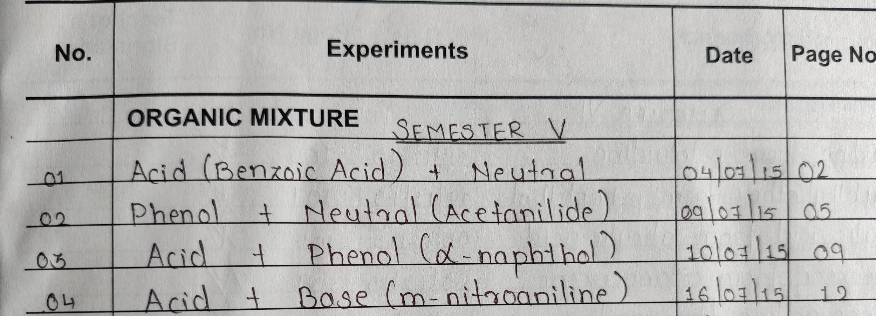
05 Acid (Salicyclic Acid) + Neutral 9-11-2020
Notes:
2-11-2020:
SK @session 1, OM-1 checked will students
MN@Session 2, OM-1,2 discussed

Slide 22
Red dye test:
https://www.youtube.com/watch?v=6XjWj5L-nZE
Notes:
http://amrita.olabs.edu.in/?sub=73&brch=8&sim=141&cnt=4 use simulator
https://www.youtube.com/watch?v=cNBlYHmW_ok mechanism of red dye test from 7.52

Slide 23
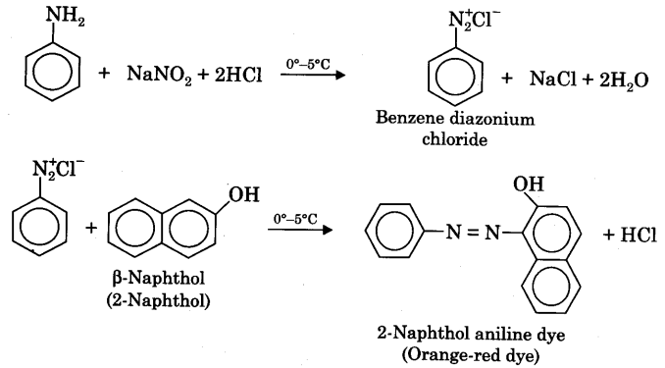
Notes:
Done till here by MN @session 2, 2-11-2020. Red dye test was discussed with examples when to write the test and when not to write with examples of Mix 2 and 4. Acetanilide and m-nitroaniline.
Mix. no. 5: Acid (Salicyclic Acid) + Neutral was given to students for solving and to write in RJ for next week. Next week test on Monday,9-11-2020 was announced.

Slide 24
Elucidate the steps to determine the mixture, given that the type is: Mix no. 5
ACID + NEUTRAL
Acid component to be characterised

Slide 25
A] PRELIMINARY TESTS
TEST | OBSERVATION
Colour | White
Nature | Solid
Odour | No characteristic odour

Slide 26
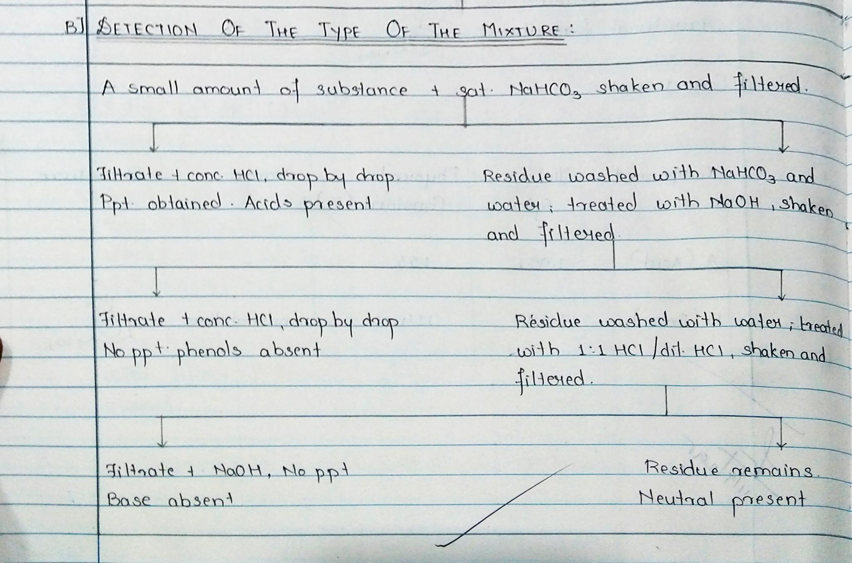
Therefore, the type of the mixture is Acid + Neutral.

Slide 27
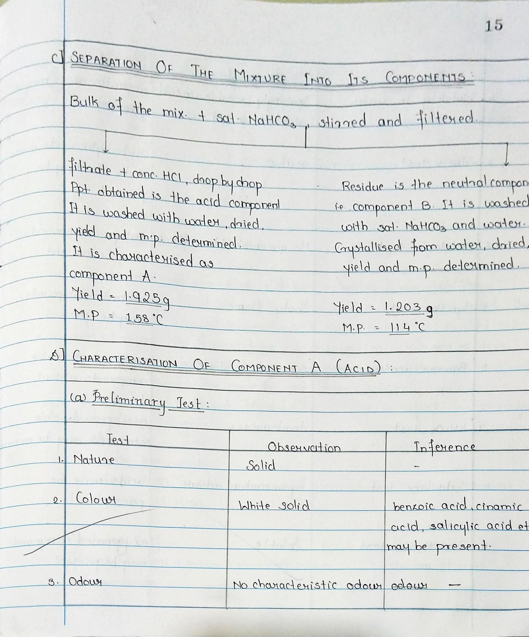
C) Separation of the Mixture into its Components
D) Determination of yield:
Notes:
Bulk separation of Mixture 5 completed .Santosh katariya.09-11-2020@ 10.10am

Slide 28
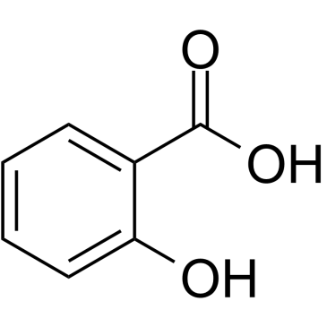

Slide 29
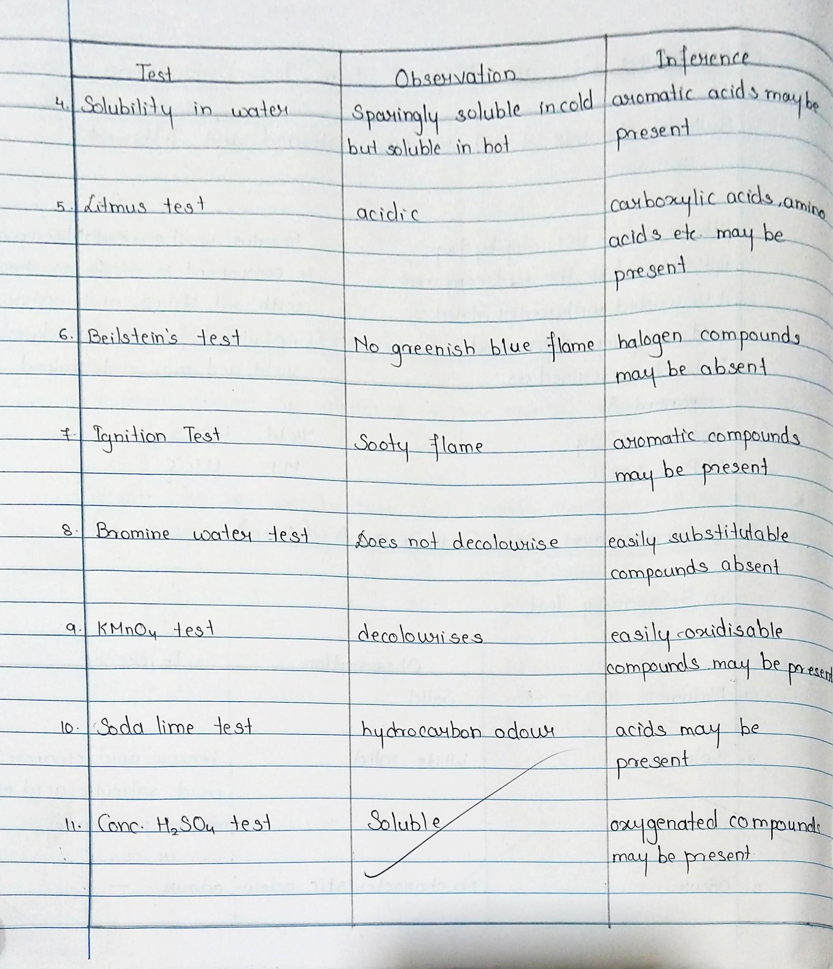

Slide 31
(c) Elemental Analysis
Freshly cut sodium metal is taken in a dry fusion tube and heated gently, till it just melts. Then add a R.G. of dry solid. The substance is allowed to react with sodium. It is heated till red hot and the fusion tube is dropped in the porcelain dish containing 5 ml of distilled water. The dish is immediately covered with asbestos sheet. The contents are mixed properly, boiled, concentrated to 2 ml and filtered.
The filtrate is tested for nitrogen, sulphur and halogens.

Slide 33
Therefore, component A is an Aromatic hydroxy acid.

Slide 35
Elucidate the steps to determine the mixture, given that the type is: Mix no. 6
NEUTRAL + WATER SOLUBLE
Water Soluble component to be characterised

Slide 36
A] PRELIMINARY TESTS
TEST | OBSERVATION
Colour | White
Nature | Solid
Odour | No characteristic odour

Slide 37
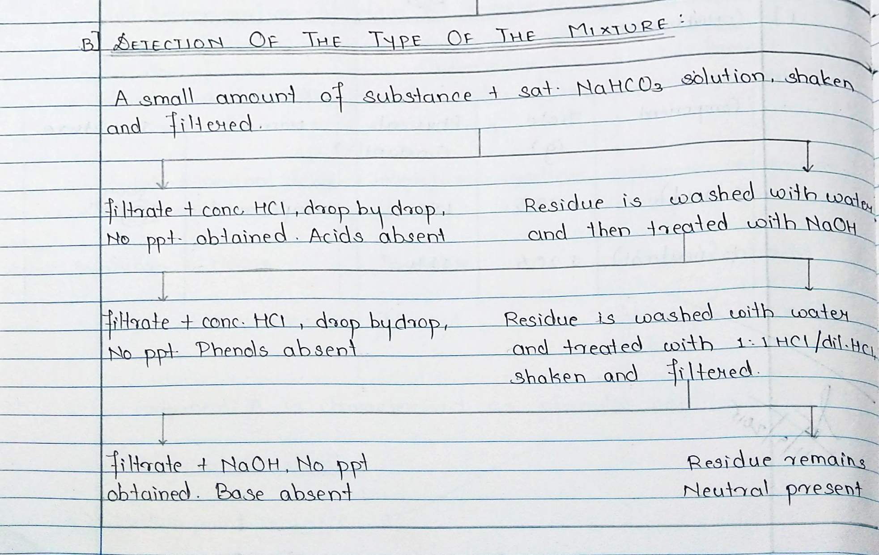
Since only one component is detected, the other component is water soluble.
Therefore, the type of the mixture is Water Soluble + Water Insoluble (Neutral).
Notes:
MN done till here at 09-11-2020 in Session 2 from Mix 5 identification to Mix 6 type detection
23-11-2020 KB to start from here….

Slide 38
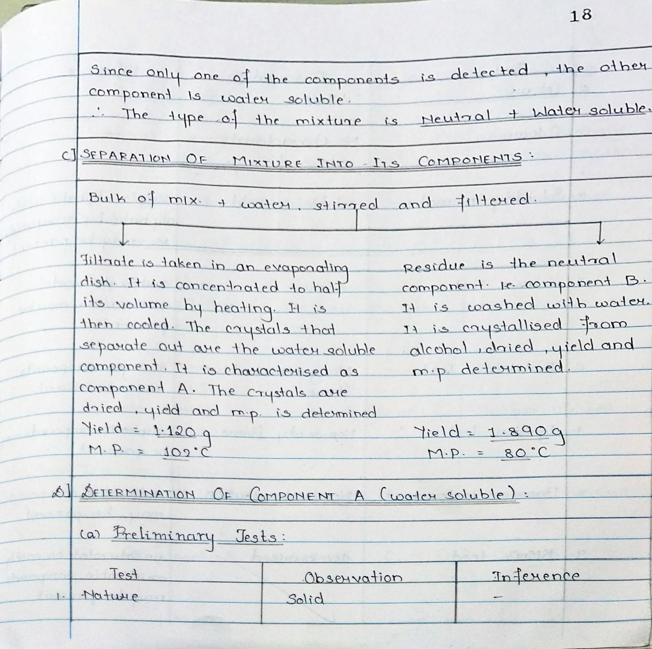
C) Separation of the Mixture into its Components
D) Determination of yield:

Slide 39
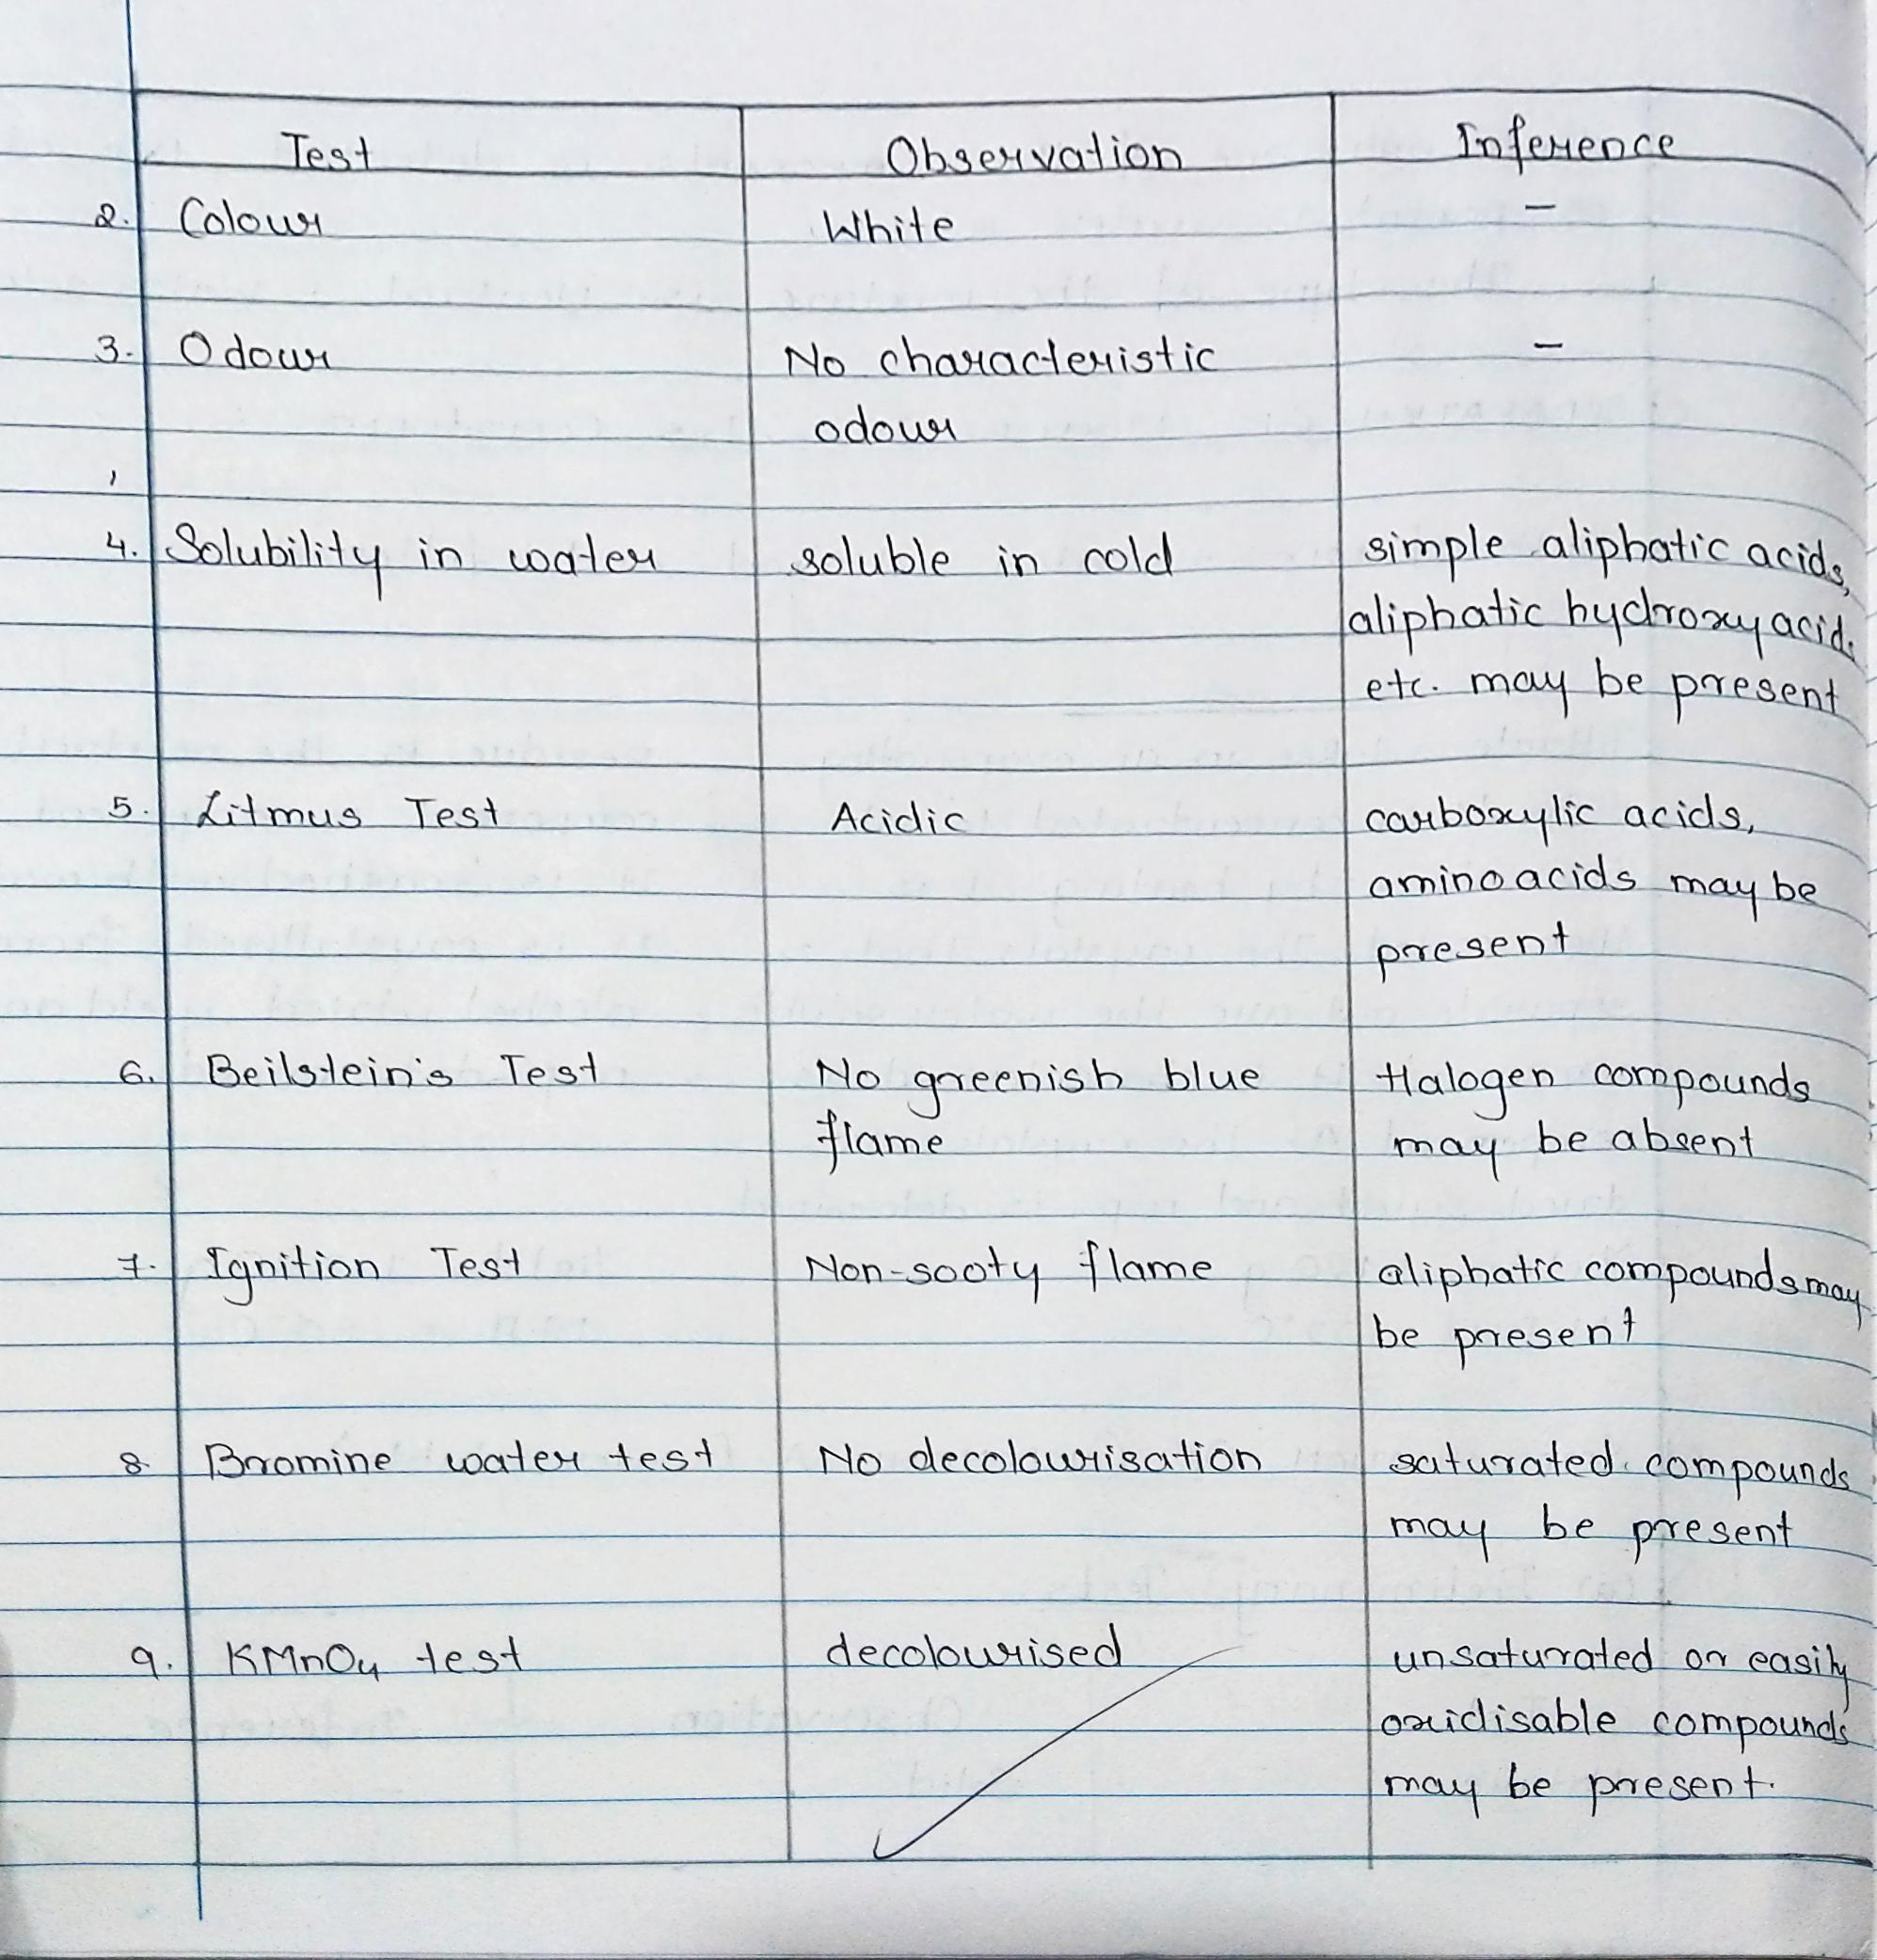
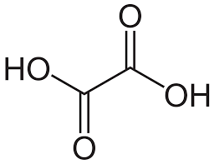

Slide 41
(c) Elemental Analysis
Freshly cut sodium metal is taken in a dry fusion tube and heated gently, till it just melts. Then add a R.G. of dry solid. The substance is allowed to react with sodium. It is heated till red hot and the fusion tube is dropped in the porcelain dish containing 5 ml of distilled water. The dish is immediately covered with asbestos sheet. The contents are mixed properly, boiled, concentrated to 2 ml and filtered.
The filtrate is tested for nitrogen, sulphur and halogens.

Slide 43
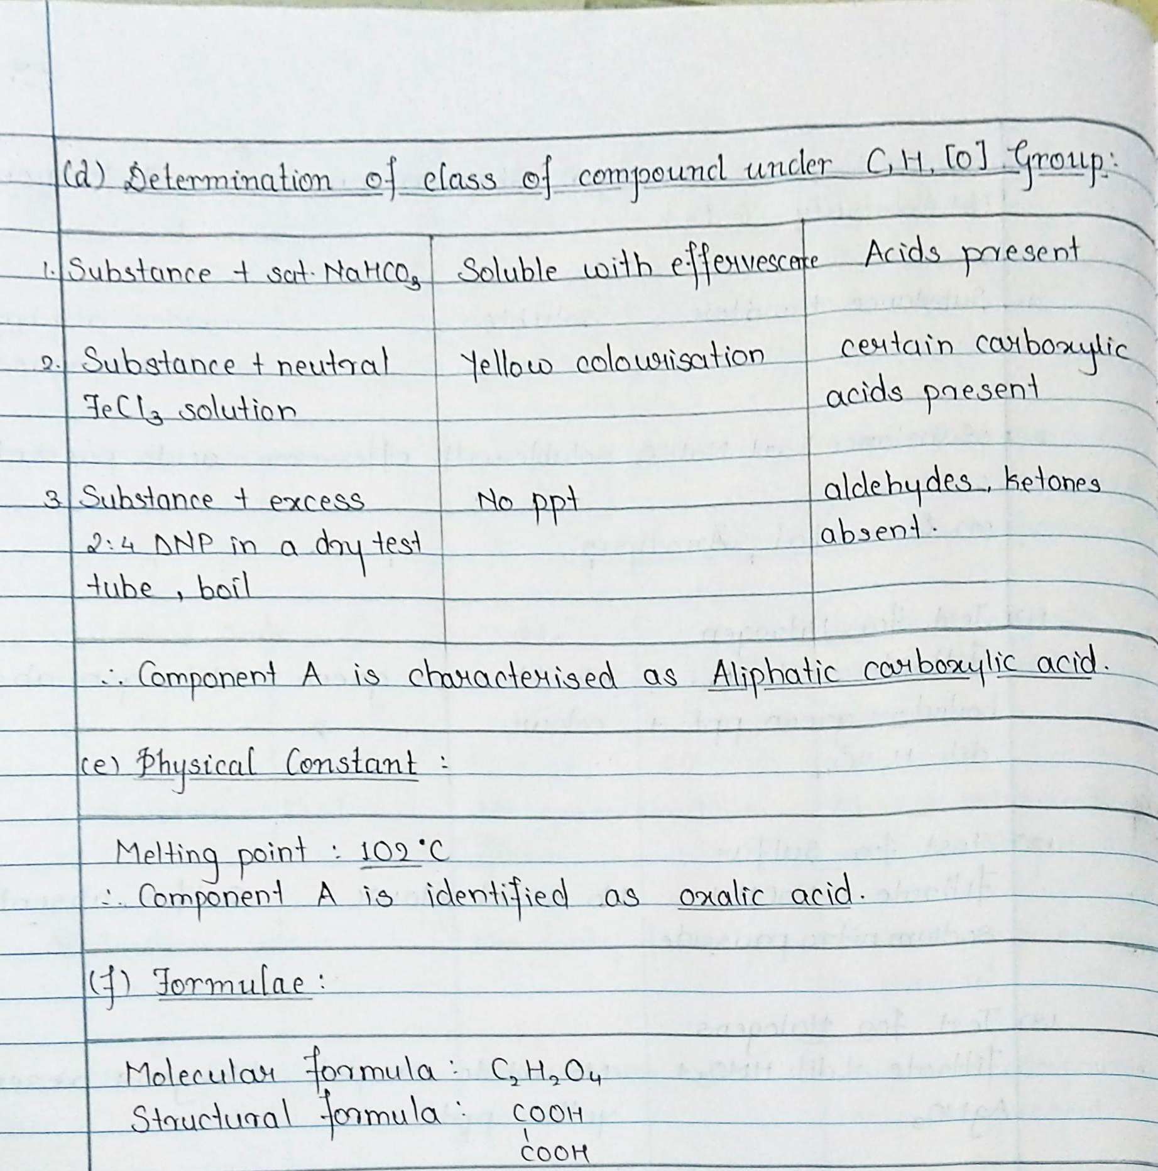

Slide 44
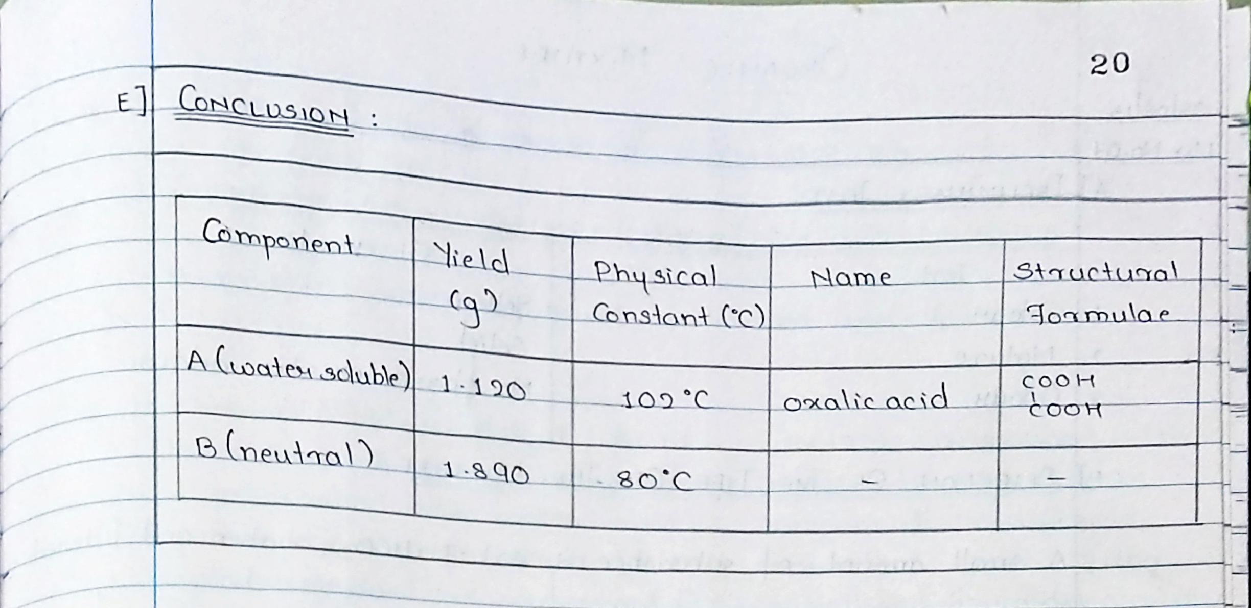

Slide 45
Expt No. 1: Analytical Chemistry Experiment
Estimation of magnesium content in talcum powder by complexometry, using standardized solution of EDTA. (6+3 Units)
Date: 23 - 11 - 2020

Slide 46
What is talcum powder?
Talcum powder is made from talc, a mineral made up mainly of the elements magnesium, silicon, and oxygen. As a powder, it absorbs moisture well and helps cut down on friction, making it useful for keeping skin dry and helping to prevent rashes. It is widely used in cosmetic products such as baby powder and adult body and facial powders, as well as in a number of other consumer products.
Chemically, talc is a hydrous magnesium silicate with a chemical formula of Mg3Si4O10(OH)2.
https://www.youtube.com/watch?v=BqNyr2ar-Us 12:49 mins
Notes:
Play this video first https://www.youtube.com/watch?v=BqNyr2ar-Us ask students to make a note of the explanation given in the video about the experiment and keep making points in miscellaneous page. During the EDTA solution preparation method, explain the students that we are using standard flask and 50ml beaker with wash bottle and distilled water, the method shown in video is different from our regular practical. End point shown in 8:27 min
General video of complexometry: https://www.youtube.com/watch?v=EQxvY6a42Dw

Slide 47
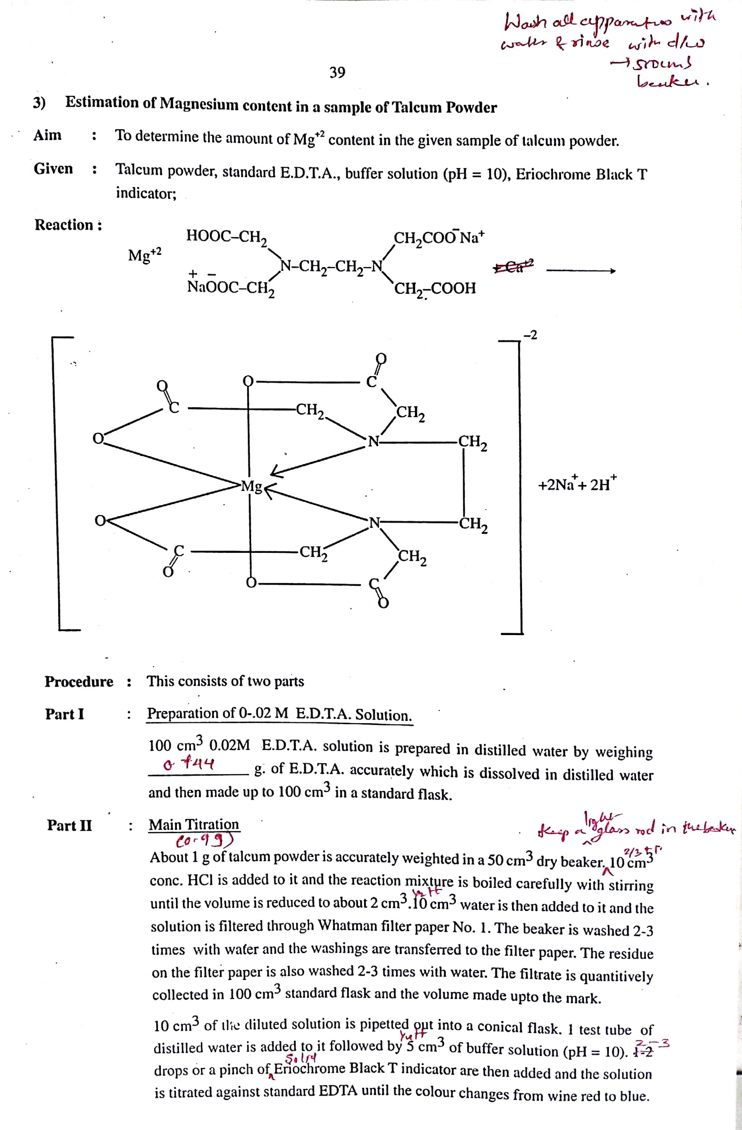

Slide 49
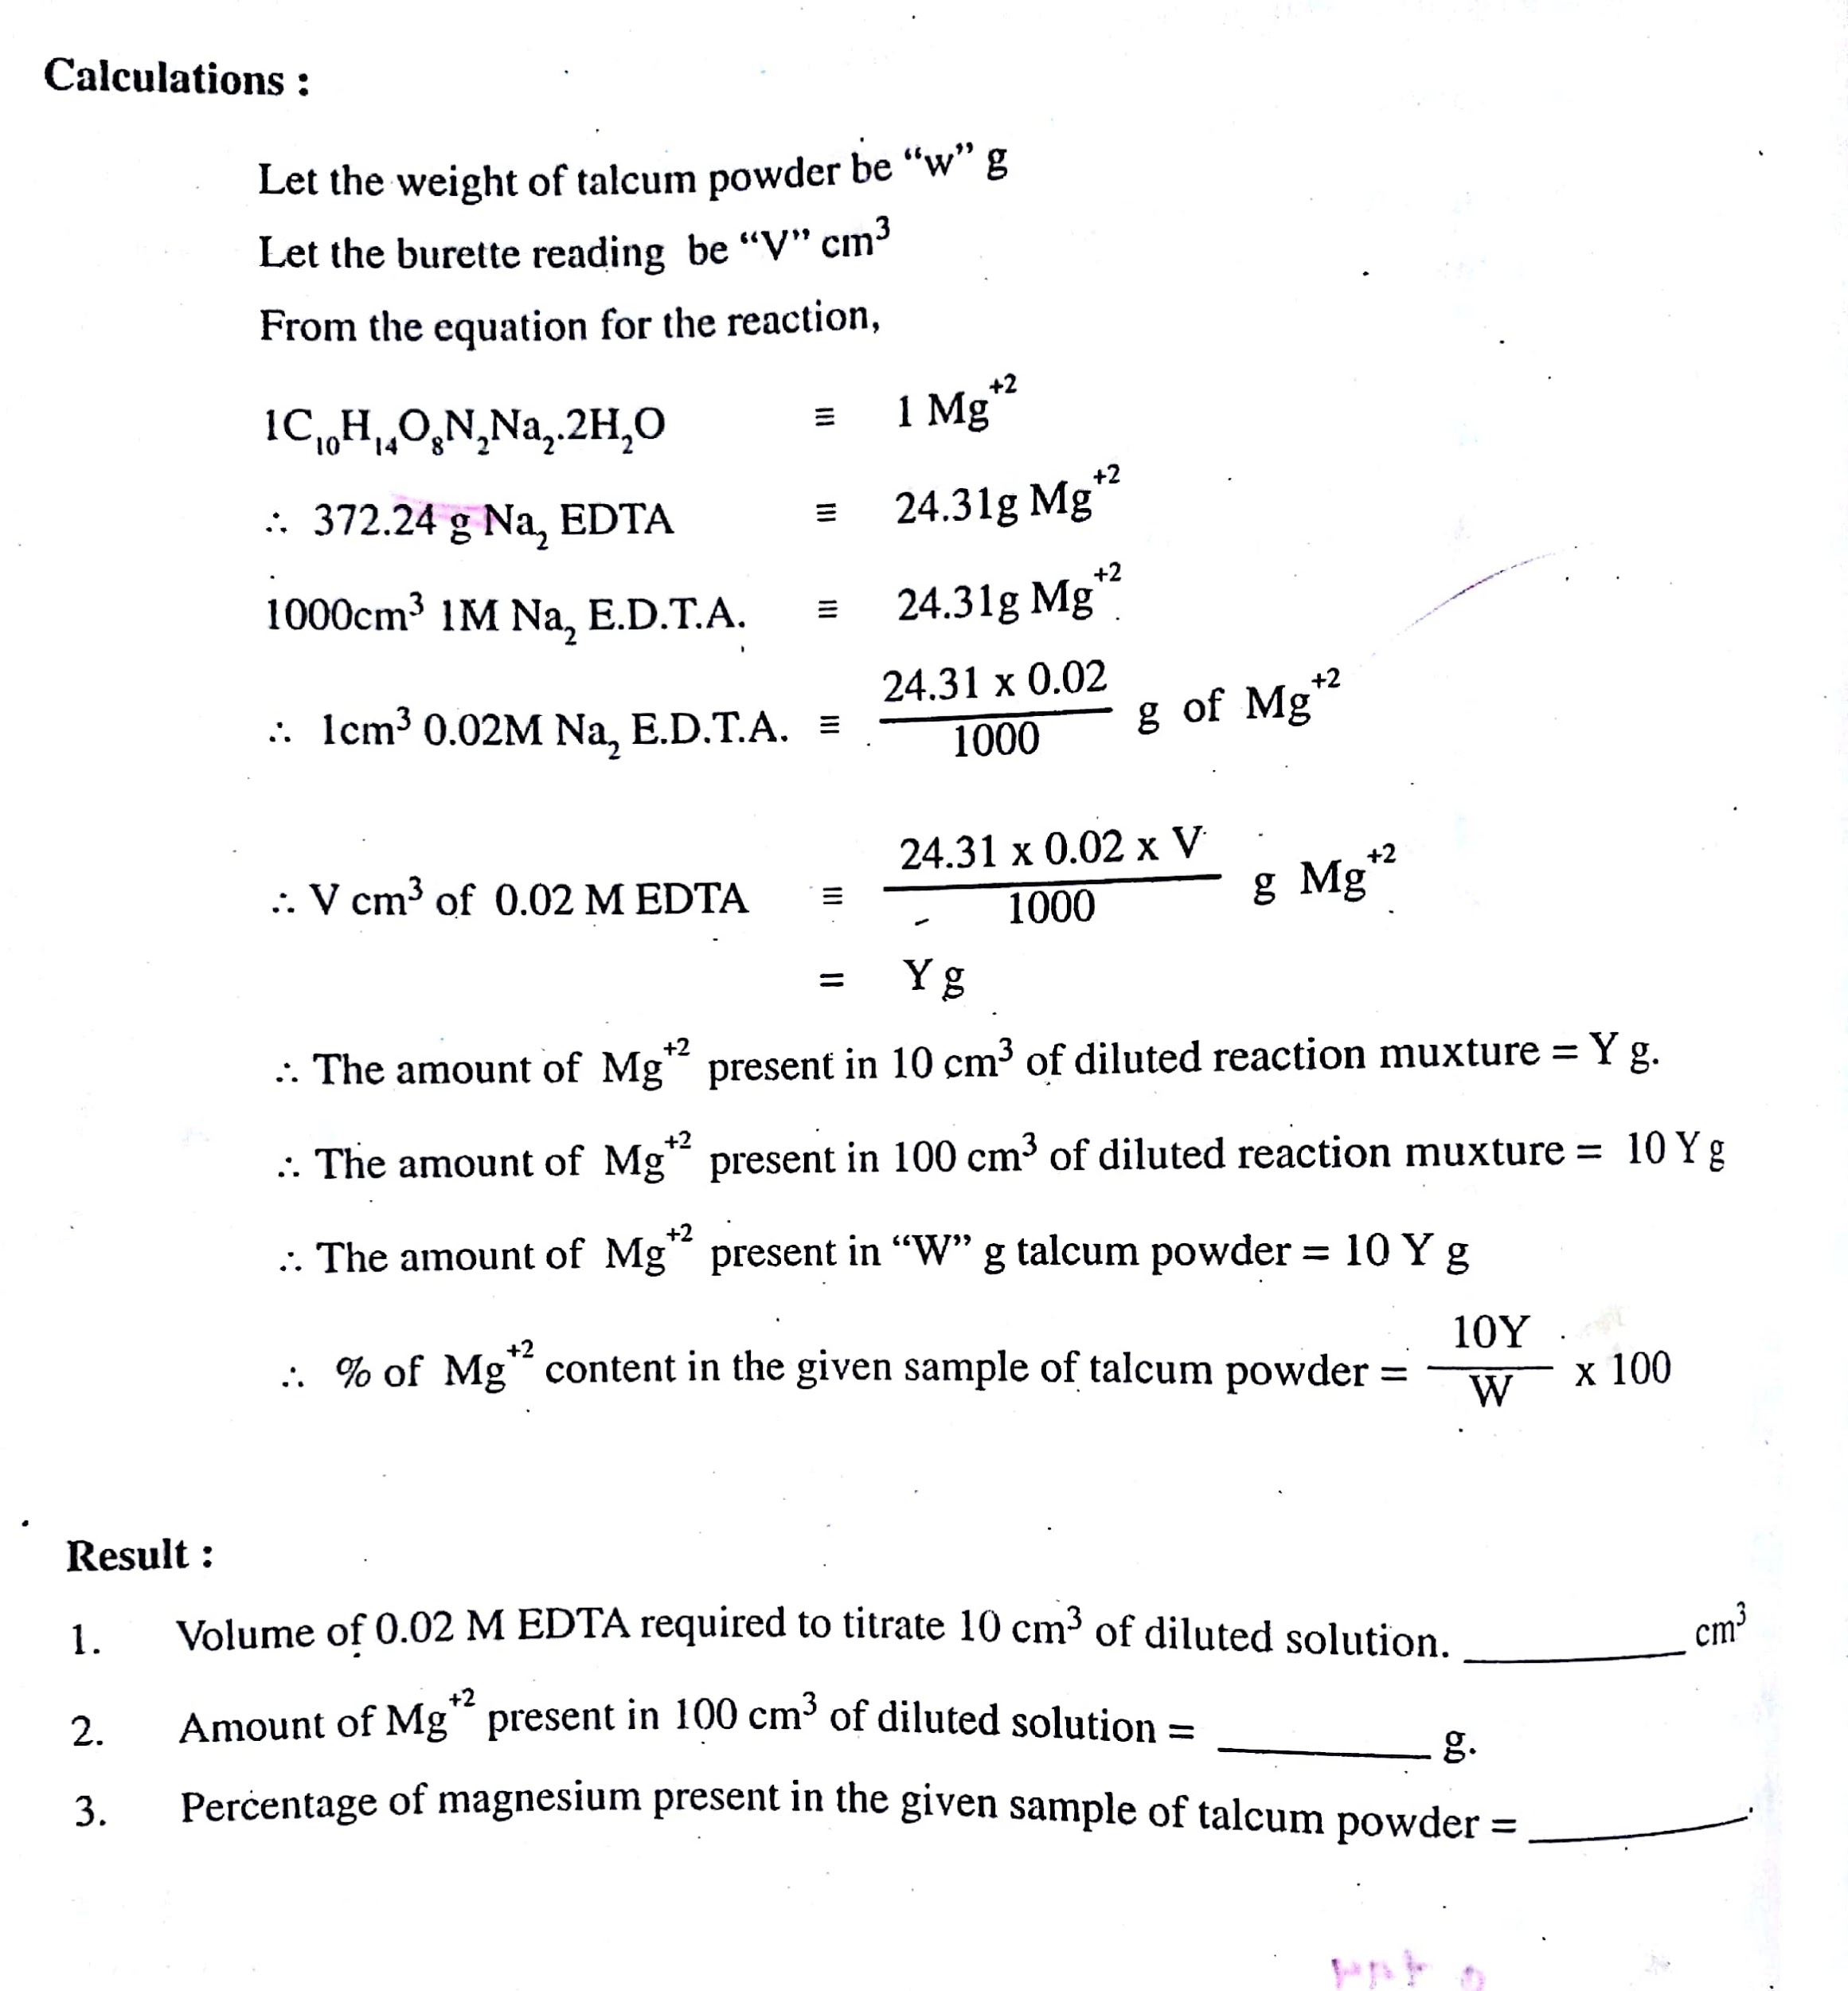

Slide 50
Expt No. 1:
Analytical Chemistry Experiment
Index:
Magnesium content in talcum powder by complexometry, using EDTA (Eriochrome Black T Indicator).
FORMAT FOR WRITING IN ROUGH JOURNAL

