Slide 2
TYBSC CHEMISTRY PRACTICAL
Semester V 2020-21
Department of Chemistry
Notes:
Page Distribution etc, all points for practical session was discussed by MN: 07-09-2020 at session 1 for all 6+3 Students 9.30am to 10.10am

Slide 3
LAB SAFETY
Laboratory safety involves the development of skills and responsibility and must be an integral part of every chemistry curriculum.
This means that safety awareness must be integrated into each laboratory course including research with increasingly broader scope at more advanced levels.

Slide 4
Important Laboratory Safety Rules

Slide 5
Avoid skin and eye contact with all chemicals.
Minimize all chemical exposures.
Never leave containers of chemicals open.
All containers must have appropriate labels. Unlabeled chemicals should never be used.
Do not taste or intentionally sniff chemicals.
Never consume and/or store food or beverages or apply cosmetics in areas where hazardous chemicals are used or stored.
Long hair and loose clothing must be pulled back and secured from entanglement or potential capture.
No cell phone or ear phone usage in the active portion of the laboratories, or during experimental operations.
Avoid wearing jewelry in the lab as this can pose multiple safety hazards.
Have a thorough understanding of the Laboratory Safety Symbols.

Slide 6
ChemSafeLabs: Safety Symbols (15.45 min)
https://youtu.be/ywJXZE3da5U
Notes:
Video can be started from 1:00 and stopped at 15:45. Students are expected to write a short summary in their rough journal under miscellaneous experiments..

Slide 7
Now that you have watched the video, list down the points on Laboratory Safety Symbols in your rough journal.
Notes:
Importance of Chem Safe Labs: Safety Symbols
Video explained to students. Students will prepare three columns in rough journal SrNo.Symbol and Meaning of Symbol.
All 6 slides explained to students.Santosh Katariya 07/09/2020 11.00 am

Slide 8
Different Type of Component as per Functional Group
Notes:
Programme Schedule from 10-09-2020 for Session 1 and 2….

Slide 9
Organic Separation - Binary Mixture (Solid - Solid type)
Steps involved in binary mixture / Format of writing the experiment :
Preliminary Tests:
Detection of the type of the mixture:
Separation of the mixture into its components:
Determination of Yield:
Identification of Component A [ ] or B [ ]: [Characterisation of one of the component A/B]
Preliminary tests:
Solubility tests / Miscibility tests:
Elemental analysis:
Determination of class of Compound under ______ group
Physical constant:
Confirmatory test:
Formulae:
Conclusion:
Notes:
Just explain what are the concepts involved in organic separation and give this outline / steps of binary mixture which will be followed - All the SOP has been posted for students in Teams Practical Group.

Slide 10
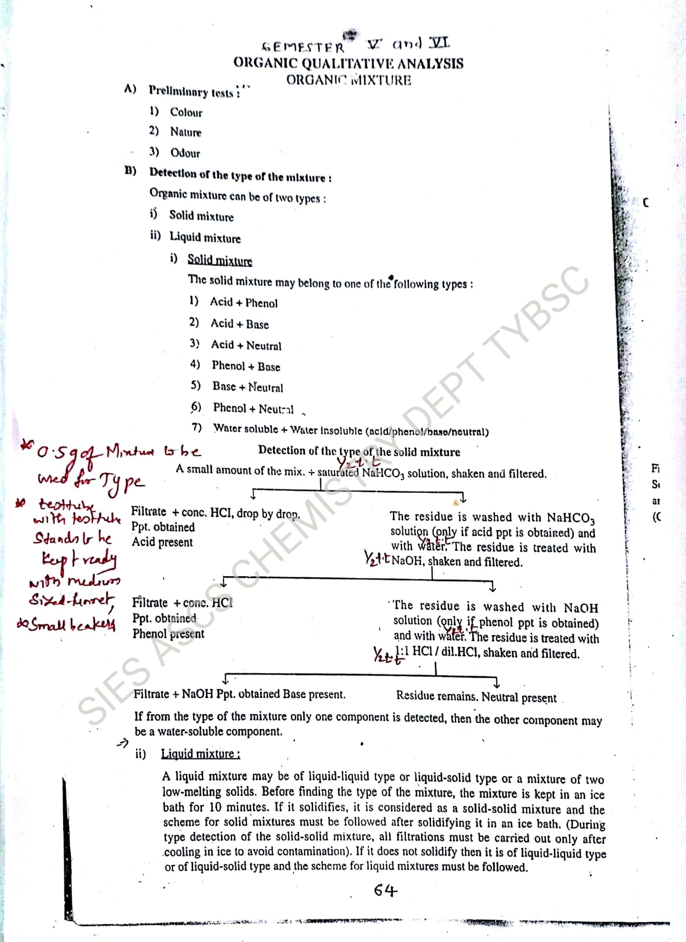
ORGANIC SEPARATION OF BINARY MIXTURE
Preliminary Tests
Detection of the type of the mixture

Slide 11
Elucidate the steps to determine the mixture, given that the type is:
ACID + NEUTRAL
Notes:
Let the students discuss and try the method

Slide 12
Now let us ask ourselves few questions to understand the chemistry behind the reactions….

Slide 13
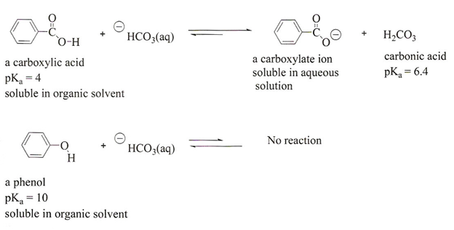
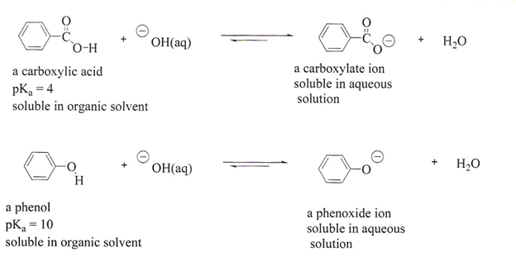
Reactions Happening in this Type when one of the given component is an Acid, on treating with saturated sodium bicarbonate.
What would be the reaction in case the component is acid or phenol?
Example: Consider Benzoic Acid / Phenol Reaction with NaHCO₃ and NaOH
Notes:
http://wwwchem.uwimona.edu.jm/lab_manuals/c1901exp8.html#:~:text=Background%20Information%3A%20Extraction%20is%20a,can%20be%20extracted%20into%20it This is the link from where the image is taken , staff members can use this link, as concepts are discussed their….

Slide 14
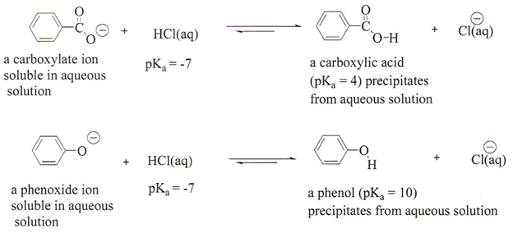
Regeneration of Acid / Phenol on addition of HCl

Slide 15
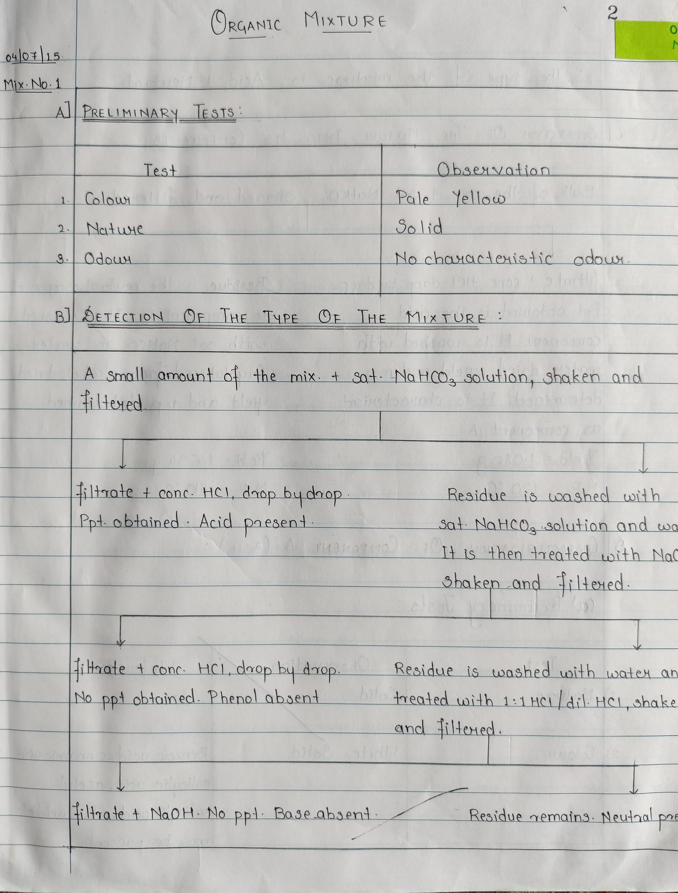
B) DETECTION
OF THE TYPE OF MIXTURE
Notes:
Basic of binary explained to students by Nitin M. 11/09/2020 9.30-10.10 am slide no. 7-14 completed
Detection of type of mixture and writing of flow chart explained taking 2 different types of mixtures (Acid+ Base and Acid + Neutral) by Pallavi R. 11/09/2020 10:20-11:00 am.

Slide 16
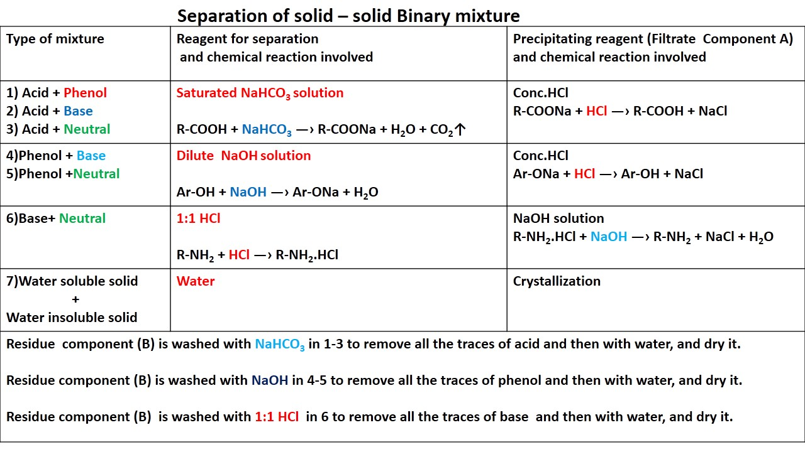

Slide 17
C) Bulk Separation
Notes:
Bulk separation part with explanation for all types mixture and drying ,yield ,crystallization ,melting point part explained to learners.Santosh Katariya 10.10 am

Slide 18
C) SEPERATION OF THE MIXTURE INTO
ITS COMPONENTS

Slide 19
D) DETERMINATION OF YIELD
E) IDENTIFICATION OF COMPONENT A / B
F) CONCLUSION
Notes:
Format available in slide number 21

Slide 20
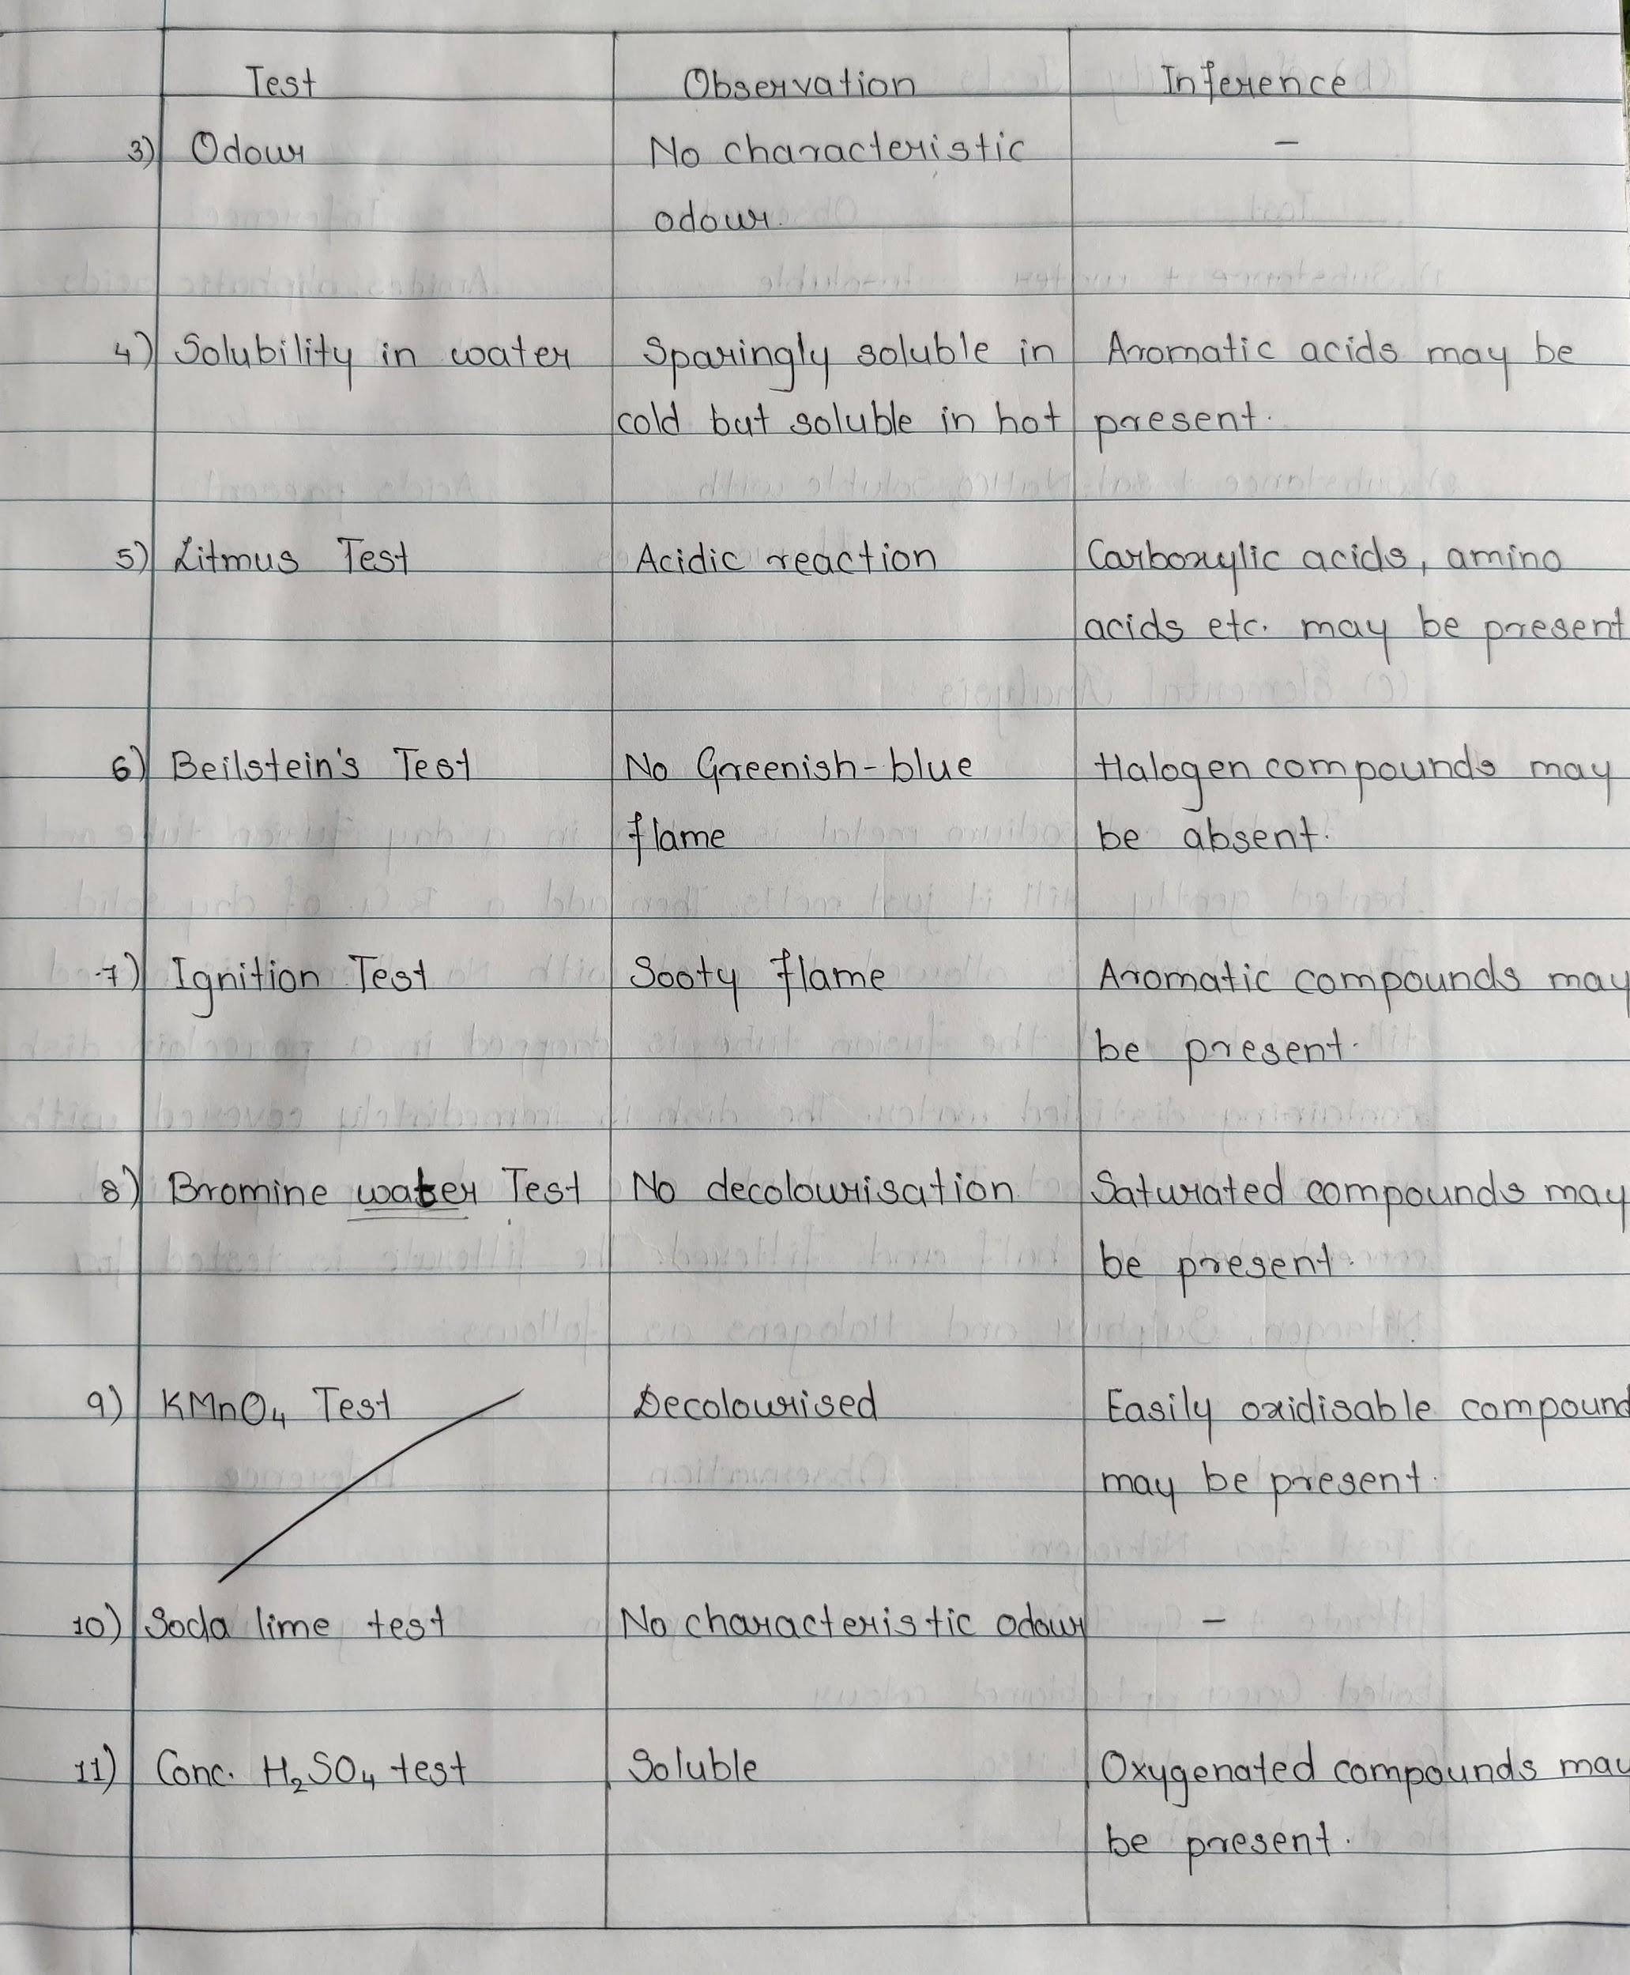

Slide 21
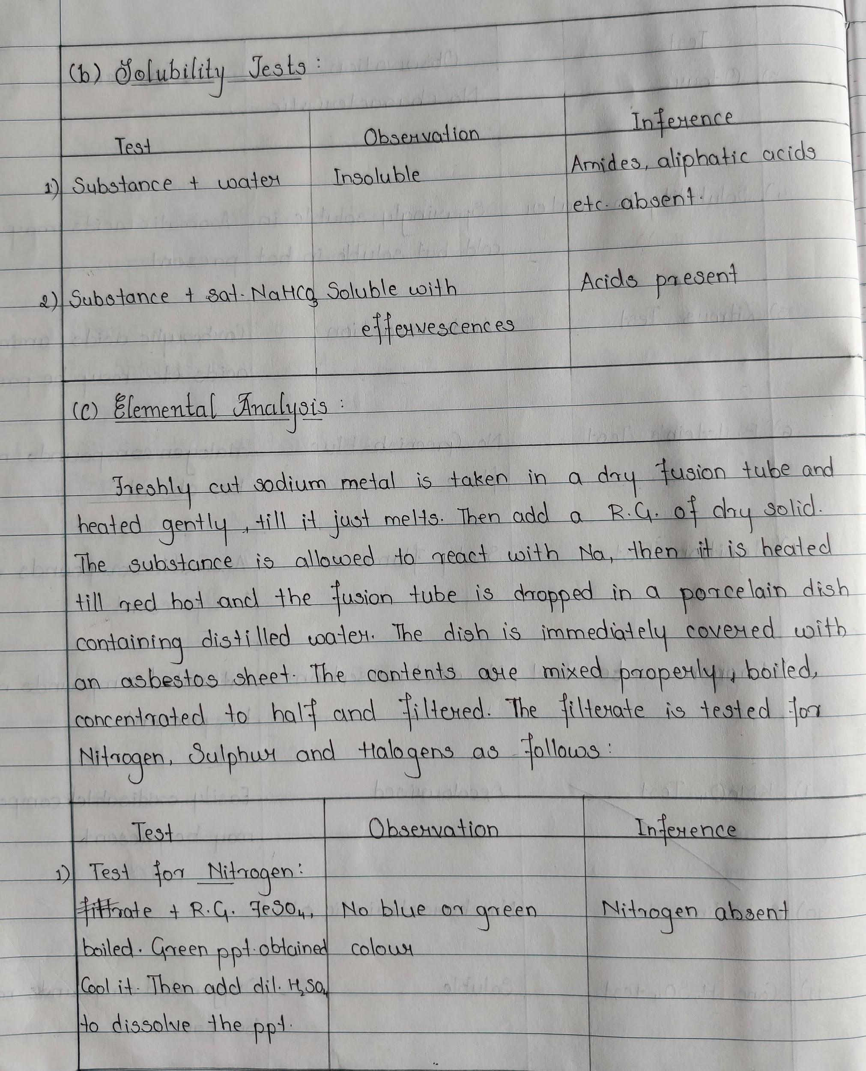
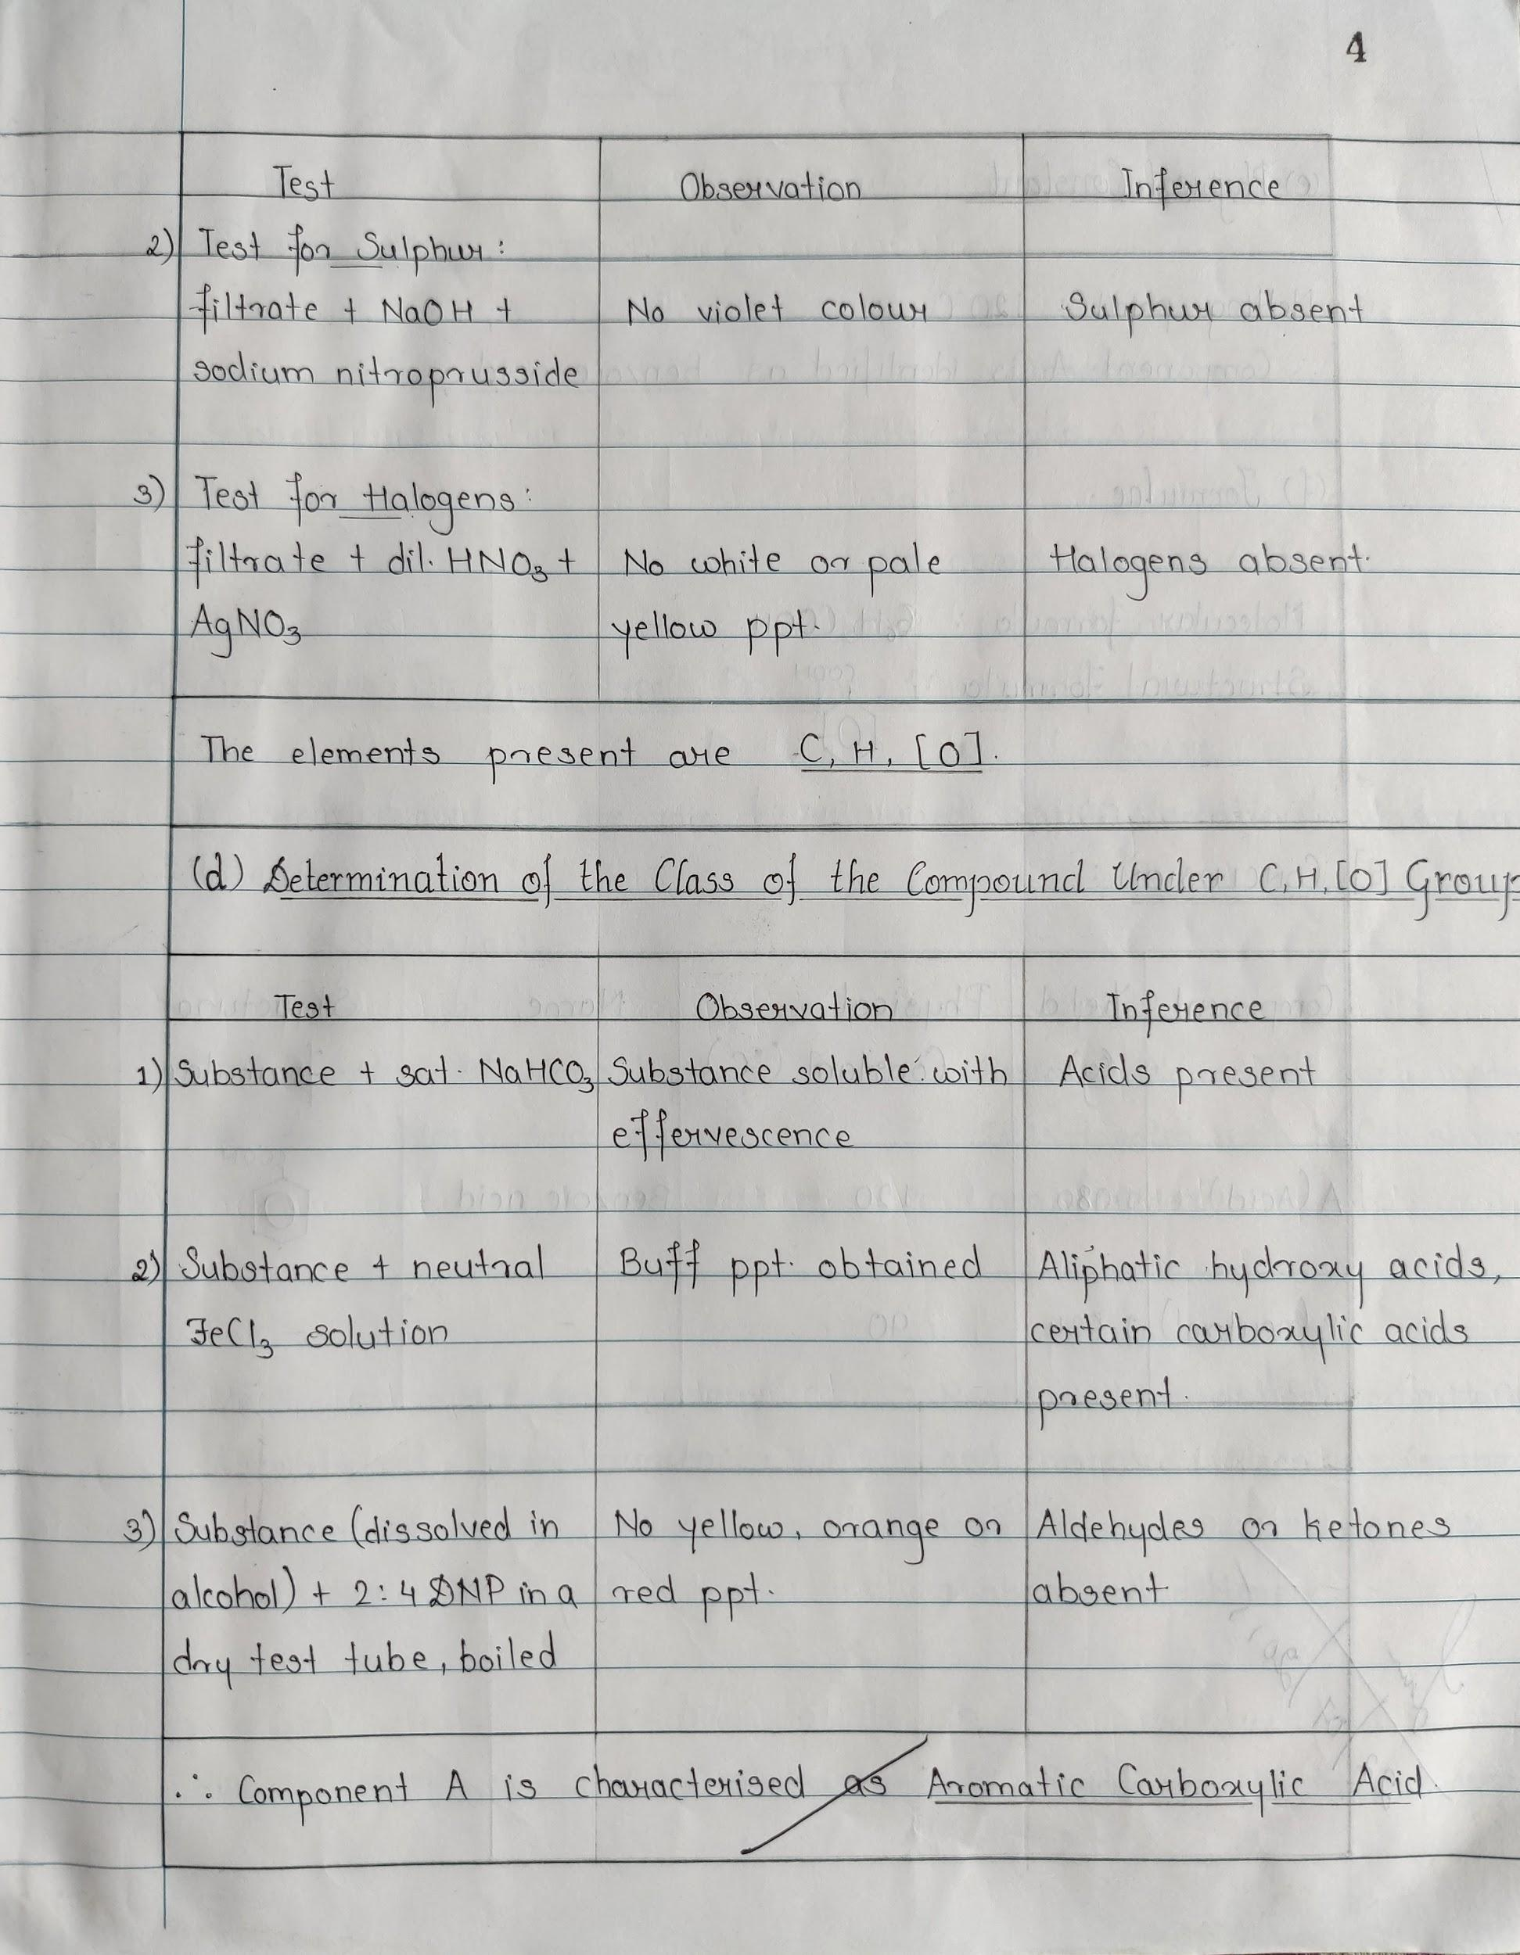

Slide 22
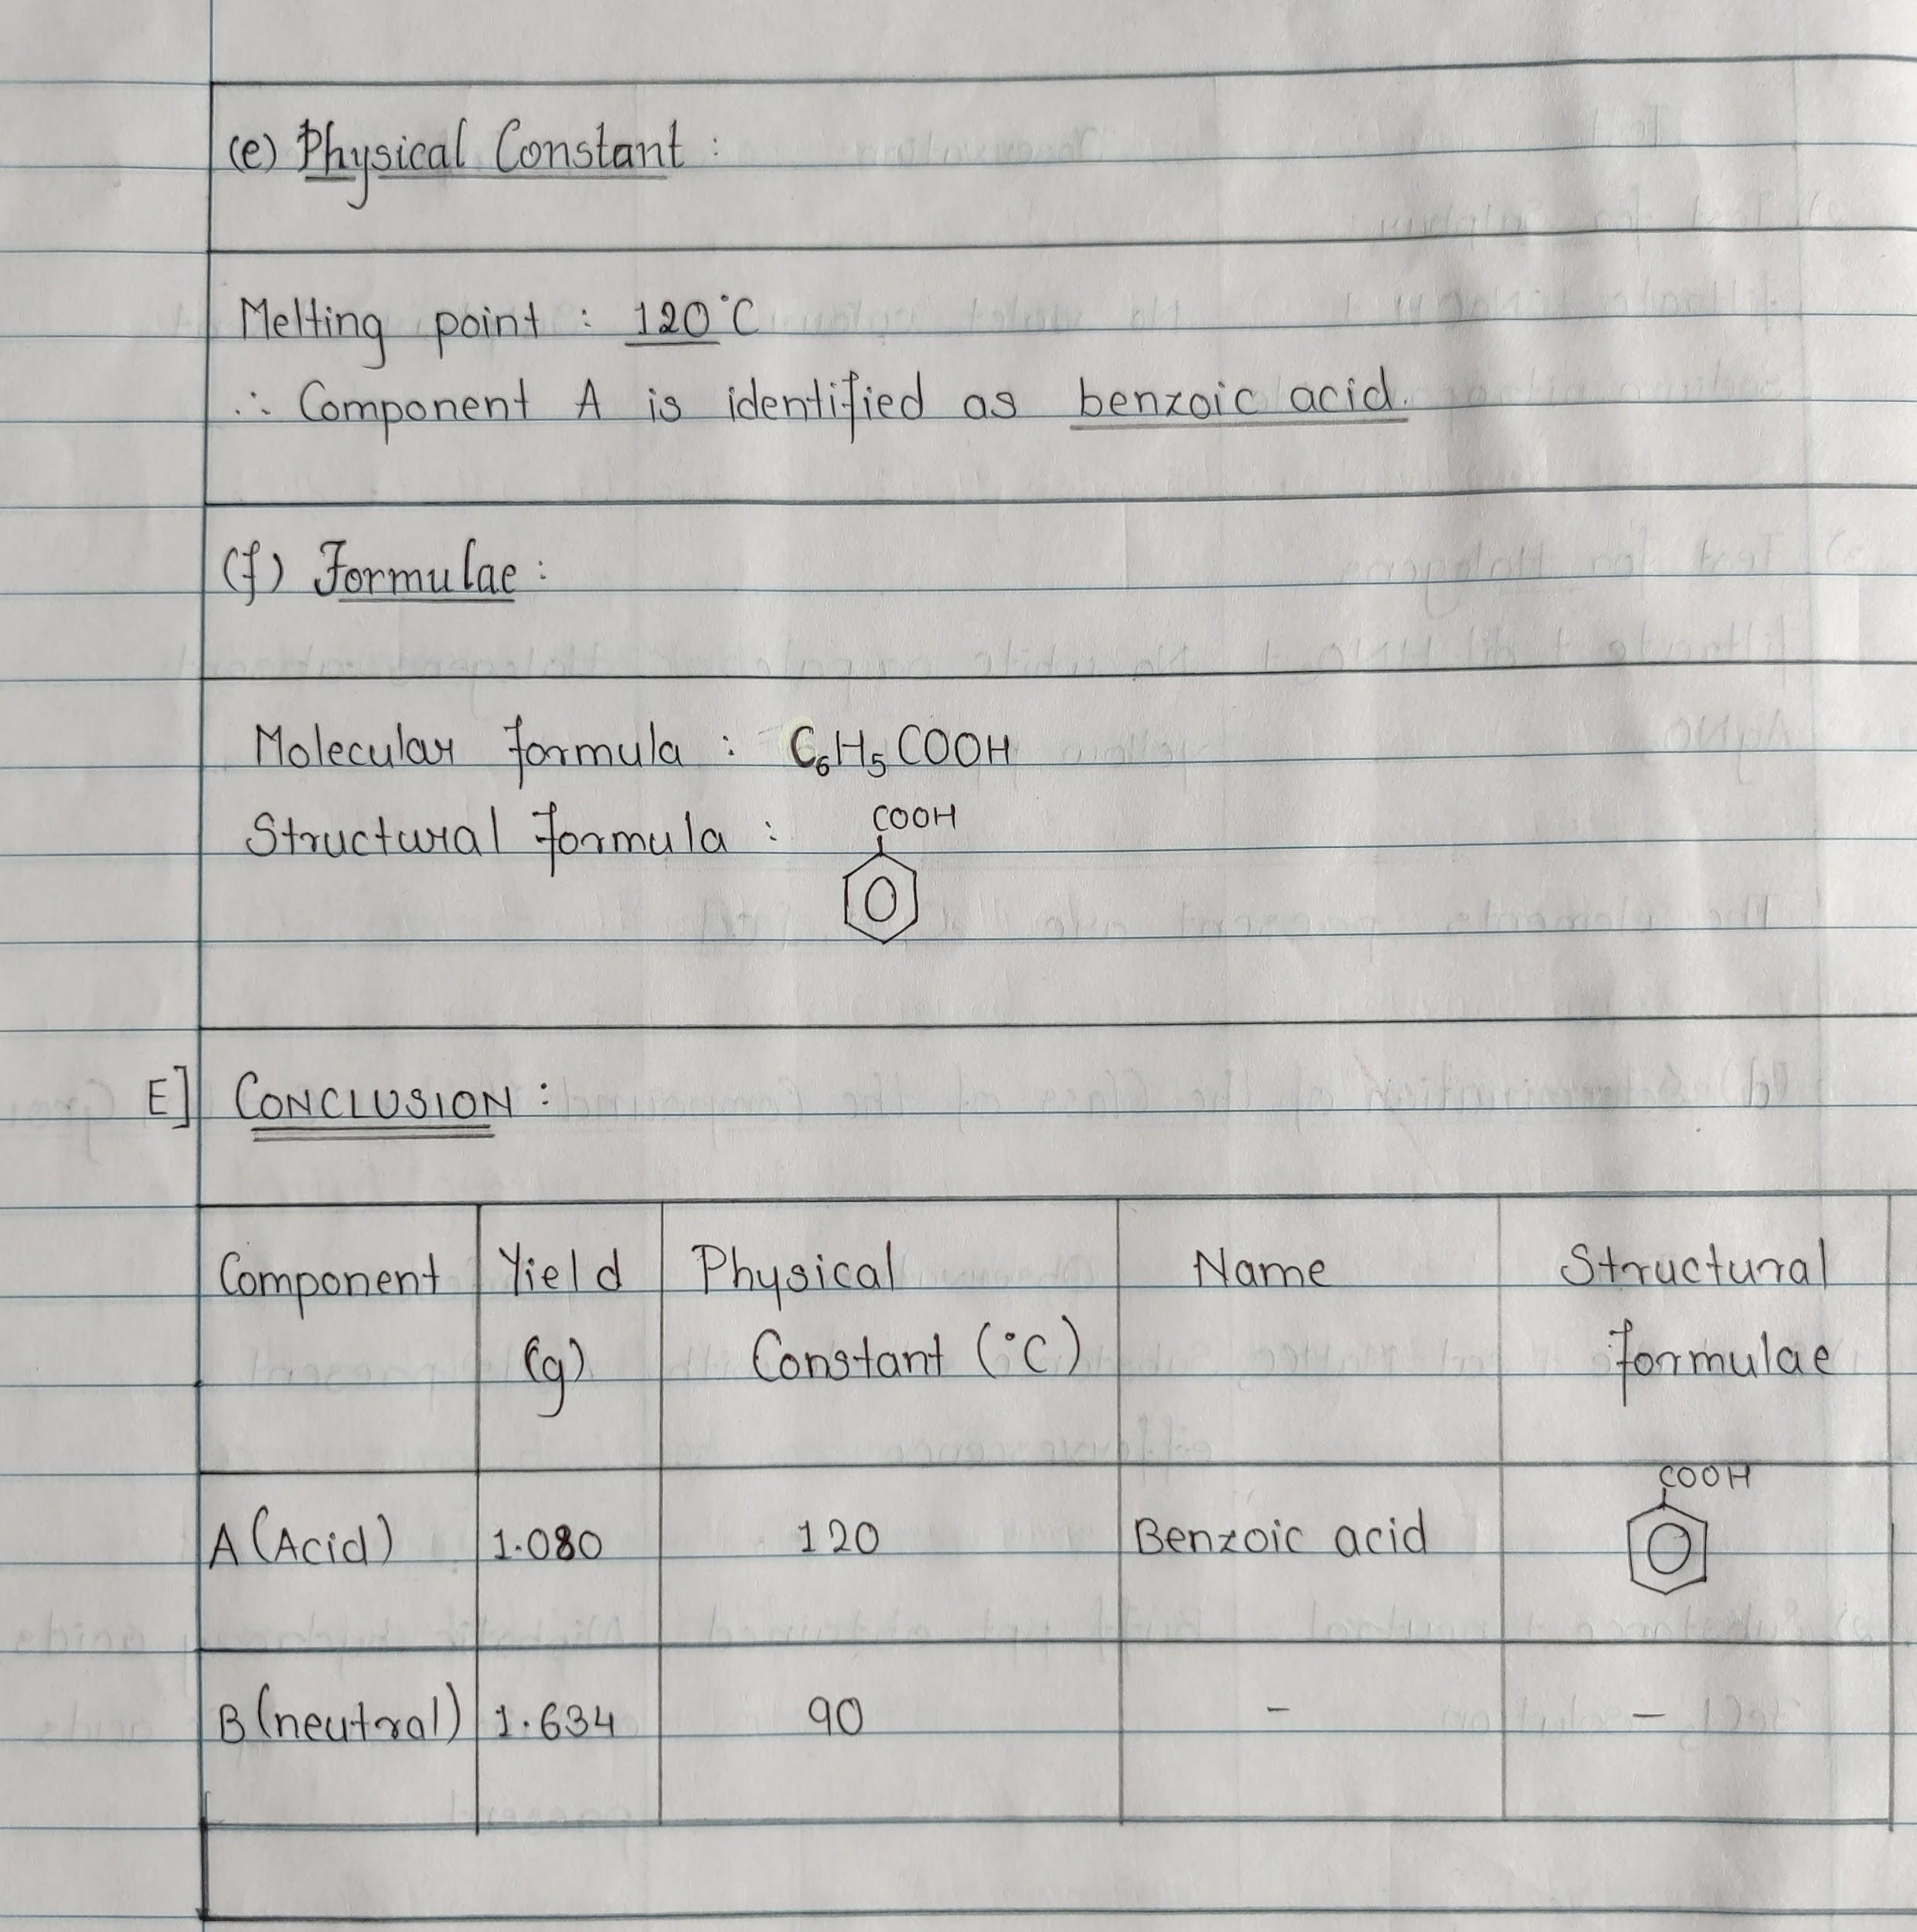
CONCLUSION
Notes:
Completed up to here on 14/09/2020. By Dr. Madhav S Mane.

Slide 23
Organic Separation - Binary Mixture (Solid - Solid type)
Steps involved in binary mixture / Format of writing the experiment :
Preliminary Tests:
Detection of the type of the mixture:
Separation of the mixture into its components:
Determination of Yield:
Identification of Component A [ ] or B [ ]: [Characterisation of one of the component A/B]
Preliminary tests:
Solubility tests / Miscibility tests:
Elemental analysis:
Determination of class of Compound under ______ group
Physical constant:
Confirmatory test:
Formulae:
Conclusion:
Notes:
Just explain what are the concepts involved in organic separation and give this outline / steps of binary mixture which will be followed - All the SOP has been posted for students in Teams Practical Group.

Slide 24
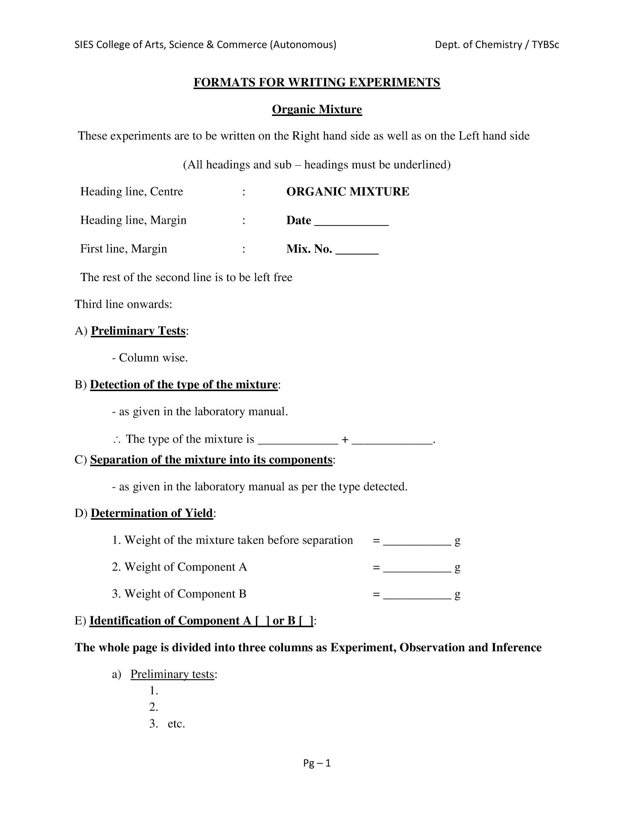
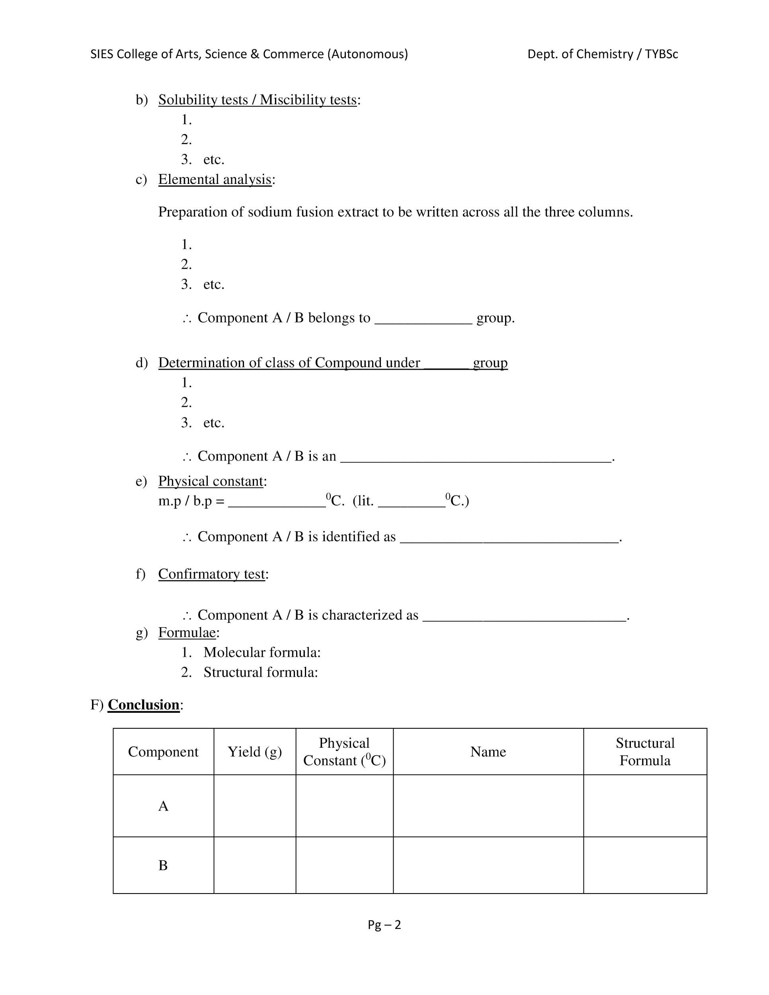
Notes:
This is the format of writing the organic mixture in rough as well as fair journal. Elemental analysis procedure they can write for first one or two experiments.

Slide 25
REFER ALL MANUAL
IN TEAMS FILES
https://teams.microsoft.com/_#/school/files/General?threadId=19%3A32028534b3e14f1aa2e79cf2e3a9e291%40thread.tacv2&ctx=channel&context=TYBSc%25206%2520%252B%25203%2520Units%2520Practical%2520SOP%25202020-21&rootfolder=%252Fsites%252FTYBScChemistryPracticalsSemV2020-21%252FClass%2520Materials%252FTYBSc%25206%2520%252B%25203%2520Units%2520Practical%2520SOP%25202020-21

Slide 26
Elucidate the steps to determine the mixture, given that the type is: Mix no. 2
PHENOL + NEUTRAL

Slide 27
A] PRELIMINARY TESTS
TEST | OBSERVATION
Colour | Pale brown
Nature | Solid
Odour | No characteristic odour

Slide 28
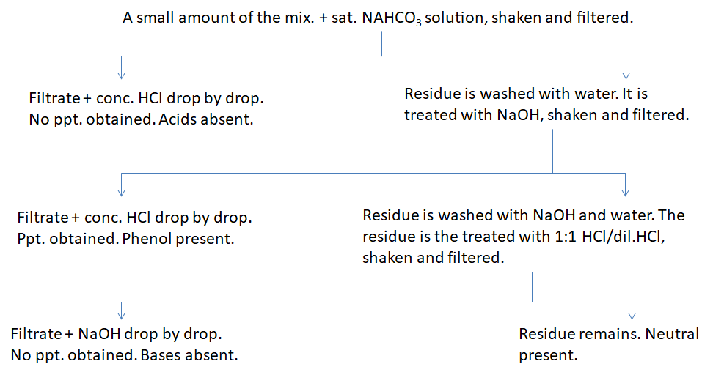
B] DETECTION OF THE TYPE OF THE MIXTURE
Therefore, the type of the mixture is Phenol + Neutral.

Slide 29
Reactions Happening in this Type when one of the given component is a Phenol, on treating with sodium hydroxide (NaOH).
What would be the reaction in case the component is acid or phenol?
Example: Consider Benzoic Acid / Phenol Reaction with NaOH
Notes:
http://wwwchem.uwimona.edu.jm/lab_manuals/c1901exp8.html#:~:text=Background%20Information%3A%20Extraction%20is%20a,can%20be%20extracted%20into%20it This is the link from where the image is taken , staff members can use this link, as concepts are discussed their….

Slide 30
Regeneration of Acid / Phenol on addition of HCl

Slide 31
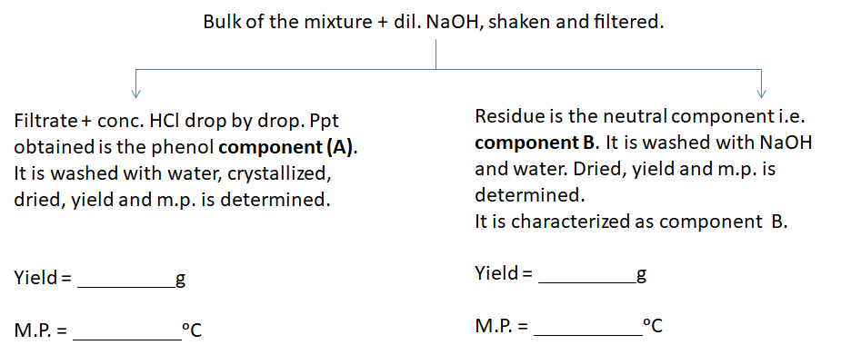
C] SEPARATION OF THE MIXTURE INTO ITS COMPONENTS

Slide 32
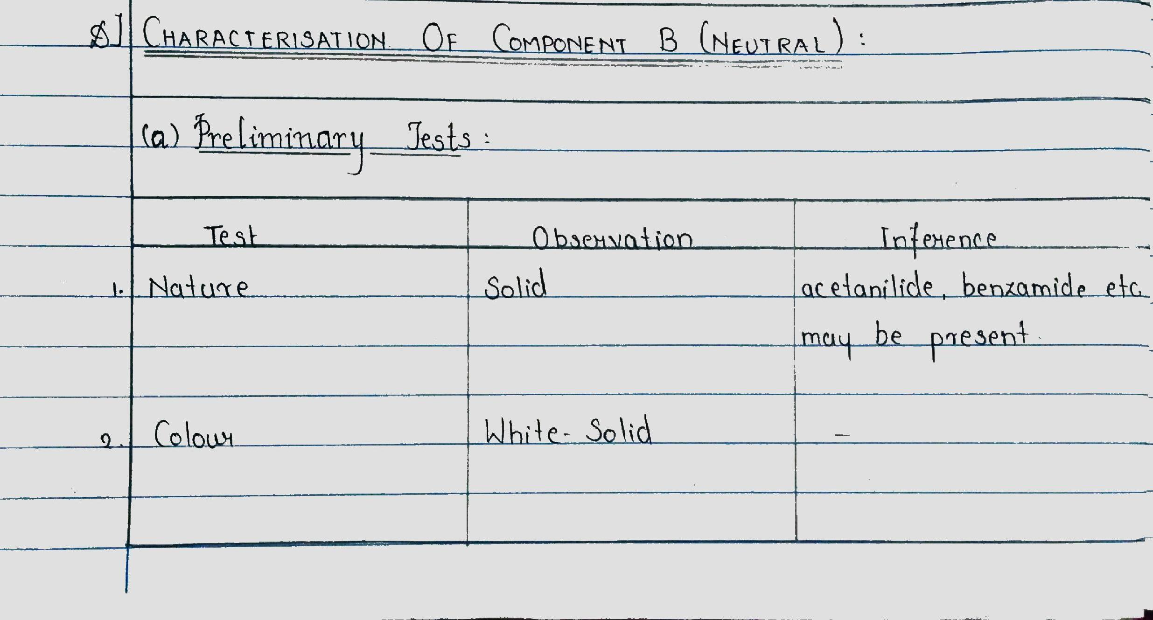
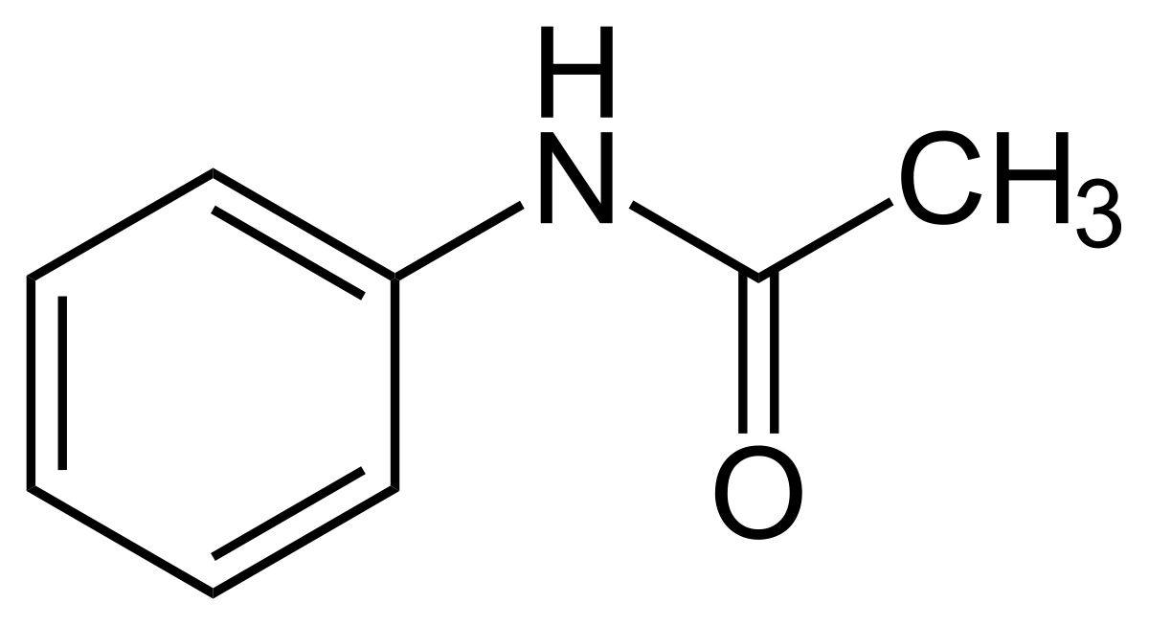
D] CHARACTERISATION OF COMPONENT B (Neutral)

Slide 33
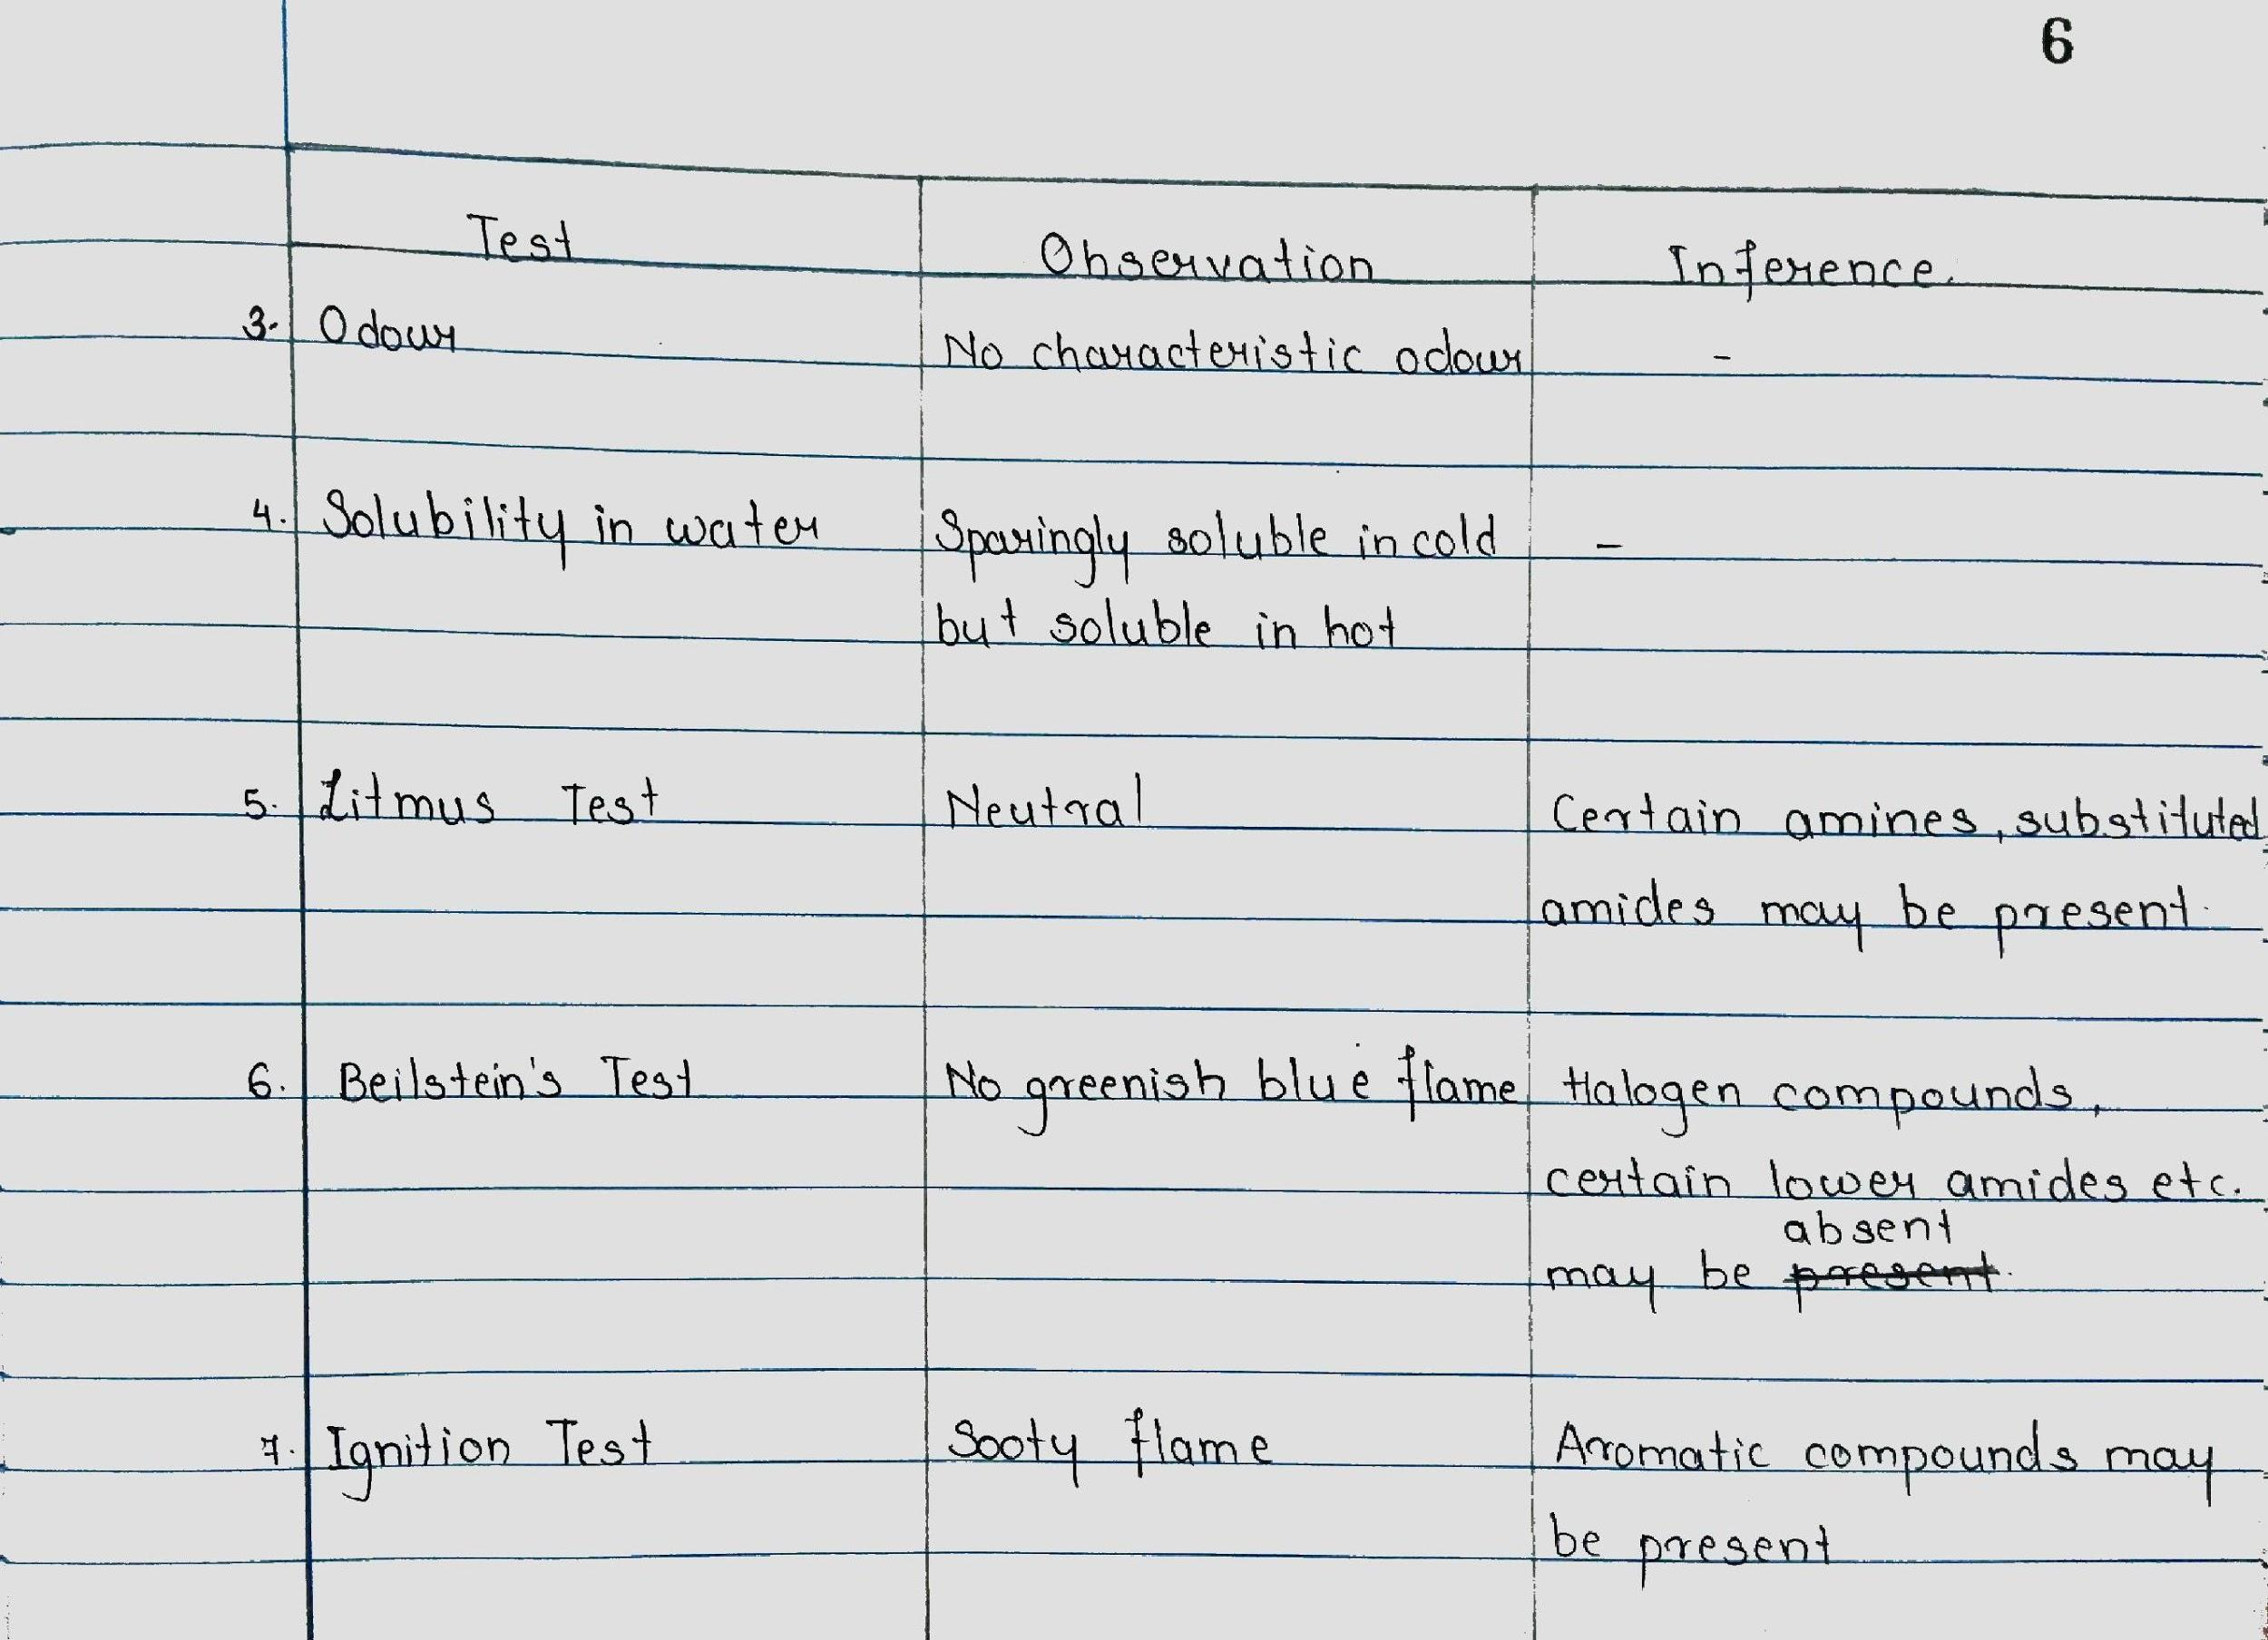

Slide 34
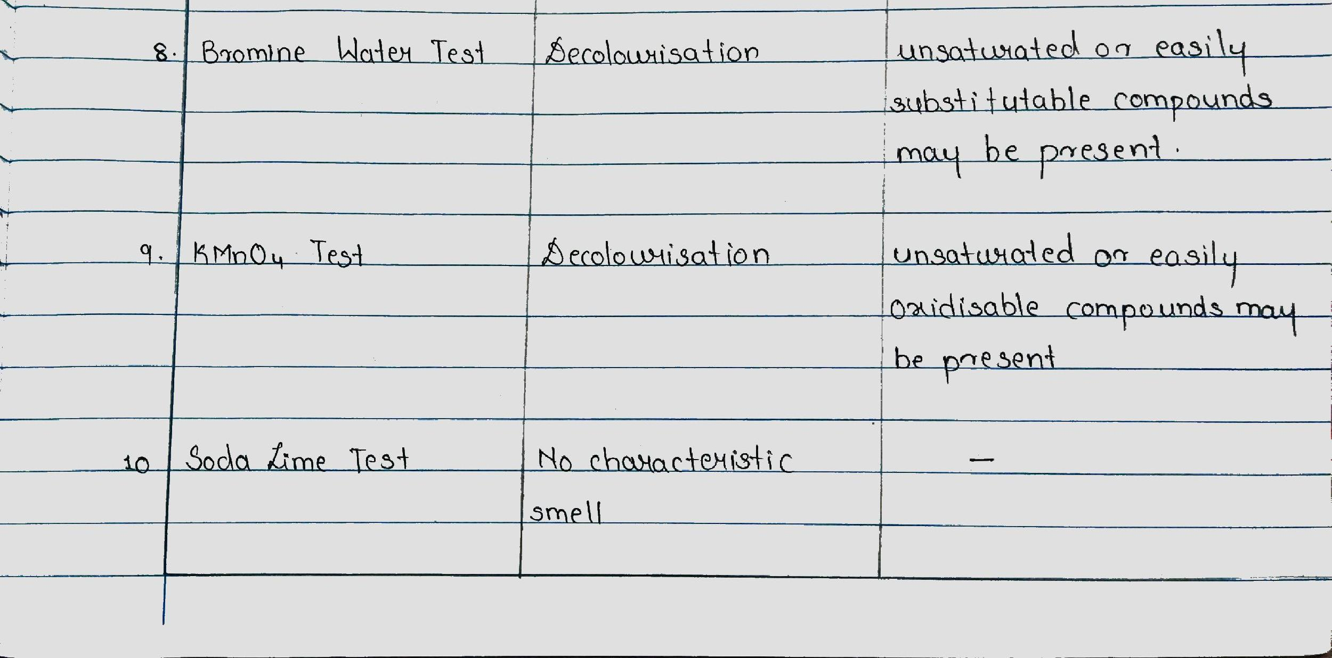

Slide 35
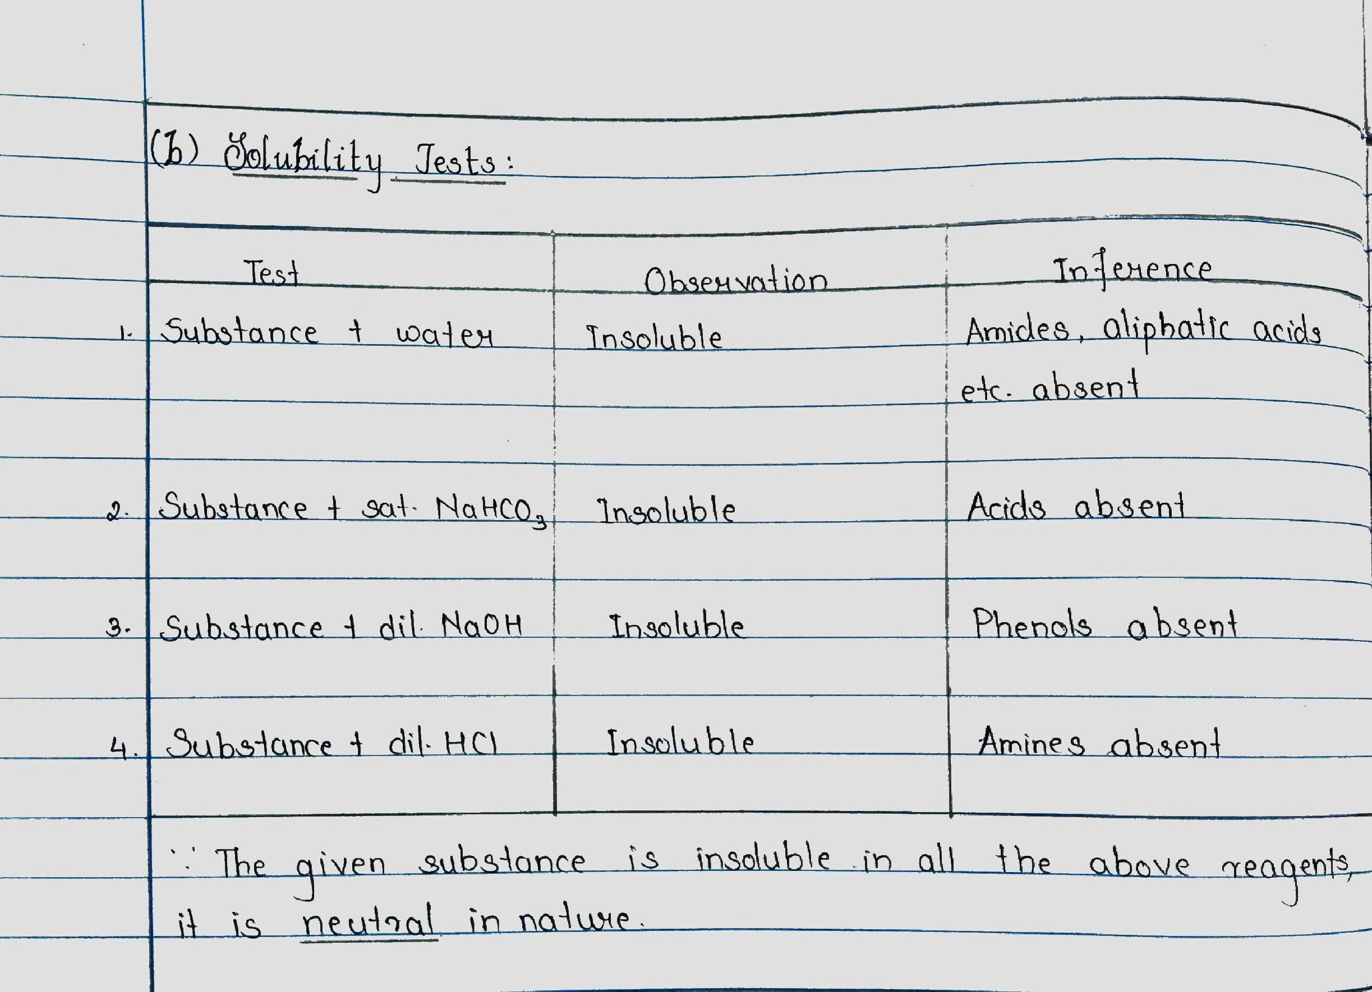
(b) Solubility Test

Slide 36
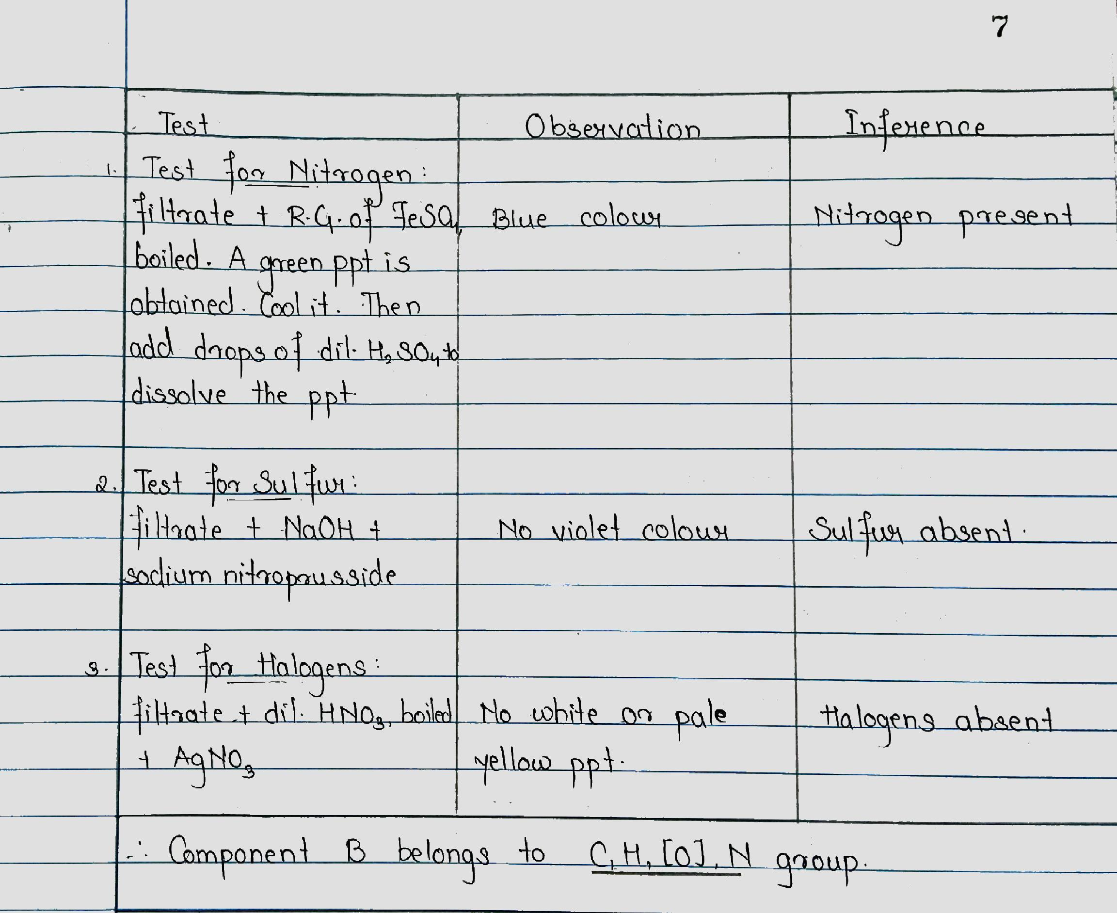
(c) Elemental Analysis
Notes:
CS - 18/09/2020 - 10:20 am to 111:00 am - elemental analysis discussed and explained. Determination of class of compound to be started. https://www.youtube.com/watch?v=FUo428guKt0

Slide 37
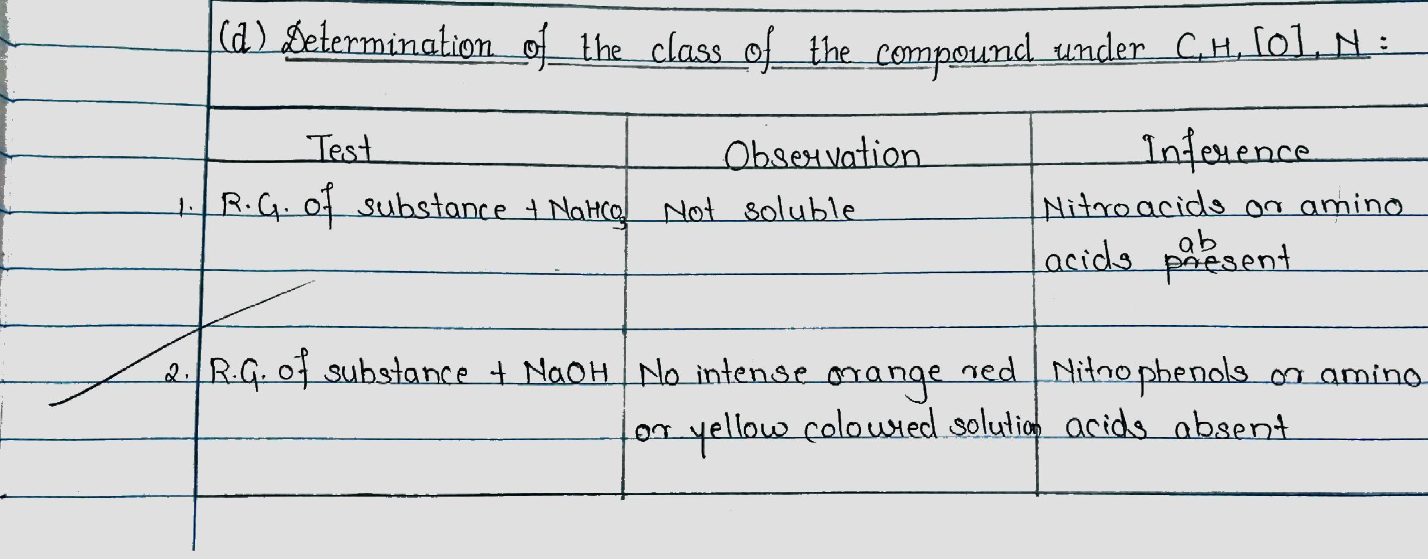
https://www.youtube.com/watch?v=FUo428guKt0
(d) Determination of the class of the
Compound under C,H,[O],N
Notes:
https://www.youtube.com/watch?v=FUo428guKt0 video on elemental analysis available. If possible show
https://www.youtube.com/watch?v=7vKQuWWgULw Nitrogen Compounds analysis video
https://www.youtube.com/watch?v=j5jgMUWri8U

Slide 38
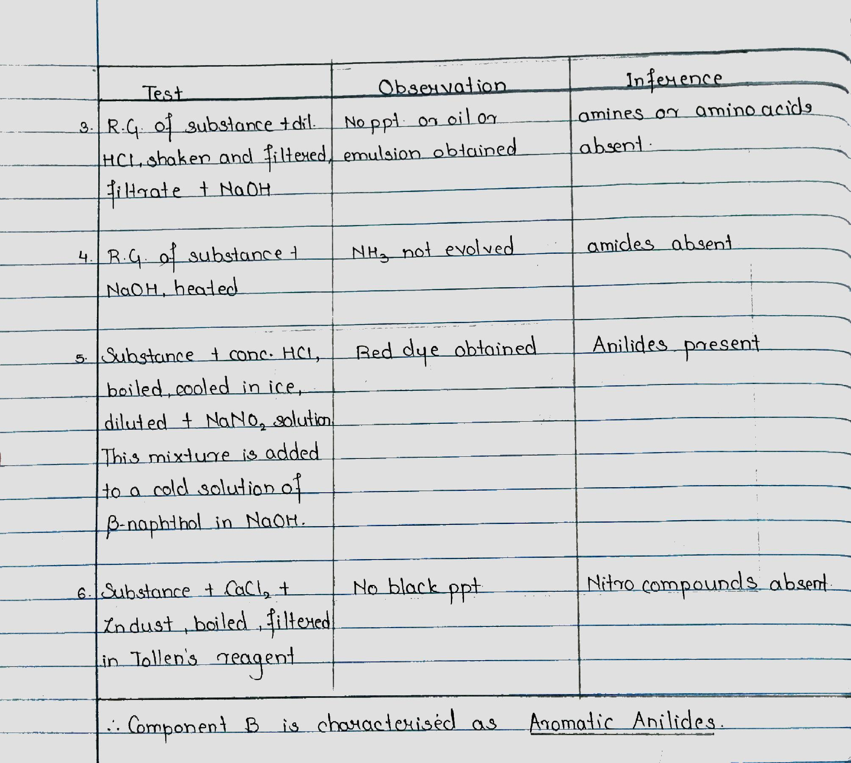
https://www.youtube.com/watch?v=7vKQuWWgULw

Slide 40
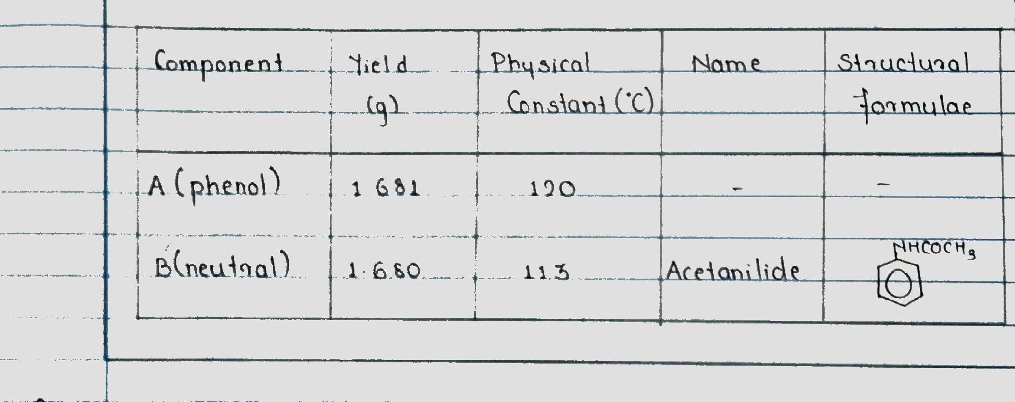
E] CONCLUSION
Notes:
Completed OM 2 with discussion 10.10 am Santosh Katariya.

Slide 41
INDEX OF ORGANIC MIXTURE in Rough Journal
6 Units - Organic Mixture
Sr. No | Experiment | Date | Page Number | Sign
1 | Acid (Benzoic Acid) + Neutral | 7 - 9 - 2020 | 51
2 | Phenol + Neutral (Acetanilide) | 14 - 9 - 2020 | ?
3 Units - Organic Mixture
Sr. No | Experiment | Date | Page Number | Sign
1 | Acid + Neutral | 7 - 9 - 2020 | 51
2 | Phenol + Neutral | 14 - 9 - 2020 | ?
Notes:
NOTE: 3 units students do not have characterisation. Since it was not possible to take separate instruction, so first two mixture concepts were given common to all. Inform 3 Units students that they do not write characterisation part in rough journal ..
MN: Discussion of Lassaigne’s Test done, Video Shown https://www.youtube.com/watch?v=FUo428guKt0 Mix no.1, Mix no. 2 writing summary and concepts was discussed, Next prac Class Rxn Video has to be shown.

Slide 42
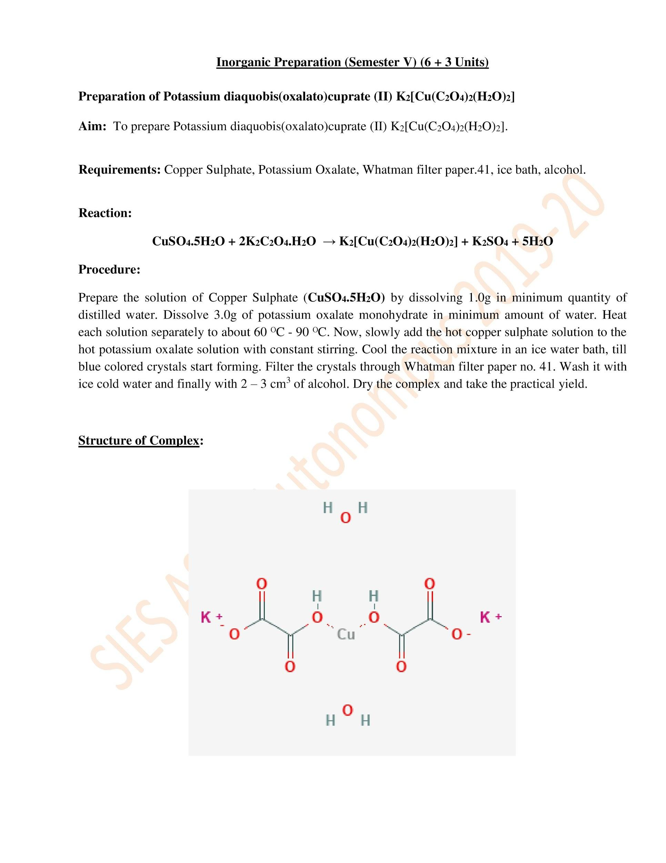
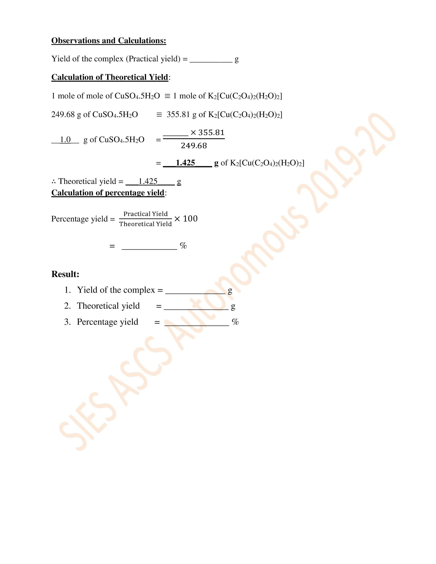

Slide 43
Inorganic Preparation - Potassium diaquo bis (oxalato) cuprate (II)
Prep.no.1
Linear Formula: K₂[Cu(C₂O₄)₂] • xH₂O
Formula: K₂[Cu(C₂O₄)₂(H₂O)₂]
Video link of the preparation
https://slideplayer.com/slide/3536469/
Notes:
Play video of Slide Player https://slideplayer.com/slide/3536469/ after discussing the procedure… Equipment Setup begins from 2.57 min on wards, pause their and explain the setup inbetween. 3.08min Safety Concerns are discussed. Play only till 4.20min. Ask students to note points from video and give inputs at the end.

Slide 44
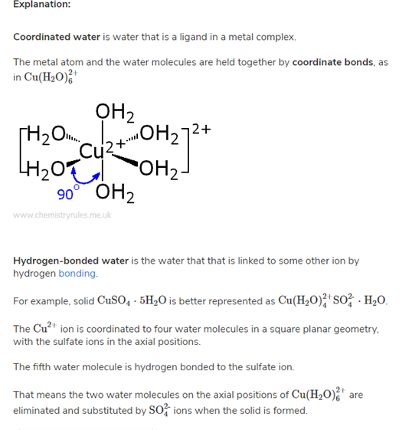
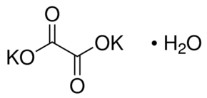
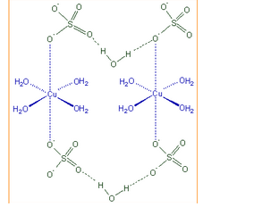
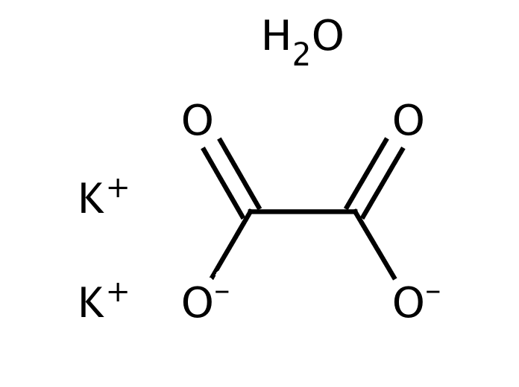
Structure of Reactants

Slide 45
Page

Slide 46
Page
Page
Notes:
Practical yield = 0.906g

Slide 47
INDEX OF INORGANIC PREPARATION in Rough Journal
6 + 3 Units - Inorganic Preparation
Sr. No | Experiment | Date | Page Number | Sign
1 | Potassium diaquobis(oxalato)cuprate(II), K₂[Cu(C₂O₄)₂(H₂O)₂] | 21 - 9 - 2020 | 14
Notes:
NOTE: 3 units students do not have characterisation. Since it was not possible to take separate instruction, so first two mixture concepts were given common to all. Inform 3 Units students that they do not have to write characterisation part in rough journal
NM: completed upto this
PR: Discussed the structure of the starting compounds and shown animations of characterization of functional groups

Slide 48
Elucidate the steps to determine the mixture, given that the type is: Mix no. 3
ACID + PHENOL

Slide 49
A] PRELIMINARY TESTS
TEST | OBSERVATION
Colour | Pale purple
Nature | Solid
Odour | Phenolic

Slide 50
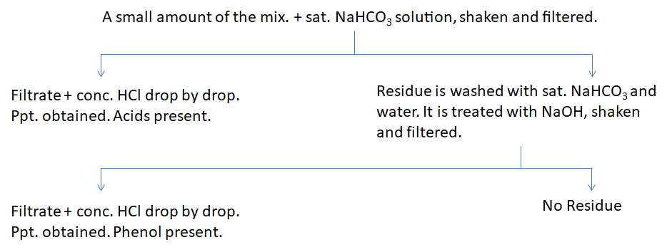
B] DETECTION OF THE TYPE OF THE MIXTURE
Therefore, the type of the mixture is Acid + Phenol.

Slide 51
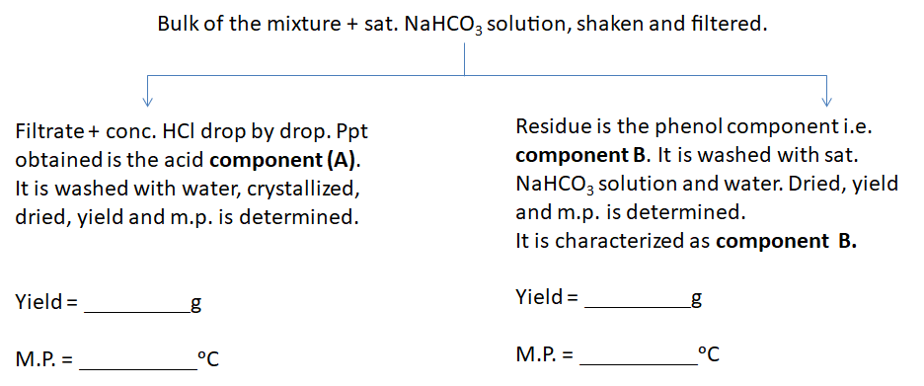
C] SEPARATION OF THE MIXTURE INTO ITS COMPONENTS

