Slide 1
Chemical Reaction Engineering II
CHE424 Note 6

Slide 2
Earliness of mixing, Segregation and RTD
The problems associated with the mixing of fluids during reaction is important for extremely fast reactions in homogeneous systems as well as for all heterogeneous systems.
This problem has two overlapping aspects: (i) the degree of segregation of the fluid, or whether mixing occurs on the microscopic level (mixing of individual molecules) or the macroscopic level (mixing of clumps, groups, or aggregates of molecules); (ii) the earliness of mixing, or whether fluid mixes early or late as it flows through the vessel.

Slide 3
These two concepts are intertwined with the concept of RTD, so it becomes rather difficult to understand their interaction. Refer to Note 1 for the reminder. We shall first treat systems in which a single fluid is reacting.
Self Mixing of a single fluid
The normally accepted state of a liquid or gas is that of a micro-fluid, and all our previous discussions on homogeneous reactions have been based on this
assumption. Now consider a single reacting macro-fluid being processed in turn in batch, plug flow, and mixed flow reactors and see how this state of aggregation can result in a behavior different from that of a micro-fluid

Slide 4
Batch reactor
Let the batch reactor be filled with a macrofluid containing reactant A. Since each aggregate or packet of macrofluid acts as its own little batch reactor, conversion is the same in all aggregates and is in fact identical to what would be obtained with a microfluid. Thus for batch operations the degree of segregation does not affect conversion or product distribution

Slide 5
Plug flow reactor
Since plug flow can be visualized as a flow of small batch reactors passing in succession through the vessel, .macro- and microfluids act the same way as a result the degree of segregation does not influence conversion or product distribution.
Mixed flow reactor microfliuid (CSTR)
When a microfluid containing reactant A is treated as in Fig. 1 (a), the reactant concentration everywhere drops to the low value prevailing in the reactor.

Slide 6
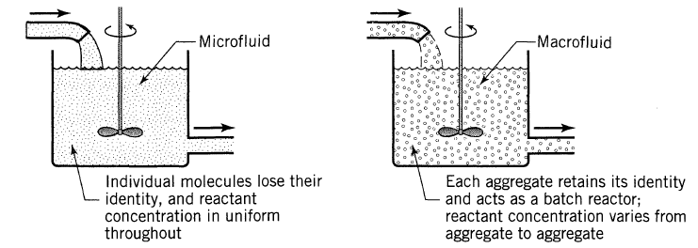
Figure 1: difference in behaviour of micro and macro fluids
No clump of molecules retain its high initial concentration of A. This is characterized by saying that each molecule loses it identity and has no determinable past history.

Slide 7
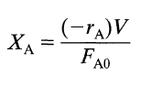
That is to say, by examining the molecule’s neighbour, we cannot tell whether the molecule is a newcommer or an old timer in the reactor.
For this system, the conversion of reactant is found by the usual methods for homogeneous reactions;
(1)

Slide 8
With constant density;
ɨ is the mean residence time of fluid in the reactor.
Mixed flow reactor – macro fluid
When a macrofluid enters a mixed flow reactor, the reactant concentration in an aggregate does not drop immediately to a low value but decreases in the same way as it would in a batch reactor. Thus a molecule does not lose its identity, its past history is not unknown and its age can be estimated by examining its neighbouring molecules.
(2)

Slide 9
The performance equation for a macro-fluid in a mixed flow reactor is given by;
Where
Replacing eqn.(4) in eqn.(3) gives;
(3)
(4)
(5)

Slide 10
This is the general equation for determining conversion of macro-fluids in mixed flow reactors. It can be solved once the kinetics of the reaction is given. Lets consider the various reaction orders:
Zero-order reaction in a batch reactor gives;
Inserting in eqn. (5) and integrating gives;
(6)

Slide 11
(7)
For a first-order reaction in a batch reactor;
Replacing into eqn. (5) we get;
On integration it gives the expression for conversion of a macro-fluid in a mixed flow reactor.
(8)
(9)
(10)

Slide 12
Equation (10) is identical to the one obtained for a microfluid (chp 5, eqn5.14a). Therefore we can conclude that the degree of segregation has no effect on conversion for first-order reactions.
Second-order reaction of a single reactant in a batch reactor
Replacing in eqn. (5) we get
(11)

Slide 13
(12)
Let α = 1/CA0kt and converting into reduced time units θ = t/t, it becomes;
This is the conversion equation for second-order reaction of a macro-fluid in mixed flow reactor. The integral represented by is called an exponential integral, it is a function of α alone. Its value is tabulated in literature in tables of integrals. Table 1 shows very brief set of values
(13)

Slide 14
Two of a family of Exponential Integrals

Slide 15
Eqn(13) may be compared with the corresponding expression for micro-fluid (5.14)
For an nth-order reaction the conversion in a batch reactor can be found by the methods of last semester’s lectures (Chp 3. Levenspiel). It is found to be;
Inserting this in eqn. (5) gives the nth-order reaction eqn for a macrofluid.
(14)
(15)

Slide 16
Difference in Performance: Early or Late Mixing, Macro- or Micr-ofluids, PFR or MFR
Figure 2 illustrates the differences in performance of macro-fluids and micro-fluids in mixed flow reactors. They clearly show that a rise in segregation improves reactor performance for reaction orders greater than unity but lowers performance for reaction orders smaller than unity. Table 2 was used for preparing this chart.
Earliness and lateness of mixing
Each flow pattern of fluid thru a vessel is associated with a clearly defined definite residence time distribution (RTD) or exit age function E

Slide 17
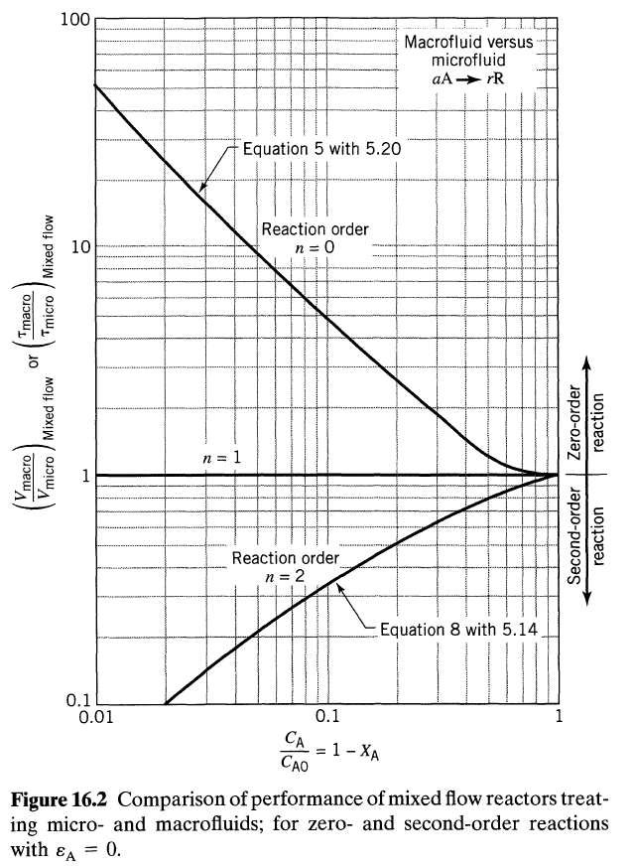

Slide 18
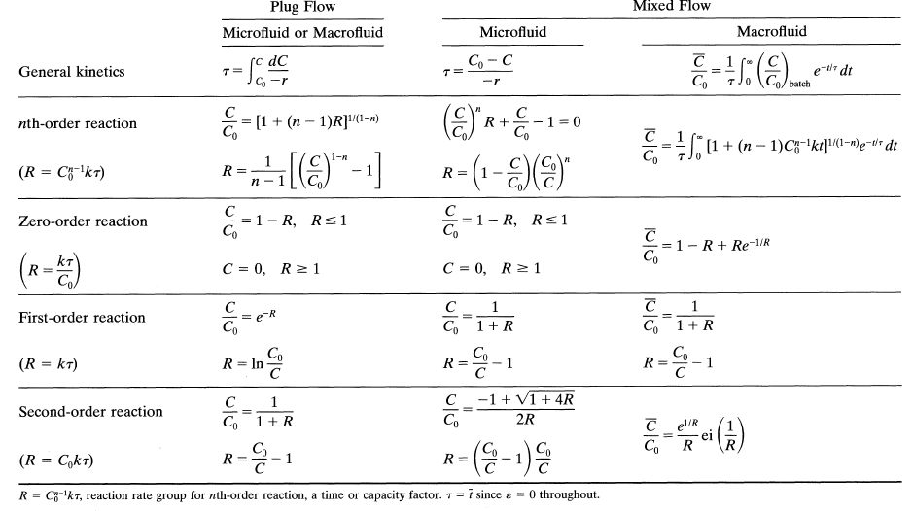
Table 2:Conversion eqns. for macro and micro-fluids with constant density

Slide 19
The converse is not true; each RTD does not define a specific flow pattern; but a number of flow patterns, some with earlier mixing others with later mixing these may be able to give the same RTD.
Idealized Pulse RTD
Reflection shows that the only pattern of flow consistent with this RTD is one with no intermixing of fluid of different ages, hence, that of plug flow. Consequently it is immaterial whether we have a micro- or macro-fluid.
In addition the question of early or late mixing of fluid is of no concern since there is no mixing of fluid of different ages.

Slide 20
Exponential decay RTD
The mixed flow reactor can give this RTD. Other flow patterns can also give this RTD, for example a set of parallel plug flow reactors of proper length, a plug flow reactor with side streams, or a combination of these. Figure 3 shows a number of these patterns. Patterns (a) and (b) fluid elements mix immediately with material of different ages while (c) and (d) this does not occur.

Slide 21
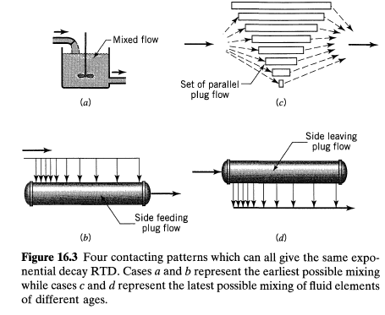
Figure 3: Four contacting patterns which can all give the same RTD
Therefore patterns (a) and (b) represent micro-fluid while patterns (c) and (d) macrofluids.

Slide 22
Summary of findings for a single fluid
1)- Factors affecting the performance of a reactor:
In general it may be written;
2)- Effect of kinetics or reaction or reaction order:
Segregation and earliness of mixing affect the conversion of reactants as follows:
For n < 1, the inequality is reversed and for n = 1, conversion is unaffected by these factors.
(16)

Slide 23
These results show that segregation and late mixing improves conversion for n > 1 and decreases conversion when n < 1.
3)- Effect of mixing factors for non-first-order reactions. Segregation plays no role in plug flow; however, it increasingly affects the reactor performance as the RTD shifts from plug to mixed flow.
4)- Effect of conversion level. At low conversion levels XA, is insensitive to RTD, earliness of mixing, and segregation. At intermediate conversion levels, the RTD begins to influence XA; earliness and segregation still have little effect. Finally, at high conversion levels all these factors may play important roles.
5)- Effect on product distribution. Although segregation and earliness of mixing can usually be ignored when treating single reactions, this is not so with multiple reactions.

Slide 24
Where the effect of these factors on product distribution can be of dominating importance, even at low conversion levels.
As an example consider free-radical polymerization. When an occasional free radical is formed here and there in the reactor it triggers an extremely rapid chain of reactions, often thousands of steps in a fraction of a second.
The local reaction rate and conversion can thus be very high. In this situation the immediate surroundings of the reacting and growing molecules-and hence the state of segregation of the fluid-can greatly affect the type of polymer formed.

Slide 25
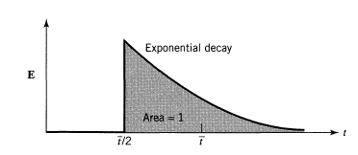
Example 1: Effect of segregation and earliness on conversion
A second-order reaction occurs in a reactor whose RTD is given in the figure. Calculate the conversion for the flow schemes shown in this figure. For simplicity, take C0 = 1; k = 1; τ = 1 for each unit.

Slide 26
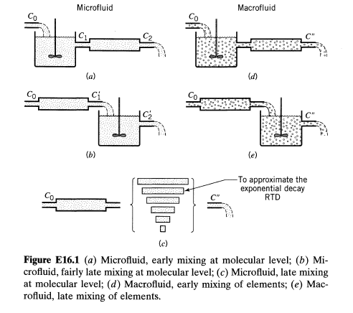

Slide 27
Scheme A: for fig.(a) for the mixed flow reactor we have:
Or
For the plug flow;
Or
Scheme B: for fig.(b) for the plug flow;
Or

Slide 28
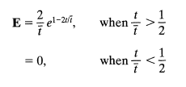
For mixed flow;
Or micro – fairly late;
Schemes C, D and E, from he Figures in (Note 2)or the E for two equal size plug-mixed flow reactor system is;
Therefore eqn. (4) becomes;
With the mean RTD in the 2 vessel system;
This becomes;
Replacing 1 + t by x, we get the exponential integral

Slide 29
From the Table of exponential integral given earlier, we find ei(2) = 0.04890 from which,
Micro late and macro late or early: C’’’ = 0.362
There are extensions for a single fluid which can be found in Levenspiel (1972) for partial segregation – intensity of segregation model; coalescence model, etc.

Slide 30
Life of an element of Fluid
Let us estimate how long a fluid element retains its identity. First, all large elements are broken into smaller elements by stretching or folding (laminar behavior) or by turbulence generated by baffles, stirrers, etc. Mixing theory estimates the time needed for this breakup.
Small elements lose their identity by the action of molecular diffusion, Einstein random walk analysis estimates this time as;
(17)

Slide 31
Thus an element of water 1 micron in size would loose its identity in a very short time;
While an element of viscous polymer 1.00 mm in size and 100 times as viscous as water would retain its identity for a long time;
(18a)
(18b)

Slide 32
In general, ordinary fluids behave as microfluids except for very viscous materials and for systems in which very fast reactions are taking place.
The concept of micro- and macrofluids is of particular importance in heterogeneous systems because one of the two phases of such systems usually approximates a macrofluid. For example, the solid phase of fluid-solid systems can be treated exactly as a macrofluid because each particle of solid is a distinct aggregate of molecules. For such systems, then, Eq. 3 with the appropriate kinetic expression is the starting point for design.

Slide 33
Mixing of two miscible fluids
The role of the mixing process when two completely miscible reactant fluids A and B are brought together. When two miscible fluids A and B are mixed, we normally assume that they first form a homogeneous mixture which then reacts. However, when the time required for A and B to become homogeneous is long with respect to the time for reaction to occur, the reaction takes place during the mixing process and the problem of mixing becomes important.
Such is the case for very fast reactions or with very viscous reacting fluids.

Slide 34
Imagine that we have A and B, each first as a micro-fluid, and then as a macro-fluid. In one beaker mix micro A with micro B and in another beaker mix macro A with macro B and let them react. Micro A and B behave in the expected manner, and reaction occurs. However, on mixing the macro-fluids no reaction takes place because molecules of A cannot contact molecules of B. These two situations are shown in Fig. 4.
Now a real system acts as shown in Fig. 5 with regions of A-rich fluid and regions of B-rich fluid.

Slide 35
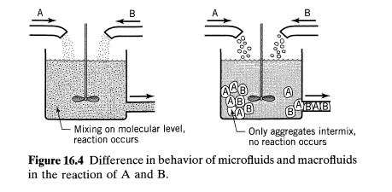
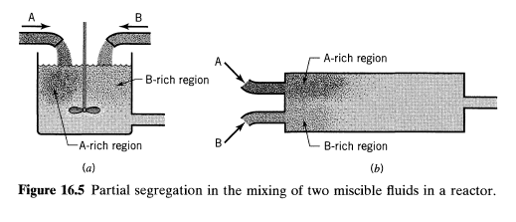

Slide 36
Though partial segregation requires an increase in reactor size, this is not the only consequence. For example, when reactants are viscous fluids, their mixing in a stirred tank or batch reactor often places layers or "streaks" of one fluid next to the other. As a result reaction occurs at different rates from point to point in the reactor giving a non-uniform product which may be commercially unacceptable.
Such is the case in polymerization reactions in which monomer must be intimately mixed with a catalyst. For reactions such as this, proper mixing is of primary importance and often the rate of reaction and product
uniformity correlate well with the mixing energy input to the fluid.

Slide 37
For fast reactions the increase in reactor size needed (because of segregation) is of secondary importance while other effects become important. For example if the product of reaction is a solid precipitate, the size of the precipitate particles may be influenced by the rate of intermixing of reactants, a fact that is well known from the analytical laboratory. Another example, hot gaseous reaction mixtures may contain appreciable quantities of a desirable compound because of favorable thermodynamic equilibrium at such temperatures. To reclaim this component the gas may have to be cooled.

Slide 38
But, as is often the case, a drop in temperature causes a shift in equilibrium with essentially complete disappearance of the desired material. To avoid this and to "freeze" the composition of hot gases, cooling must be very rapid. When the method of quenching used involves mixing the hot gases with an inert cold gas, the success of such a method depends on the rate at which segregation can be destroyed.
Finally the length, type, and temperature of a burning flame, the combustion products obtained, the noise levels of jet engines, and the physical properties of polymers as they are affected by the molecular weight distribution of the material are some of the many phenomena influenced by the rate & intimacy of mixing.

Slide 39
Product distribution in multiple Reactions
When multiple reactions take place on mixing two reactant fluids and when these reactions proceed to an appreciable extent before homogeneity is attained, segregation is important and can affect product distribution.
Consider the homogeneous-phase competitive consecutive reactions
(19)

Slide 40
occurring when A and B are poured into a batch reactor. If the reactions are slow enough so that the contents of the vessel are uniform before reaction takes place, the maximum amount of R formed is governed by the k2/k1 ratio. This situation is one in which we may assume micro-fluid behavior.
If, however, the fluids are very viscous or if the reactions are fast enough, they will occur in the narrow zones between regions of high A concentration and high B concentration. See figure 6.

Slide 41
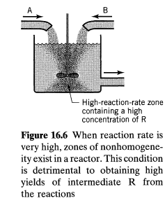
The zone of high reaction rate will contain a higher concentration of R than the surrounding fluid. But from the qualitative treatment of this reaction we know that any non-homogeneity in A and R will suppress formation of R. Thus partial segregation of reactants will suppress the formation of intermediate.

Slide 42
For increased reaction rate, the zone of reaction narrows, and in the limit, for an infinitely fast reaction, becomes a boundary surface between the A-rich and B-rich regions.
Now R will only be formed at this plane. Consider a single molecule of R formed at the reaction plane. If it starts its random wanderings (diffusion) into the A zone and never moves back into the B zone, it will not react further and will be saved. However, if it starts off into the B zone or if at any time during its wanderings it moves through the reaction plane into the B zone, it will be attacked by B to form S.

Slide 43
A man by the name Feller (1957) likened it to the probability of the betting game and showed that the odds in favor of a molecule of R never entering the B zone become smaller and smaller as the number of diffusion steps taken by a molecule gets larger and larger.
This finding holds, no matter what pattern of wanderings is chosen for the molecules of R. So we conclude that no R is formed. As seen in Chp 8, an infinitely fast reaction gives a maximum non-homogeneity of A and R in the mixture, resulting in no R being formed.
Figure 7 shows the concentration of materials at a typical reaction interface and illustrates these points.

Slide 44
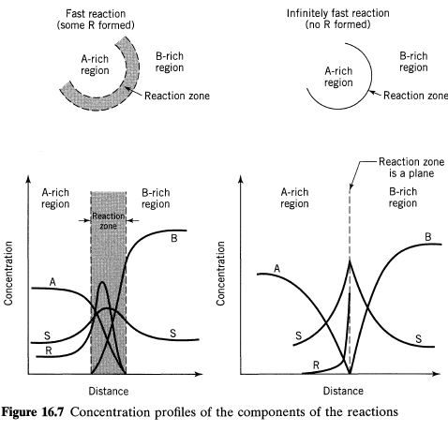
Figure 7: Concentration profiles of components

Slide 45
This behavior of multiple reaction has been used by Paul and Treybal(1971) Ottino (1989, 1994) discuss the whole problem of intermixing of fluids A and B in terms of stretching, folding, thinning, and finally diffusional mixing of fluid elements. Figure 8 tries to illustrate this mechanism.
These observations serve as a guide to the selection and design of equipment favoring the formation of intermediate when reaction is very fast. The important point is to achieve homogeneity in A and R throughout the reaction mixture
before reaction has proceeded to any significant extent. This is done by:
(a) making the reaction zone as large as possible by vigorous mixing.
(b) dispersing B in A as fine as possible, rather than A in B.
(c) slowing the reaction.

Slide 46
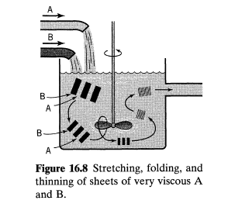
Figure 8: Stretching, Folding and thinning of sheets of very viscous A and B

