Slide 1
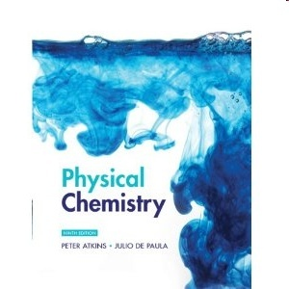
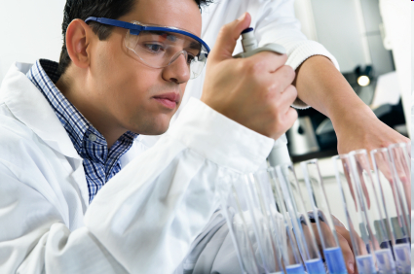

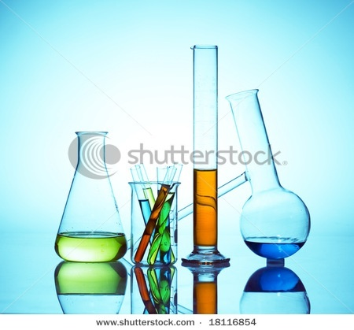
OXIDATION
M.Sc. Chemistry Sem.II
Dr. Suryawanshi V.S.
Assistant Professor,
Department of Chemistry,
S.C.S.College,Omerga.

Slide 2
Introduction:
Inorganic Concept:-
Loss of electron(s) and increase in oxidation number.
Example. Zn ⁽⁰⁾ Zn ⁺⁺ + 2e⁻
This is not easy to apply incase of Organic molecules.
Organic concept:-
Conversation of a functional group from one category to higher one.
Conversion of any compound to another in same category is not an
^{oxidation or reduction.}

Slide 3
Example:-
Most oxidations in organic chemistry involves
Gain of oxygen .Mg + O₂ MgO.
Ca+ O₂ 2CaO.
Loss of hydrogen
CH₃OH+Cr₂O₇²⁻ HCHO
or both can be happens.
Variety of oxidizing agents are,
KMnO₄ (in Acid, base and neutral Media---- Reactivity is different)
Hexavalent chromium,
Chromic acid (versatile),MnO₂
PCC,Selenyl halide
Ozone, oxygen with Pt.
Iodine,Iodic acid
Periodic acid
SeO₂,Lead tetra acetate
Peroxides and per acids
OsO₄
Chromyl chloride
Nitric acid, Thallium nitrate
Sulphuryl chloride
Nitrites ,Nitroceyl chloride
Bromine, copper sulphate
Sulphur,Selenium,DDQ
CH₄+ Br₂ CH₃Br + HBr
PhO ⁻ + Fe⁺³ PhO .
RCHO + [O] RCOOH
RCH₂OH RCHO + 2H

Slide 4
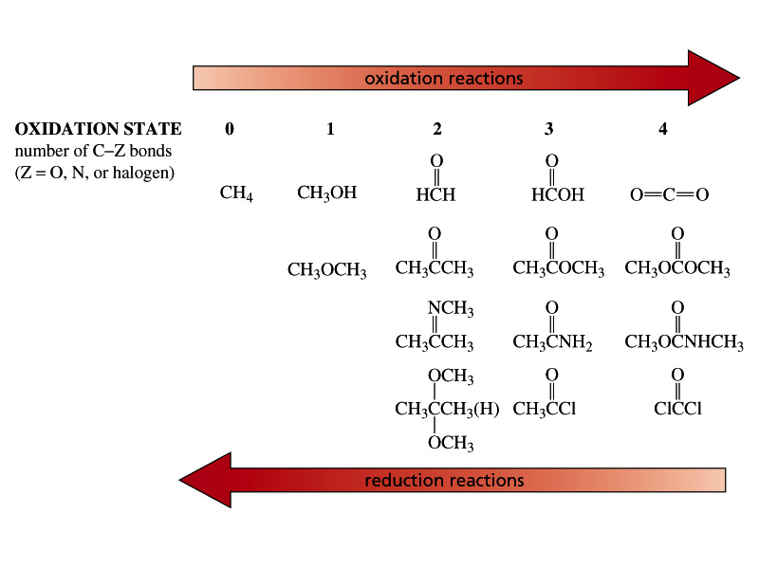
The oxidation state of a carbon atom equals the total number of its C–O, C–N, and C–X bonds

Slide 5
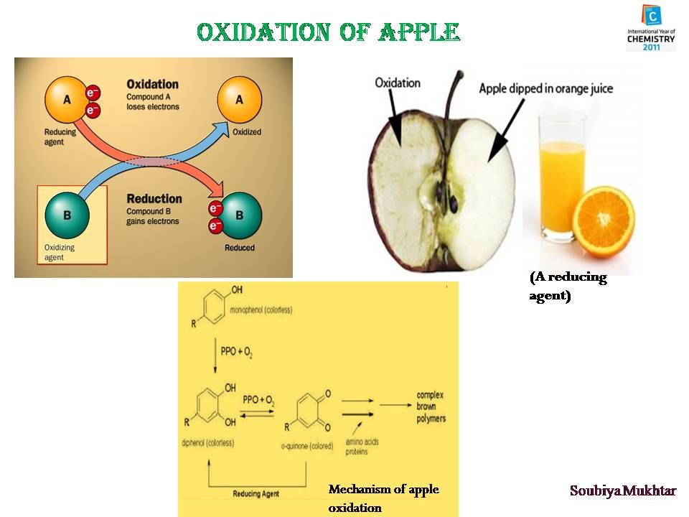
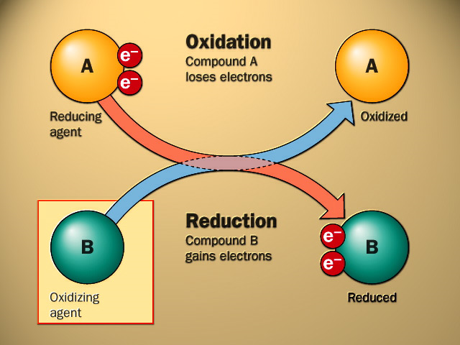

No oxidation without a concurrent reduction
Oxidation and reduction are complimentary in any system in which one species is oxidized ,another is reduced
Oxidation and reduction are complimentary in any system in which one species is oxidized ,another is reduced

Slide 6
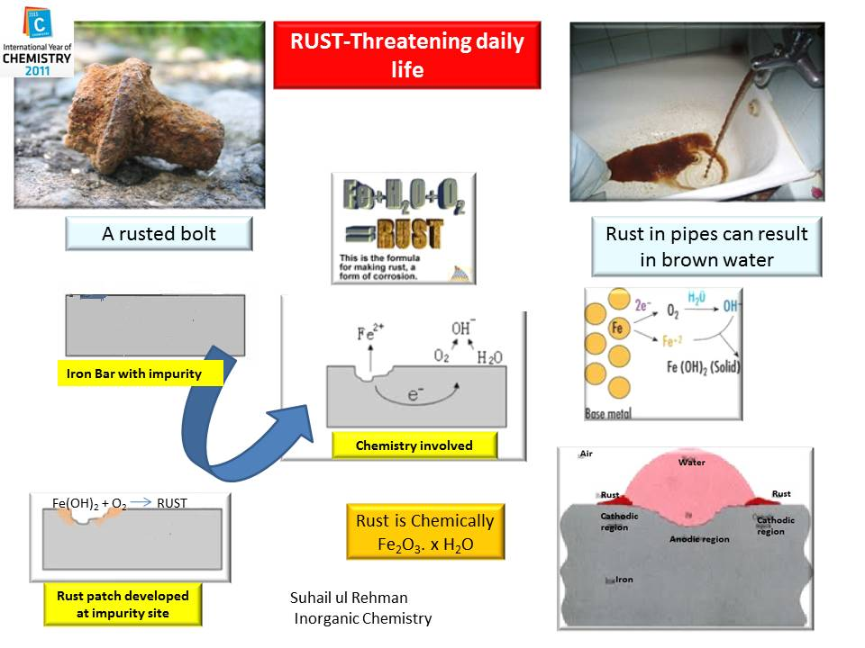

Slide 7
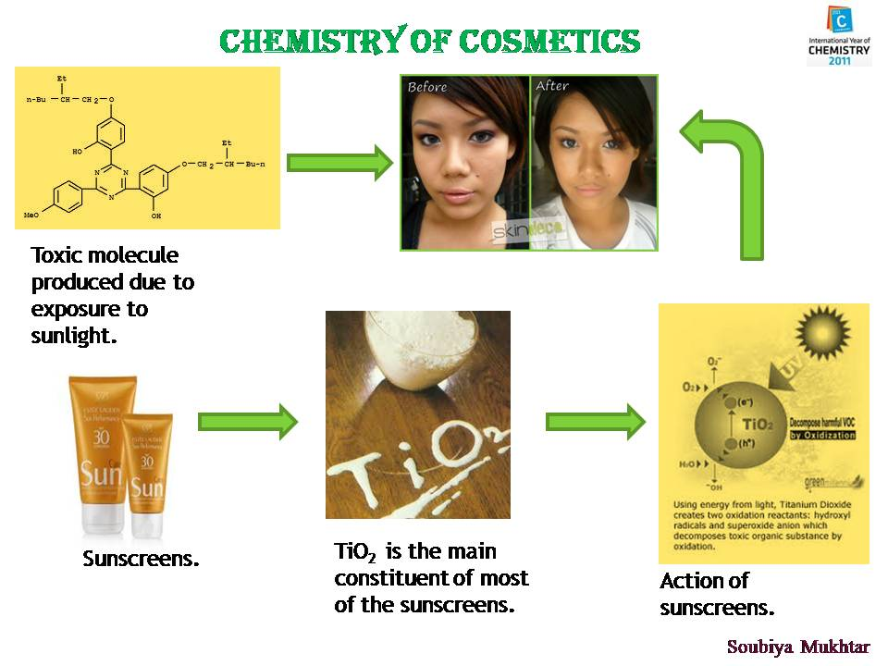

Slide 8
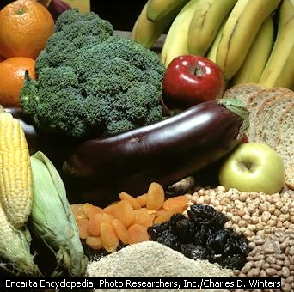
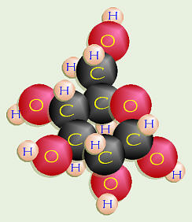
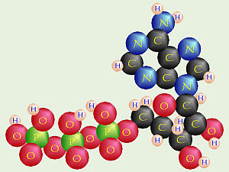
Cell respiration
C₆H₁₂O₆+6O₂ 6CO₂+6H₂O+ 30 ATP Energy.
Glucose (reductant) Oxygen Carbon dioxide water Energy=ATP
(Oxidant) (Adenosine Triphosphate)

Slide 9
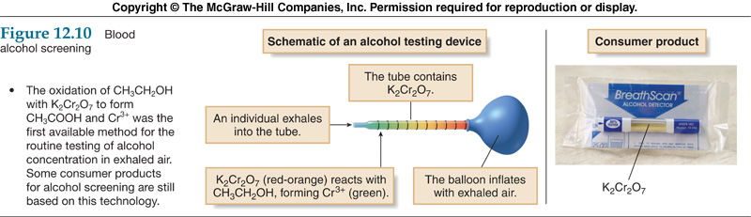
Blood alcohol screening
The higher the concentration of CH₃CH₂OH in the breath, the more Cr⁶⁺ is reduced, and the farther the green Cr³⁺ color extends down the length of the sample tube.
The extent of the green color is then correlated with blood alcohol levels.
The higher the concentration of CH₃CH₂OH in the breath, the more Cr⁶⁺ is reduced, and the farther the green Cr³⁺ color extends down the length of the sample tube.
The extent of the green color is then correlated with blood alcohol levels.

Slide 10
Oxidation of Alkanes:-
1) Under vigorous conditions.
2) KMno₄ and chromic acid are used but mixture of product obtained in low yield.
Amount of acetic acid can be titrated with std. NaOH solution.
So this is a quantitative method for determination of amount of acid hence structure elucidation can be possible.
H₂O
Alkane + CrO₃(Acid) CH₃COOH

Slide 11
Oxidation of alkenes:-
General oxidizing agents are,
A) Oxidation with selenium dioxide:-
Oxidation of allylic C-H (R-CH=CH-CH₂-R) to produce allylic alcohol.
Order of reactivity, -CH₂ > -CH₃ > -CH ( Allylic Hydrogen)
1) Selenium dioxide 2) Per acids 3)Osmium tetraoxide
4) KMnO₄ 5)Iodine-silver acetate 6)Ozone
7) Sodium periodate 8) Bromine

Slide 12
Reaction and its mechanism:-

Slide 13
B) Epoxidation:-
Epoxidation results in a cyclic ether with an oxygen atom by using peracid (RCOOOH).
Preparation:- Carboxylic acid + H₂O₂ Peroxyacid or Peracid.
2) Stereochemistry of addition is syn.
3) Epoxidation is stereo specific because cis and trans alkenes yield different stereoisomer's as products.
Rate of reaction enhances by substituting electron donating group on alkene.
5) Rate of reaction enhances by substituting electron withdrawing group on per acid.

Slide 14
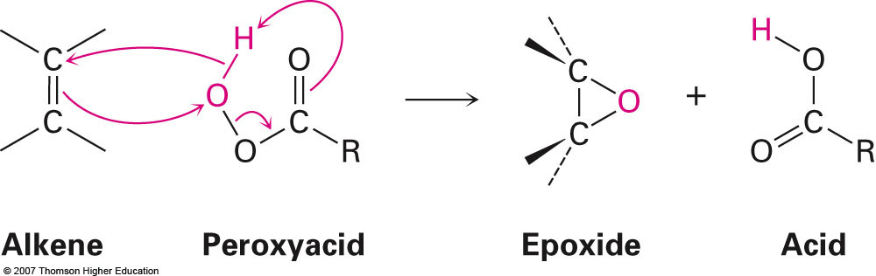
It is regioselective reaction
For most electron rich double bond when more than one double bond is present.
It is stereo specific reaction.
Reaction Mechanism:-

Slide 15
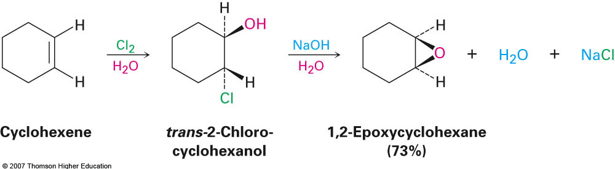
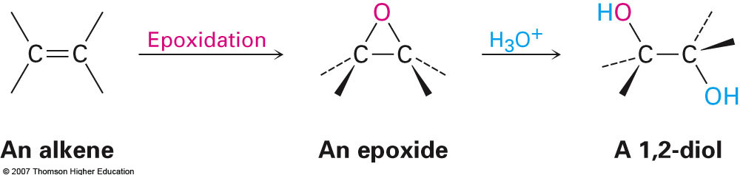
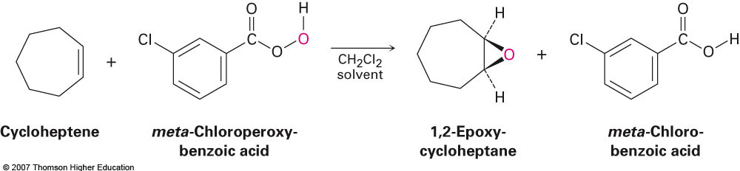
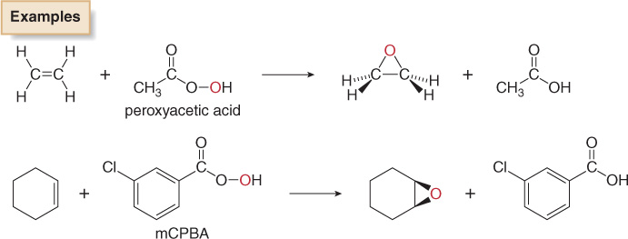

Slide 16
3) Oxidation by using Osmium tetraoxide:-
1) First step is rapid precipitation of cyclic osmate ester.
2) Finally on hydrolysis gives 1,2 diol.
3) Syn addition takes place.
4) This is a stereospecific reaction.
5) It reacts with most electron rich double bond so reaction is regioselective.
6) It attacks rigid cyclic system from less hindered side yields more stable cis diols.

Slide 17
Mechanism
Chromatic ester
Notice the
transfer of
2e⁻ onto Os
= REDUCTION
OXIDIZED
Both of the hydroxyl
oxygens in the glycol
come from OsO₄
REDUCED

Slide 18
SYN ADDITION GIVES CIS GLYCOLS
C
H
3
C
H
H
3
H
O
2
O
H
O
s
O
N
a
H
S
4
O
3
H
O
H
cis
C
H
3
C
H
3
H
C
H
C
H
O
C
H
syn
conformation
C
H
2
3
3
C
H
O
H
O
C
s
O
N
a
H
S
4
O
3
H
O
H
cis -2-butene
meso
remember: addition is syn
result is cis

Slide 19
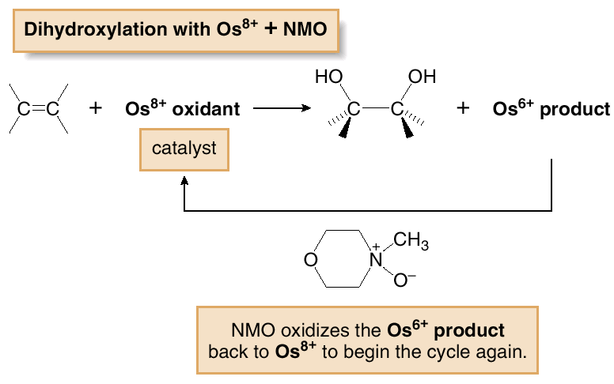
Dihydroxylation can also be carried out by using a catalytic amount of OsO₄, if the oxidant N-methylmorpholine N-oxide (NMO) is also added.
In the catalytic process, dihydroxylation of the double bond converts the Os⁸⁺ oxidant into an Os⁶⁺ product, which is then re-oxidized by NMO to Os⁸⁺.

Slide 20





Learning Check:
What is the major product of the following reaction?
1.
2.
5.
3.
4.

Slide 21
4) Oxidation by using KMnO₄:-
Generally aq.KMnO₄ is used with co-solvent usually t-butanol or acetic acid.
To prevent further oxidation alkaline medium is used ie to avoid formation of alpha hydroxy ketone.
Less satisfactory results than OsO₄. but cheaper and less hazardous.
Mechanism:-

Slide 22
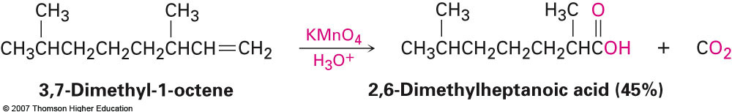
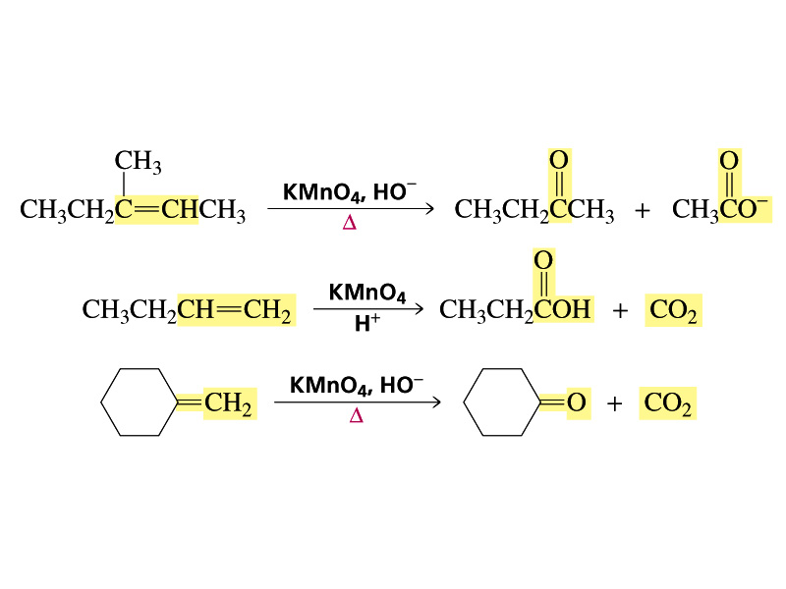
Potassium permanganate (KMnO₄) can produce carboxylic acids and carbon dioxide if H’s are present on C=C
A peroxyacid, OsO₄, and (cold basic) KMnO₄ break only the pi bond of the alkene
Ozone and acidic KMnO₄ break both the pi bond and the sigma bond

Slide 23





Learning Check:
Which alkene would produce two identical ketones when reacted with KMnO₄/H⁺?
1.
2.
3.
4.
5.

Slide 24
Learning Check:
Which reaction sequence on an alkene will accomplish the same end result as treating the alkene with O₃ followed by Zn/AcOH?
RCO₃H followed by KMnO₄/H₃O⁺
BH₃/THF followed by OsO₄ followed by NaHSO₃/H₂O
OsO₄/NMO followed by HIO₄
Hg(OAc)₂/H₂O/THF followed by NaBH₄ followed by KOH
Br₂/H₂O followed by KOH, followed by H₃O+

Slide 25
5) Woodward Hydroxylation:-
Iodine-Silver acetate in wet condition.
Alkene cis - diol.
Reaction mechanism:-

Slide 26
6) Prevost hydroxylation:-
Iodine-silver acetate in dry condition.
Alkene Trans – 1,2 diol.
Stereo selective reaction which produces syn or anti diol depends on geometry of olefins.
Reaction mechanism:-

Slide 27
7) Ozonolysis:-
Ozone reacts as an electrophile with alkene to form different products depends on structure of alkene.
2) Ozonids are dangerously explosive.
Isolable ozonide on solvolysis gives ketones and acids depends on structure of the alkene.

Slide 28
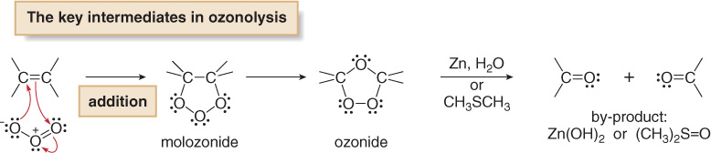
Addition of O₃ to the π bond of an alkene forms an unstable intermediate called a molozonide, which rearranges to an ozonide in a stepwise process.
The unstable ozonide is reduced to afford carbonyl compounds. Zn (in H₂O) or dimethylsulfide (CH₃SCH₃) are two common reagents used to convert the ozonide into carbonyl compounds.

Slide 29
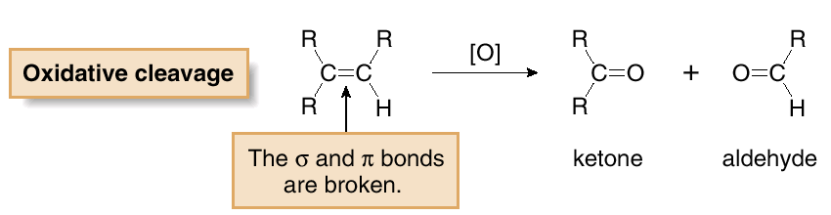
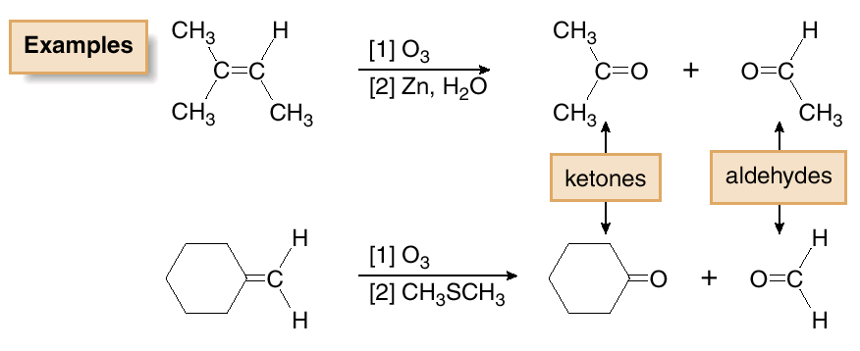
Oxidative cleavage of an alkene breaks both the σ and π bonds of the double bond to form two carbonyl compounds. Cleavage with ozone (O₃) is called ozonolysis.

Slide 30
WORKUP PROCEDURES FOR OZONOLYSIS
Two types of workup (decomposition of the ozonide)
are possible :
1. OXIDATIVE
Hydrogen peroxide is present
Aldehydes are oxidized to carboxylic acids.
Formaldehyde is oxidized to carbon dioxide,
which is lost as a gas.
2. REDUCTIVE
METHOD A
Add Zn and H₂O or H₃O⁺
METHOD B
Reduce the ozonide with Pd / H₂ ,
and then add acid ( H₃O⁺ ).
Aldehydes survive intact and are not oxidized with reductive
conditions.

Slide 31
EXAMPLES
O₃
Zn / H₂O
REDUCTIVE
WORKUP
OR
O₃
1) Pd/H₂
O₃
2) H₃O⁺
2) H₂O₂ H₃O⁺
+ H₂O
OXIDATIVE
WORKUP

Slide 32
AT ONE TIME OZONOLYSIS WAS WIDELY USED
FOR STRUCTURE PROOF BY DEGRADATION
Broken apart ( or degraded ) to
simpler pieces that are easier to
identify.
Unknown
compound
“At one time” =
before spectroscopy.
The original structure can be
deduced by reassembling the
pieces.

Slide 33
PROBLEM TO SOLVE
1) O₃ / CH₂Cl₂
C₇H₁₂
2) H₃O⁺
Pd / H₂
C₇H₁₄
answer

Slide 34
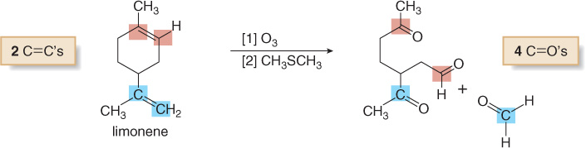
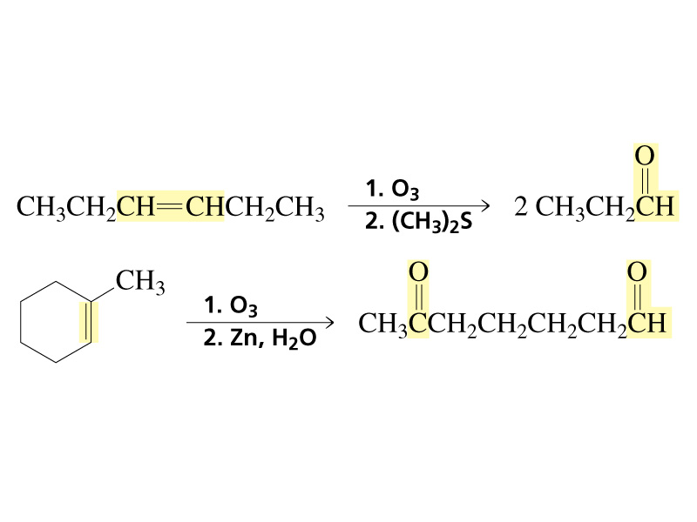
Ozonolysis of dienes or other polyenes results in oxidative cleavage of all C=C bonds.
It is important to note that when oxidative cleavage involves a double bond that is part of a ring, the ring opens up affording a single chain with two carbonyls at the carbons where the double bonds were originally.
Examples:-

Slide 35
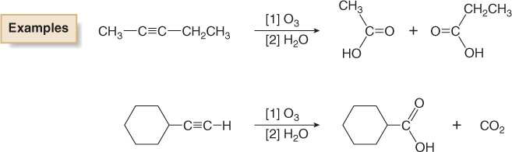
Oxidative Cleavage of Alkynes:-
Alkynes undergo oxidative cleavage of the σ and both π bonds.
Internal alkynes are oxidized to carboxylic acids (RCOOH).
Terminal alkynes afford carboxylic acid and CO₂ from the sp hybridized C—H bond.
1) O₃, CH₂Cl₂
2) H₃O⁺
KMnO₄ or
Oxidation of acetylenes, whether by KMnO₄ or ozone, normally yields carboxylic acids.

Slide 36
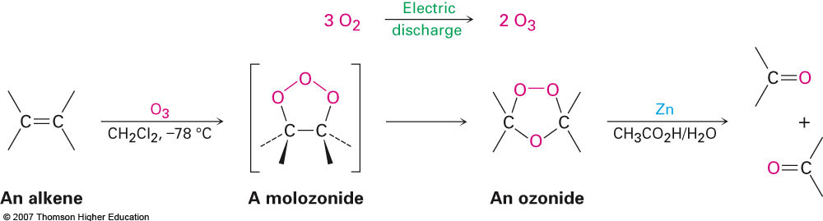
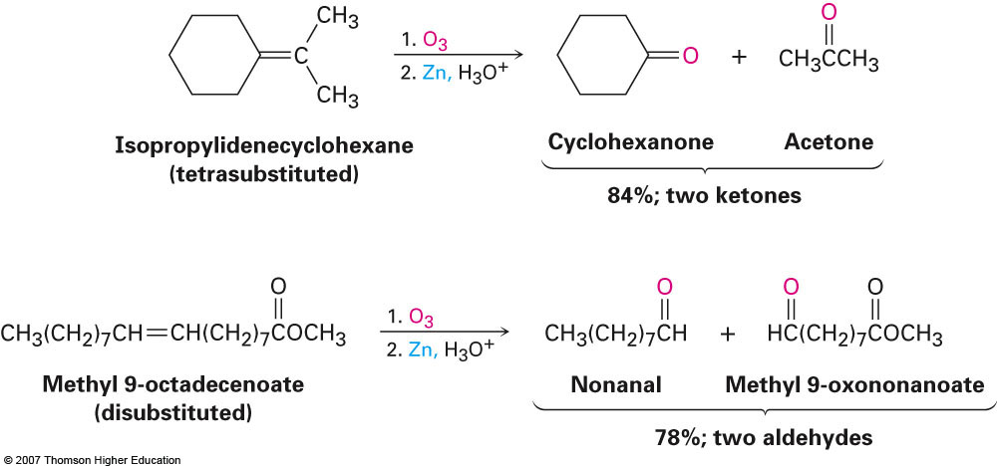

Slide 37





Learning Check:
Compound X reacts with O₃ (followed by Zn/AcOH) to give I and II.
Which of the following could be X?
1.
2.
3.
4.
5.

Slide 38
WHAT WAS THE ORIGINAL STRUCTURE ?
H₂O₂
oxidative
workup

Slide 39
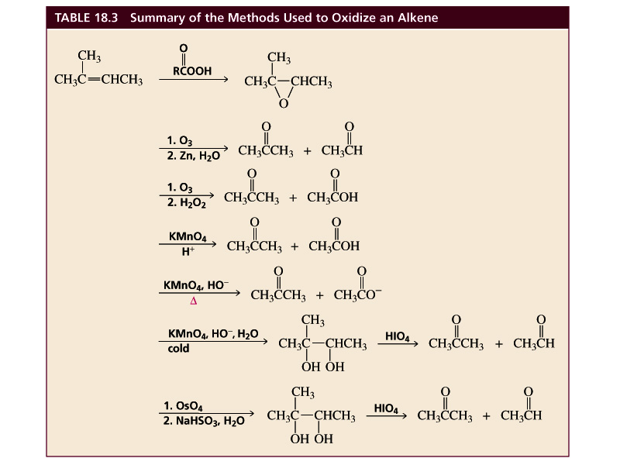
Table 20.1 Summary of the Methods Used to Oxidize an Alkene

Slide 40
8) Lemieux reagent:-
As O₃ is unpleasant to handle & not selective for alkenes so this reagent is used .
It contents dil.solution of sodium periodate with catalytic amount of KMnO₄ and OsO₄.
3) First step involves formation of cis diol further cleaved by periodate gives aldehydes and ketones. Further KMnO₄ then oxidizes aldehyde to carboxylic acid.

Slide 41
9) Oxidation of alkenes by chromium (VI)oxide:-
1) Chromic acid in acetic acid favors allylic oxidation of alkenes .
2) This will be favorable if phenyl substituent is present, due to stabilization of carbocation.

Slide 42
Oxidation of aromatic rings:-
Oxidation by Chromic acid and KMnO_{4.}
In absence of activating group –OH,-NH₂ aromatic rings oxidizes slowly.
With chromium (VI) oxide in acetic anhydride/ H₂SO₄ _{Etard reaction}
Same can be possible by using a soln. of chromyl chloride in CS₂ or CCl₄

Slide 43
Oxidation with ozone
Oxidation with V2O5
It is industrial method, Cheaper then Ozonolysis.
From this method we gets maleic anhydride and phthalic anhydride in cheaper way.
Phthalic anhydride is useful for synthesis for cellulose acetate and polyvinyl chloride, polyester resin etc…

Slide 44
Oxidation with CrO3/Chromium (VI) oxide.
Oxidation with Fe⁺³ and K₃Fe(CN)₆.

Slide 45
Oxidation with Na₂Cr₂O₇.
Aromatic amines are sensitive to oxidation and discolor in air. Products are complex.
Sodium sulphate is used as dehydrating agent since quinone is rapidly attacked by water.

Slide 46
Oxidation of Primary Alcohol to Aldehyde
Subtraction: Remove -H from alcohol group
Remove -H from alcohol carbon

Slide 47
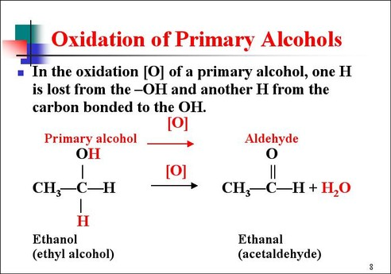
Reactions of Alcohols

Slide 48
Oxidation of Secondary Alcohol to Ketone
Subtraction: Remove -H from alcohol group
Remove -H from alcohol carbon

Slide 49
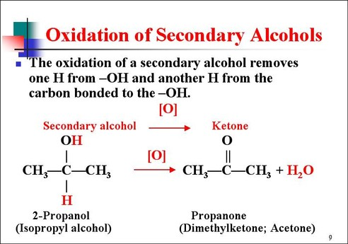
Reactions of Alcohols

Slide 50
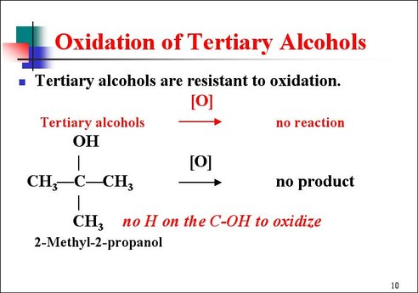
Reactions of Alcohols

Slide 51
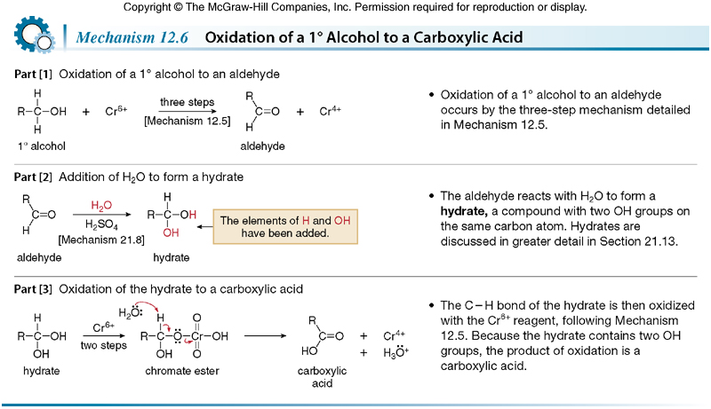

Slide 52
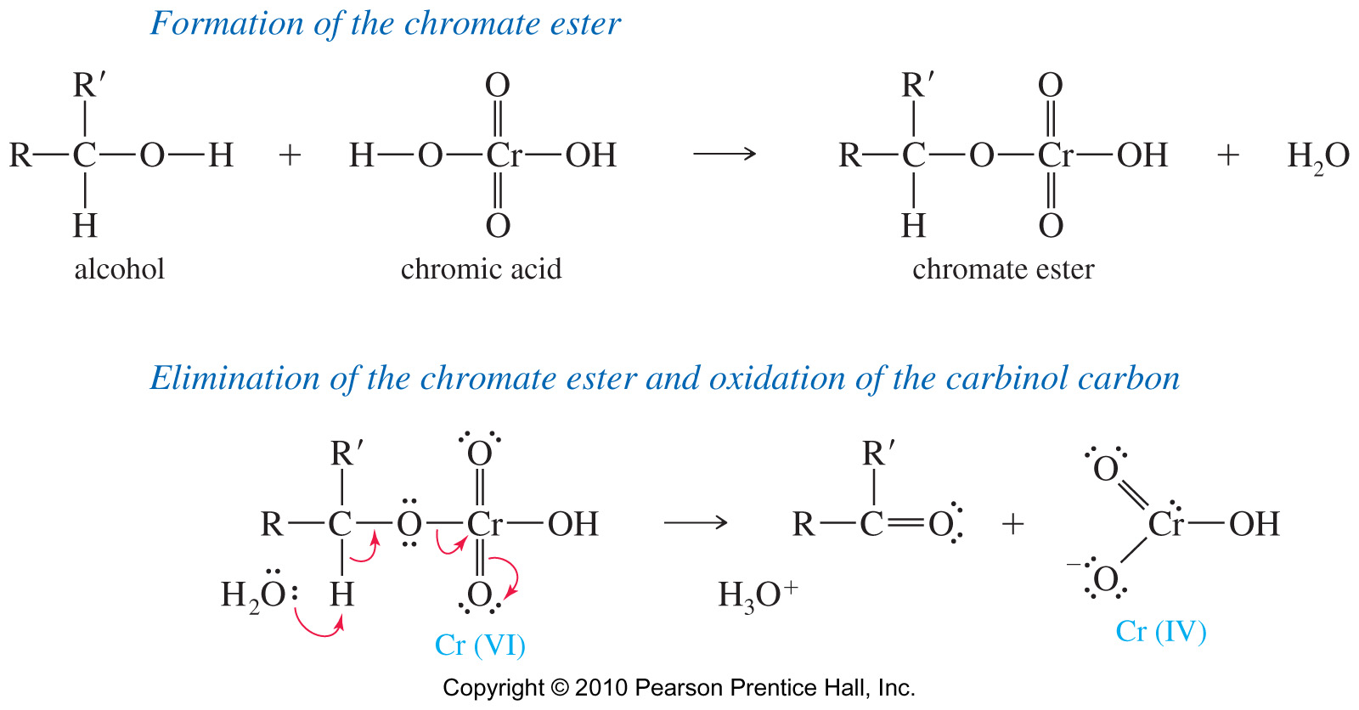
Oxidation Mechanism

Slide 53
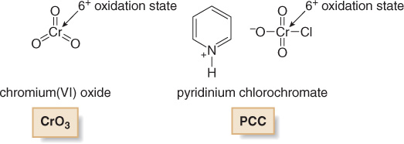
Recall that the oxidation of alcohols to carbonyl compounds is typically carried out with Cr⁶⁺ oxidants, which are reduced to Cr³⁺ products.
CrO₃, Na₂Cr₂O₇, and K₂Cr₂O₇ are strong, nonselective oxidants used in aqueous acid (H₂SO₄ + H₂O).
PCC is soluble in CH₂Cl₂ (dichloromethane) and can be used without strong acid present, making it a more selective, milder oxidant.

Slide 54
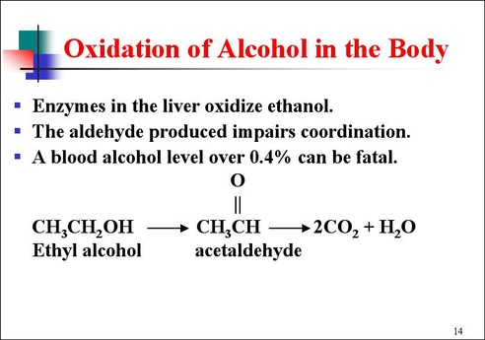
Reactions of Alcohols

Slide 55
Oxidation of Aldehyde to Acid
Add oxygen from oxidizing agent
Insert O between H of carbon double oxygen

Slide 56
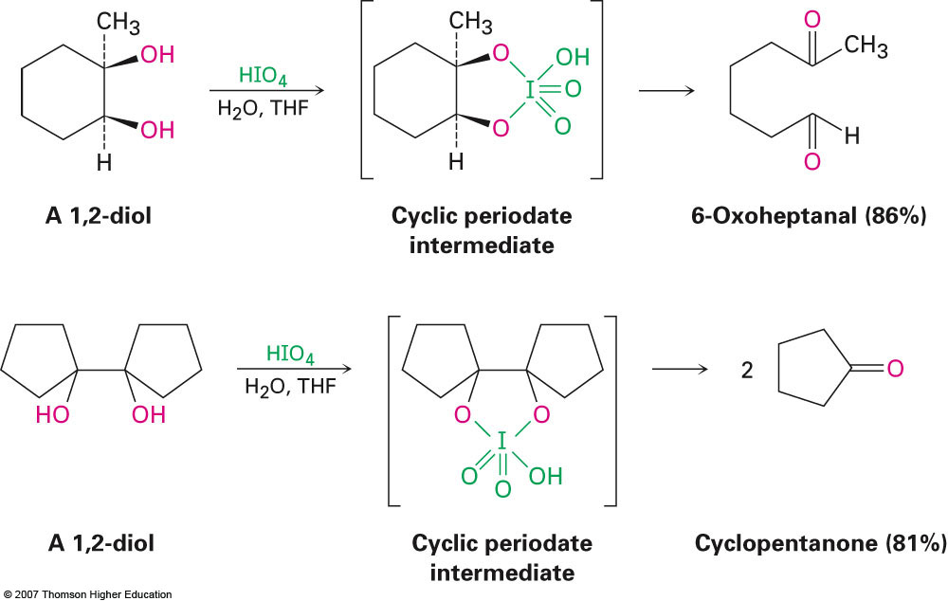
Oxidation of 1,2-diols
Reaction of a 1,2-diol with periodic (per-iodic) acid, HIO₄ , cleaves the diol into two carbonyl compounds
Sequence of diol formation with OsO₄ followed by diol cleavage is a good alternative to ozonolysis

Slide 57


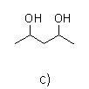

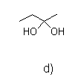
Learning Check:
Which of the following will react with periodic acid (HIO₄) to give an aldehyde?
1.
2.
3.
5.
4.

