Slide 1
Aromatic Nucleophilic Substitution
Dr.Suryawanshi V.S.
Associate Prof.of Chemistry
S C S College, Omerga

Slide 2
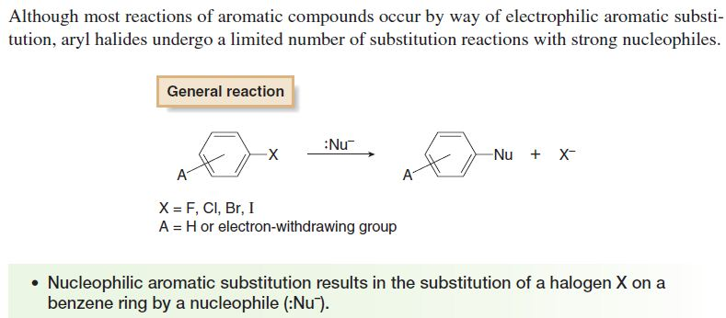

Slide 3
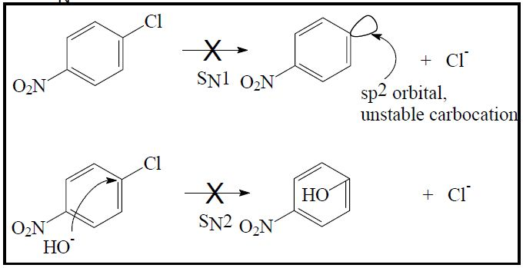
These reactions cannot occur by an SN1 or SN2 mechanism since…
SN1 reaction leads to unstable phenyl carbocation while SN2 reaction requires backside attack: bad geometry!

Slide 4
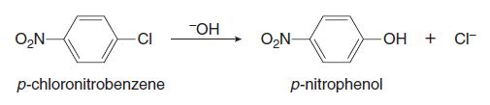
However, SN Ar, SN1 and Benzyne mechanism has been proposed to
explain aromatic nucleophilic substitution reaction.
A. Nucleophilic Aromatic Substitution by Addition–Elimination (SN Ar):
Aryl halides with strong electron-withdrawing groups (such as NO₂ , Carbonyl gr., -CN etc) on the ortho or para positions react with nucleophiles to give
substitution products.
For example:
Nucleophilic aromatic substitution occurs with a variety of strong nucleophiles,
including –OH,–OR, –NH2, –SR, and in some cases, neutral nucleophiles such as
NH3 and RNH2.

Slide 5
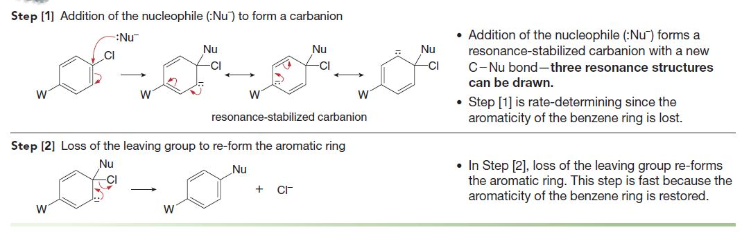
Nucleophilic Aromatic Substitution by Addition–Elimination Mechanism
It is a two step mechanism:

Slide 6
In nucleophilic aromatic substitution, the following trends in reactivity
are observed. (Evidences for above mechanism)
1) Increasing the number of electron-withdrawing groups increases the reactivity of the aryl halide. Electron-withdrawing groups stabilize the intermediate carbanion, and by the Hammond postulate, lower the energy of the transition state that forms it.

Slide 7
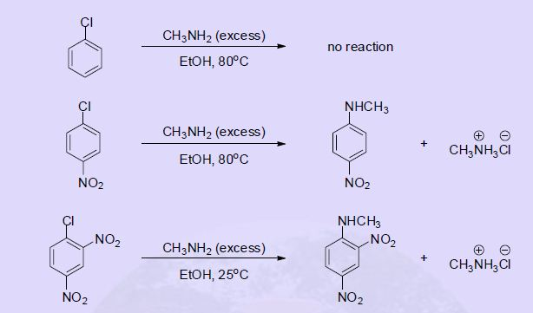
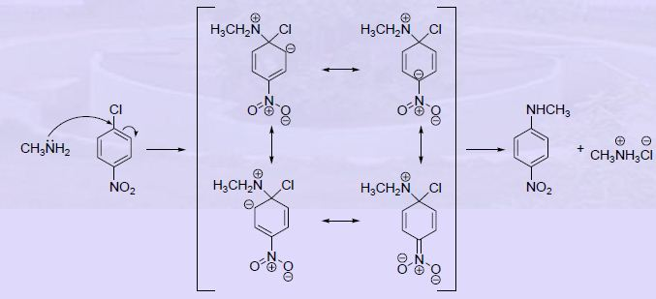

Slide 8
2) Increasing the electronegativity of the halogen increases the reactivity of the aryl
halide. A more electronegative halogen stabilizes the intermediate carbanion by an
inductive effect, making aryl fluorides (ArF) much more reactive than other aryl halides, which contain less electronegative halogens.
Rate: X= F ˃ Cl ˃ Br ˃ I

Slide 9
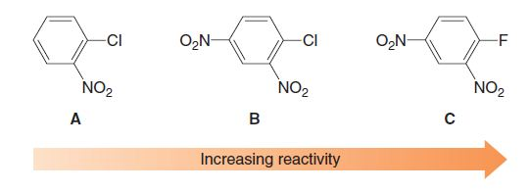
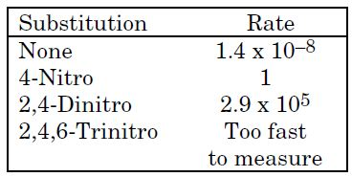
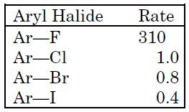
Relative rates of reactions of halobenzenes with sodium methoxide in methanol at 50oC.

Slide 10
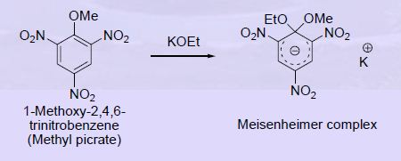
Isolation of intermediate carbanion gave a strong evidence for above mechanism.

Slide 11
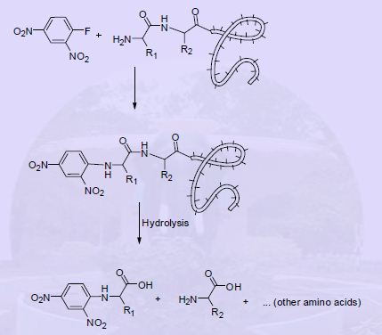
Sanger’s Method of N-terminal Amino acid determination in proteins:
This method was introduced in 1945 and used in the structural elucidation of insulin,
reported in 1955. Sanger was awarded Nobel prize for chemistry in 1958 for those
contributions.

Slide 12
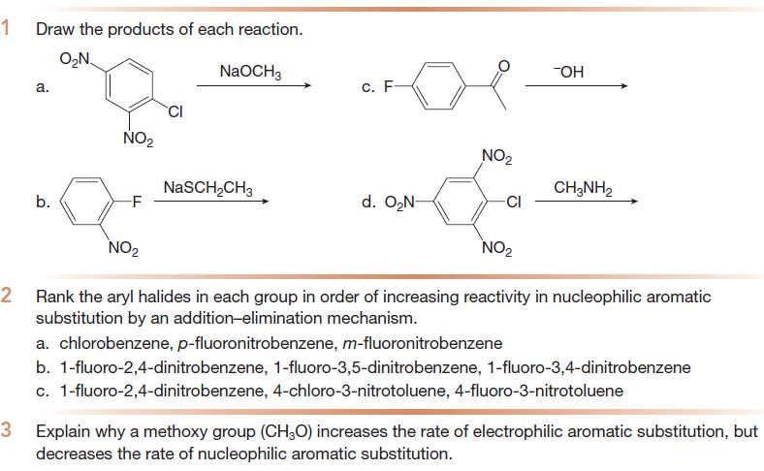
Examples

Slide 13
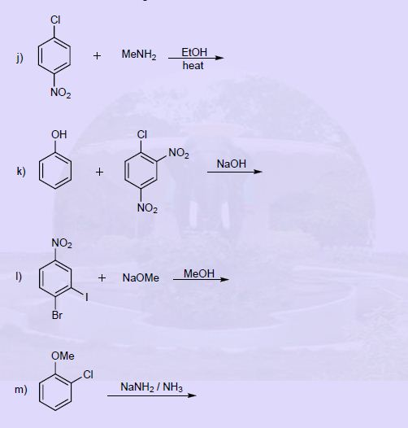
Examples

Slide 14
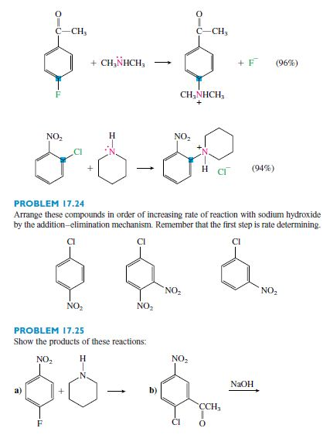
Examples

Slide 15
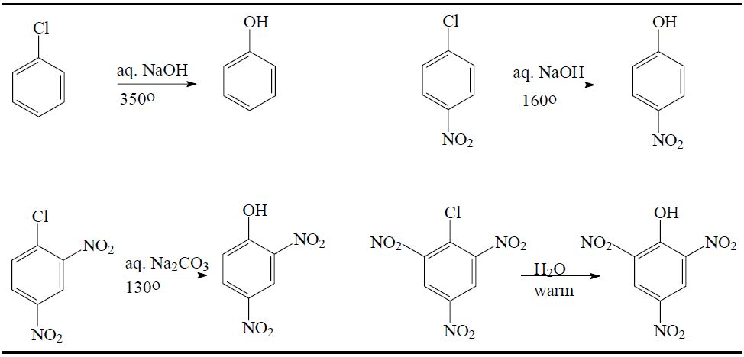
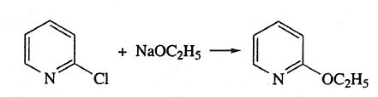
Examples

Slide 16

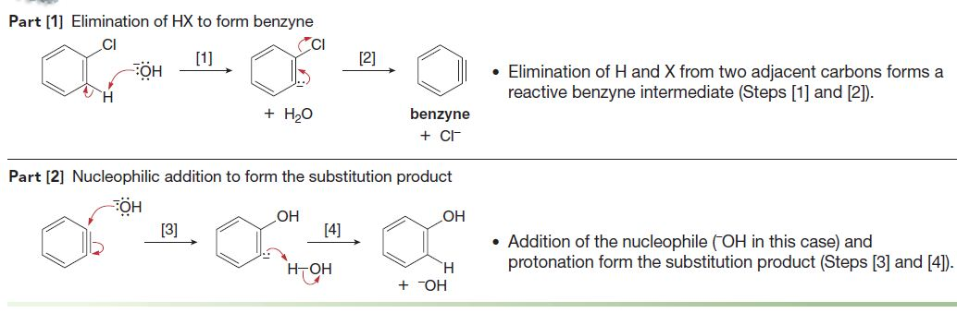
B. Nucleophilic Aromatic Substitution by Elimination–Addition: Benzyne
Aryl halides that do not contain an electron-withdrawing group generally do not react with
nucleophiles. Under extreme reaction conditions or with strong bases, however, nucleophilic
aromatic substitution can occur with aryl halides.
For example:
Mechanism:

Slide 17
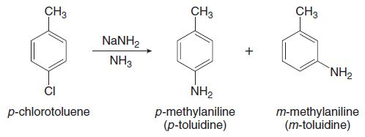
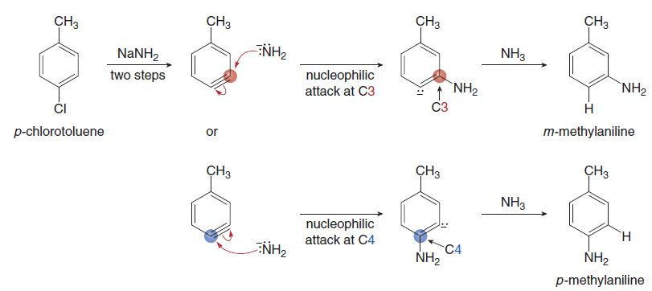
Evidences for proposed Benzyne Mechanism:
Formation of mixtures of Products from substituted aryl halides can only be
explained by intermediacy of benzyne intermediate.
Mechanism:

Slide 18
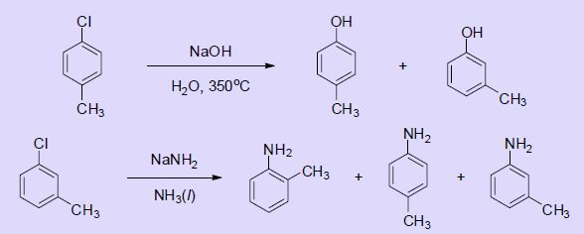
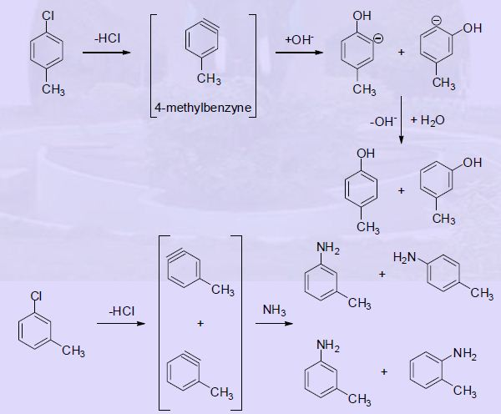
Mechanism:

Slide 19

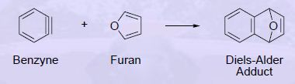
2. Unlike addition-elimination, the order of halogen reactivity in these reactions is
I > Br > Cl > F.
3. Another evidence for this mechanism is reaction of 2,6-dimethylchlorobenzene
with sodium amide in liquid ammonia. No substitution is observed in this reaction
– obviously because there are no hydrogen atoms beta to the chlorine for the
initial elimination step.
4. Further support was obtained by trapping the benzyne intermediate in a
Diels-Alder reaction.

Slide 20
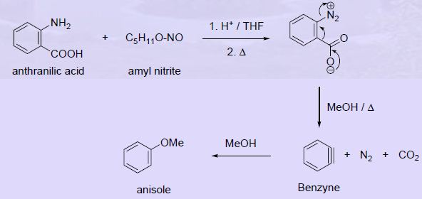
One can generate benzynes without having to resort to strong bases.

Slide 21
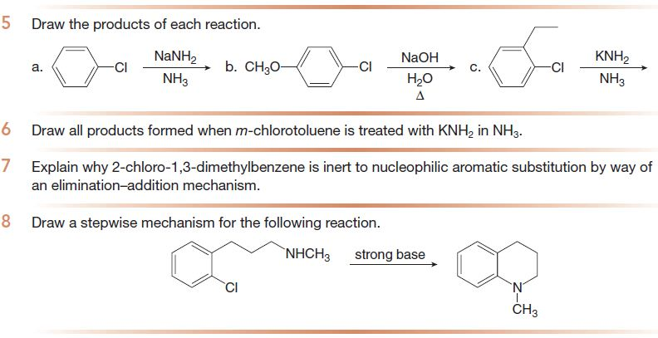
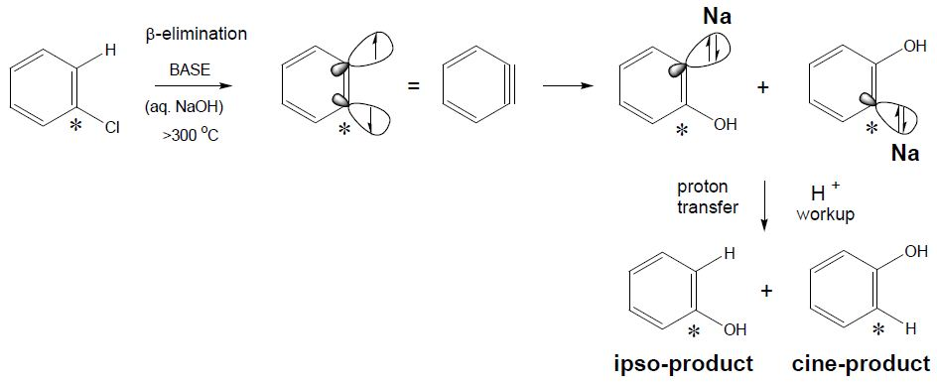
Examples

Slide 22
Predict the product of following reactions.

Slide 23
C. Nucleophilic Aromatic Substitution by SN1 mechanism:
Aryl diazonium salts on treatment with nucleophiles undergo nucleophilic substitution
by SN1 mechanism.
For example:
Mechanism:

Slide 24

Evidences for this mechanism:
The rate of decomposition of diazonium follows first order kinetics.
On addition of hailde salt in high concentration, the product formed is aryl halide,
however, rate of reaction is independence of concentration of added halide salt.
The isomerisation of isotopically lebelled p-tolune diazonium N15 fluoroborate
was obeserved during reaction
For example:

Slide 25
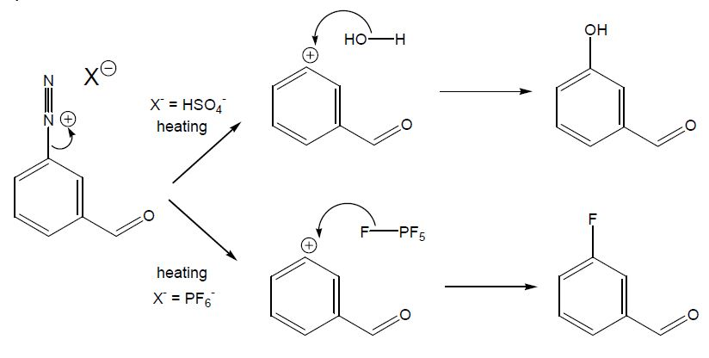
Examples:

